Slide 1
NESIR case presentation
Rush Chewning, MD
Pediatric Interventional Radiology Fellow
Boston Children’s Hospital
01/09/2017

Slide 2
History
4-year-old female with history of:
Trisomy 21
Developmental delay
VSD
Conductive hearing loss
Marked hypotonia
Multiple ophalmologic issues

Slide 3
Presentation
Abdominal distention
Elevated LFTs
Pancytopenia
Ultrasound ordered

Slide 4
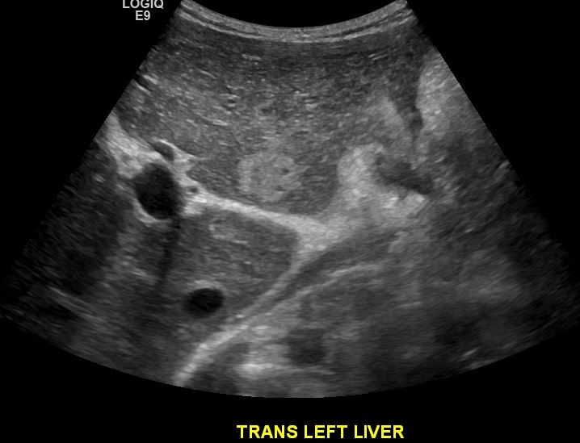
Presentation
Ultrasound:
Liver mass
Portal vein poorly seen (question thrombosis)
Ascites
Hepatosplenomegaly

Slide 5
Workup
Next step?
Diagnostic paracentesis
Liver mass biopsy
CT
MRI

Slide 6
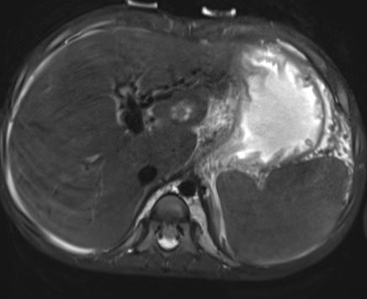
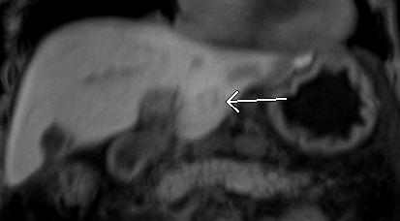
Workup
MRI:
Liver mass
Takes up and retains Eovist
FNH favored over adenoma
Diffuse lymphadenopathy (not shown)

Slide 7
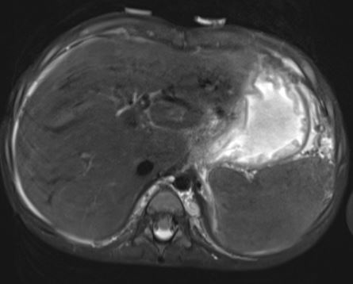
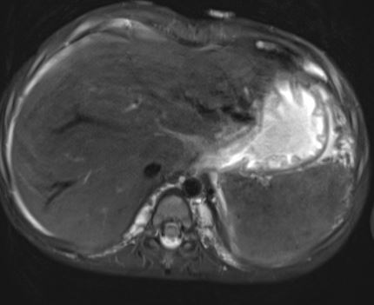
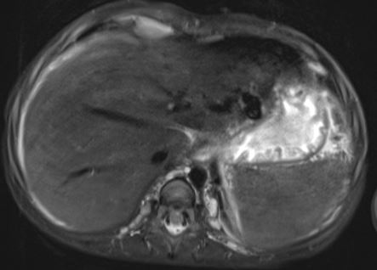
Workup
MRI:
Tortuous vessels, particularly left lobe
Cavernous transformation portal vein?
Formation of perigastric varices?

Slide 8
Workup summary so far
Liver mass
Diffuse lymphadenopathy
Possible cavernous transformation portal vein
Stigmata of portal hypertension
Hepatosplenomegaly
Ascites
Esophageal varices (found on EGD)

Slide 9
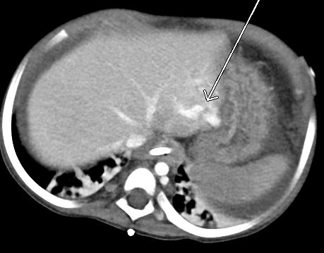
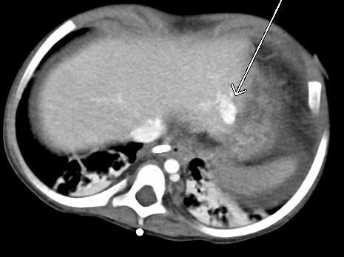
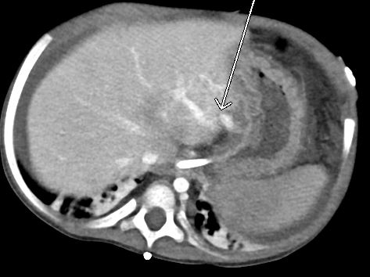
Workup
CT:
Left portal vein larger than main portal vein
Diminutive right portal vein
Prominent variceal vessels left lobe
Appeared to be contiguous with left portal vein

Slide 10
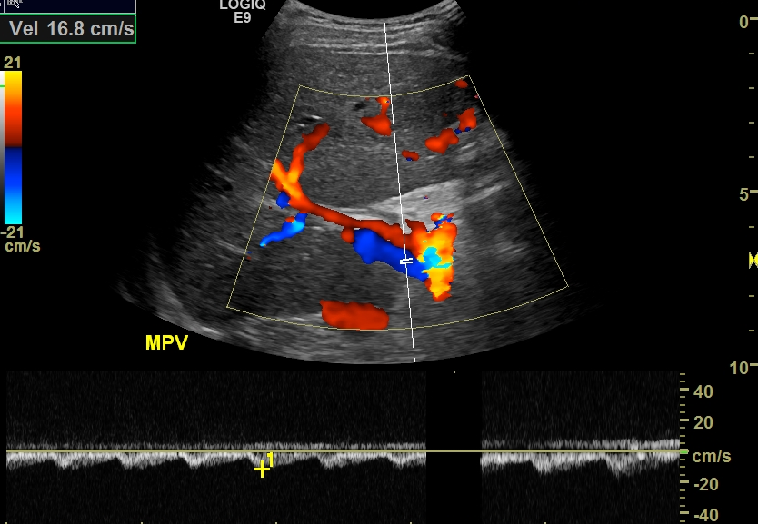
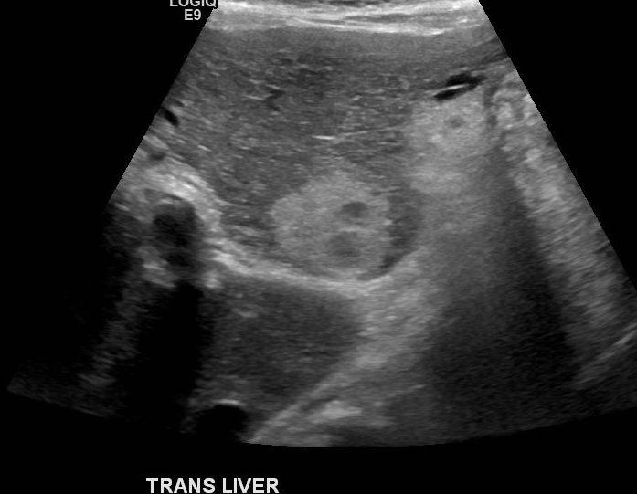
Workup
Ultrasound:
Reversal of flow in main portal vein
Flow is pulsatile
Mass is larger
Ascites has increased

Slide 11
Workup
Diagnosis?
Venous malformation
Venovenous shunt
Arterioportal fistula
Hypervascularity associated with malignancy

Slide 12
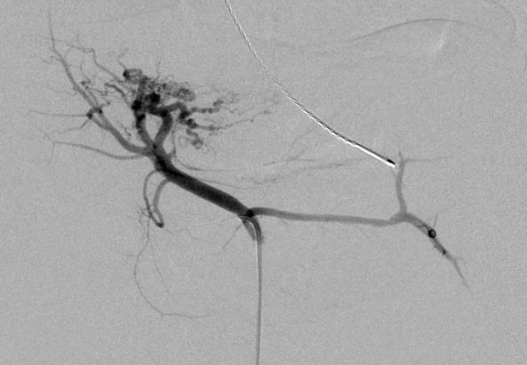
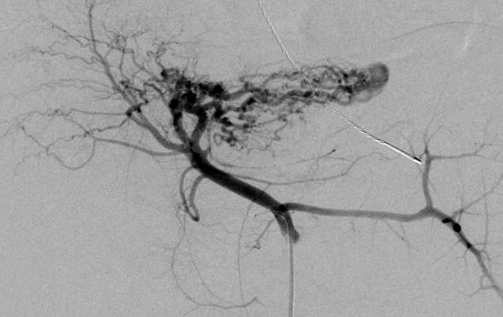
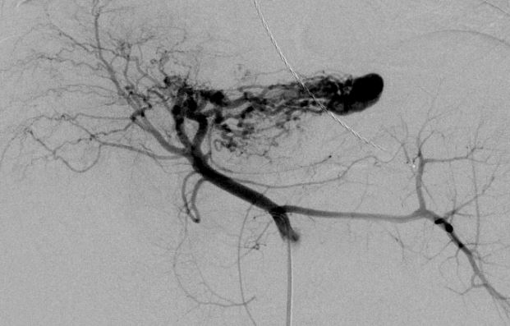
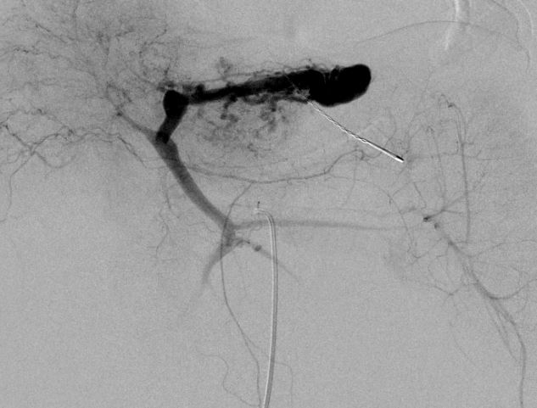
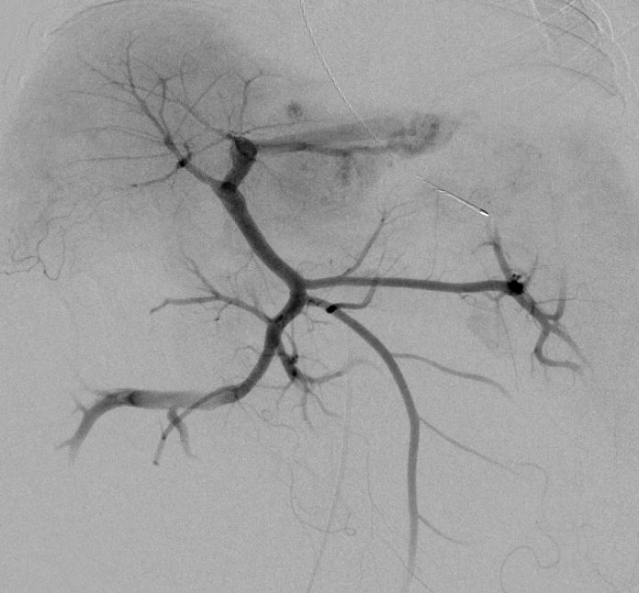
Workup
Angiogram

Slide 13
Diagnosis
Intrahepatic arterioportal fistula (IAPF) causing portal hypertension
Treatment choice?
Surgical excision (left lobectomy)
Arterial embolization – coils
Arterial embolization – particles
Arterial embolization – glue
Venous embolization – coils

Slide 14
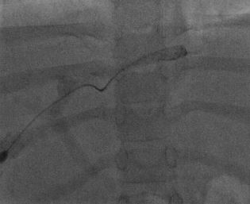
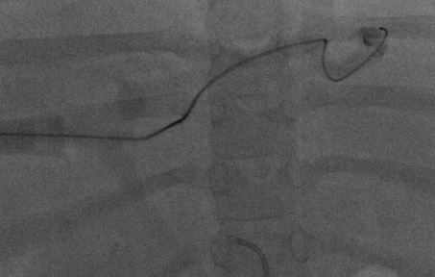
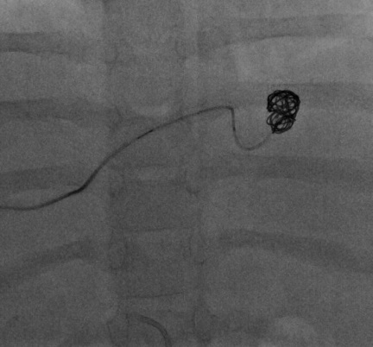
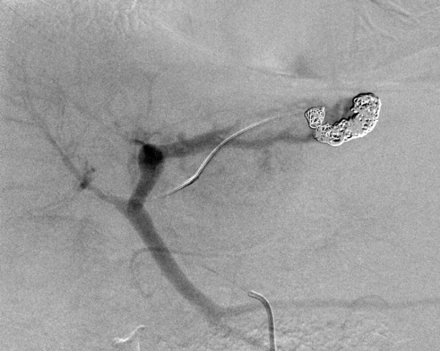
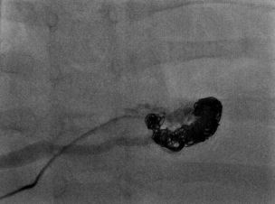
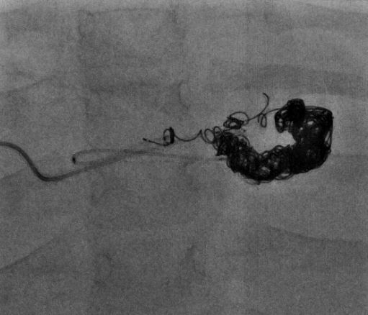
Treatment
Venous embolization

Slide 15
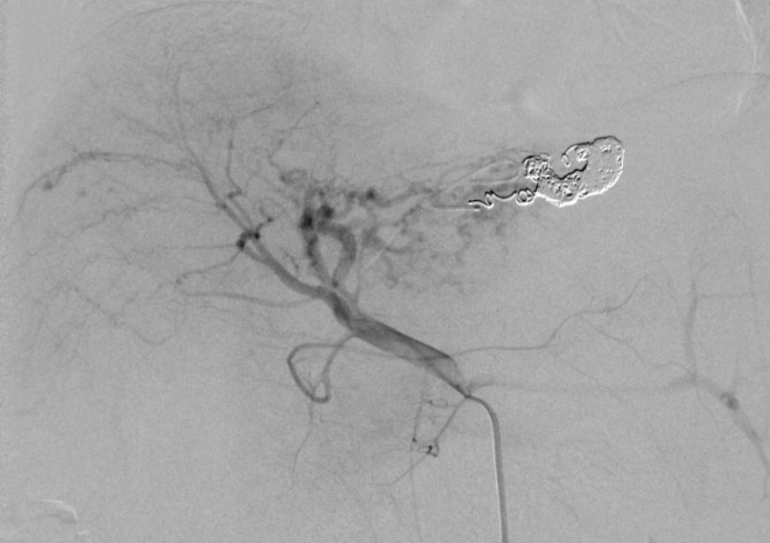
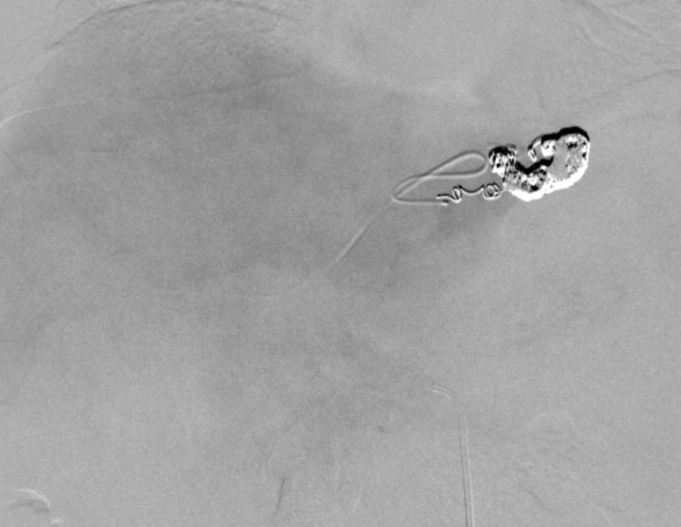
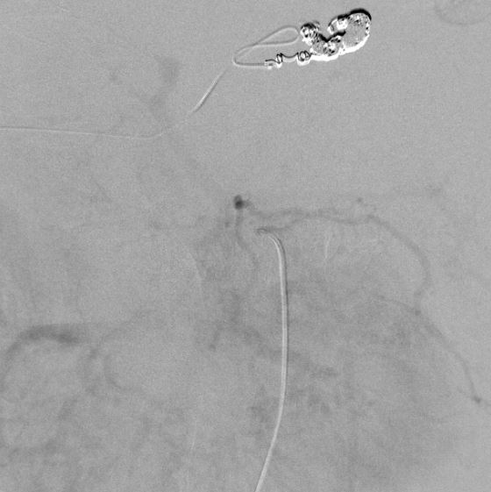
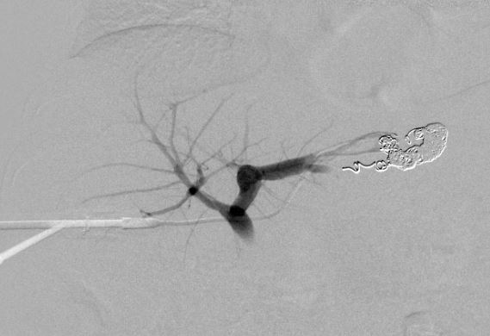
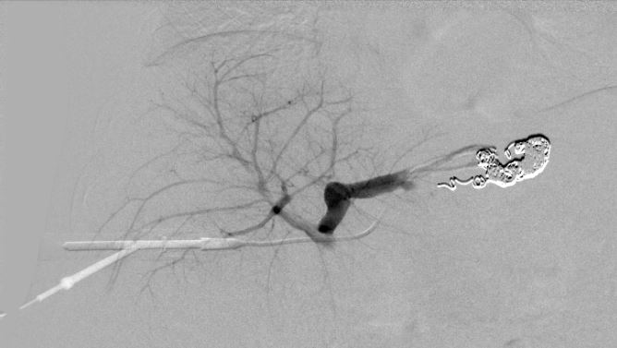
Treatment
Post embolization

Slide 16
Early outcome
Doppler US immediately post embolization
Restoration of hepatopetal flow in main, right, and left portal veins
Slow velocities in portal system
Doppler US day 4 post embolization
Continued hepatopetal flow
Increased velocities compared to day 0
Ascites resolved; peritoneal drain removed
Patient discharged home day 5 post embo

Slide 17
Portal Hypertension
Portal hypertension:
Cirrhosis (in West) > 90%
Non-cirrhotic causes:
Schistosomiasis
Portal vein thrombosis
Primary myelofibrosis
IAPF (rare)

Slide 18
Intrahepatic arterioportal fistula
IAPF is typically iatrogenic:
Surgery
Biopsy
Transhepatic intervention
Other causes:
Trauma
Rupture of hepatic artery aneurysm

Slide 19
Congenital IAPF
Congenital IAPF as cause of PHTN is exceedingly rare
As of 2015, only 39 cases reported in literature
Patient presentation:
Upper GI bleeding
Hepatosplenomegaly
Ascites
Failure to thrive
Protein losing enteropathy
Chronic diarrhea / steatorrhea
Zhang et al. World Journal of Gastroenterology 2015 Feb 21; 21(7): 2229-2235
Norton et al. Journal of Pediatric Gastroenterology and Nutrition 2006 Aug 43(2): 248-255

