Slide 1
Improvement of Chylothorax after Central Venous Thrombolysis
Sudhen B. Desai, MD
Fellow, Pediatric Interventional Radiology
Boston Children’s Hospital

Slide 2
Presentation
2M DCM secondary to late repair of VSD
Afternoon 6/26/16 - fussy and uncomfortable
6/27/16 AM, awoke and had a bottle, subsequently vomited and became unresponsive
Father gave rescue breaths with return of consciousness
Taken to local hospital and then transferred to BCH in cardiogenic shock.
Arrested, onto ECMO 6/27/16

Slide 3
Initial IR Involvement
8/26/16 - IR first involved with exchange of pigtail thoracostomy tube
8/26-9/11/16 – Outputs fluctuate between 100-400 mL (few episodes of > 700 mL outputs)
Serosanguinous
8/3/16 1010 – Bloody, WBC - 10,142, RBC - 27,436, Lymphocyte – 74, Trigyceride -130
9/28/16, 1113a – Pleural Fluid Evaluation: WBC - 518 L, RBC - 1,274, Lymphocyte - 79, Triglyceride - 61
Remained on ECMO, VAD support to bridge

Slide 4
Clinical Course
Orthotopic Heart Transplant 09/11/16
Bilateral surgical chest tube outputs change to chylous
Prolonged interdisciplinary discussions re: Course of action
Lymphangiogram planned to evaluate TD

Slide 5
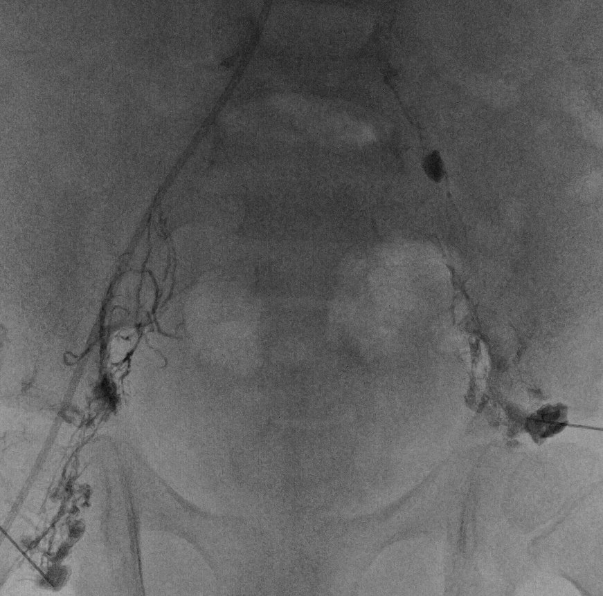
Venogram/Lymphangiogram
10/5/16 – LUE and central venography (hand IV), intranodal lymphangiography, attempted cannulation of abdominal portion of the thoracic duct
L SCV occluded with collaterals to the right BCV. Patent SVC.
Patent left IJ and BCV (by US).

Slide 6
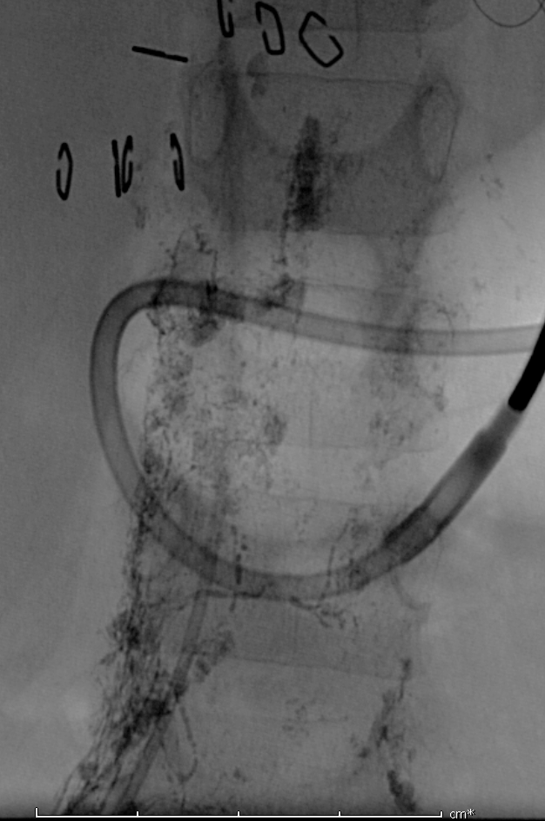
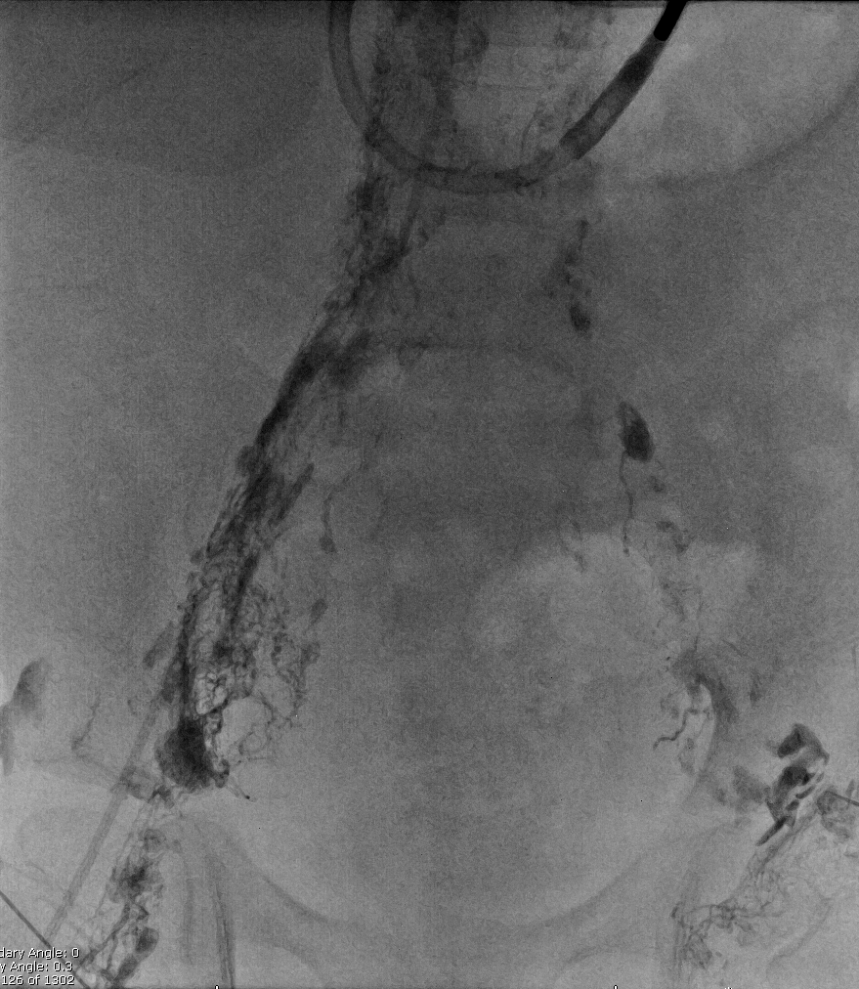
Opacification of bilateral iliac lymphatic channels. Morphologically normal TD in upper abdomen and chest.

Slide 7
Opacification of the cervical portion of TD. No passage of contrast into the central veins. Reflux/leak into lymphatics in the left chest (peribronchial) and left jugular and subclavian region.

Slide 8
Ultrasound 10/7/16 identified echogenic filling material junction LSCV/BCV without internal flow suggestive of clot

Slide 9
Normal Lymphatic Anatomy

Slide 10
Venogram/Lymphangiogram
Query lymphatic obstruction/hypertension
Notes:
Attempted cannulation of TD in the abdomen/cisterna chyli with a 22 G chiba needle with passage of a 0.018 in wire into the mid chest, but passage of 2.3 F catheter over the wire and contrast injection indicated contrast in retroperitoneal /posterior mediastinal tissues

Slide 11
Initiation of Thrombolysis
10/10/16 - Left upper extremity and central venography, wire recanalization of central occlusion, initiation of catheter-directed thrombolysis

Slide 12
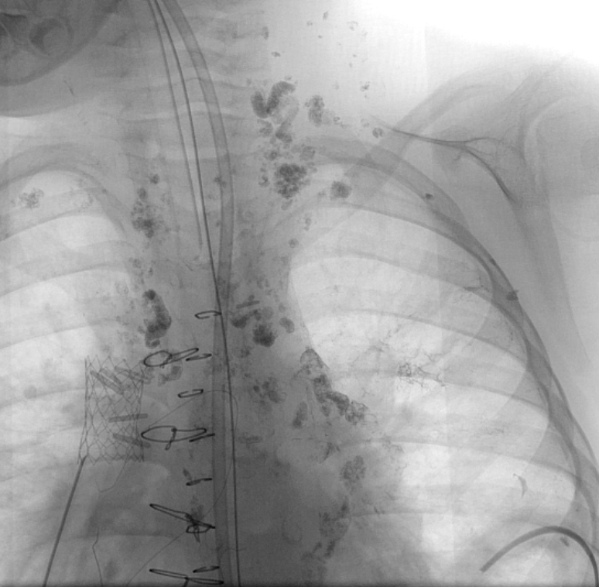
Catheter-Directed Thrombolysis
Cardiologists placed SVC stent, failed cross into SCV from below
10/6/16 – SVC gradient of 6 mm Hg
10/25/16 – No SVC gradient on follow-up catheterization

Slide 13
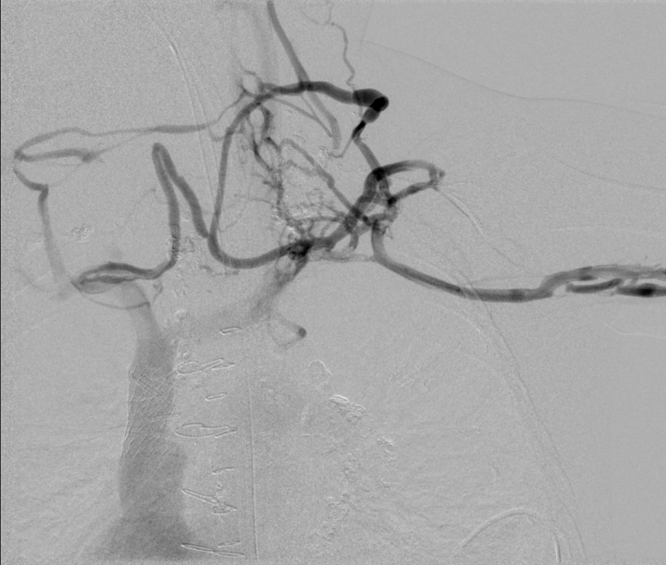
Catheter-Directed Thrombolysis
LUE Venography from brachial vein injection
Diminutive subclavian and LBCV fill

Slide 14
Catheter-Directed Thrombolysis

Slide 15
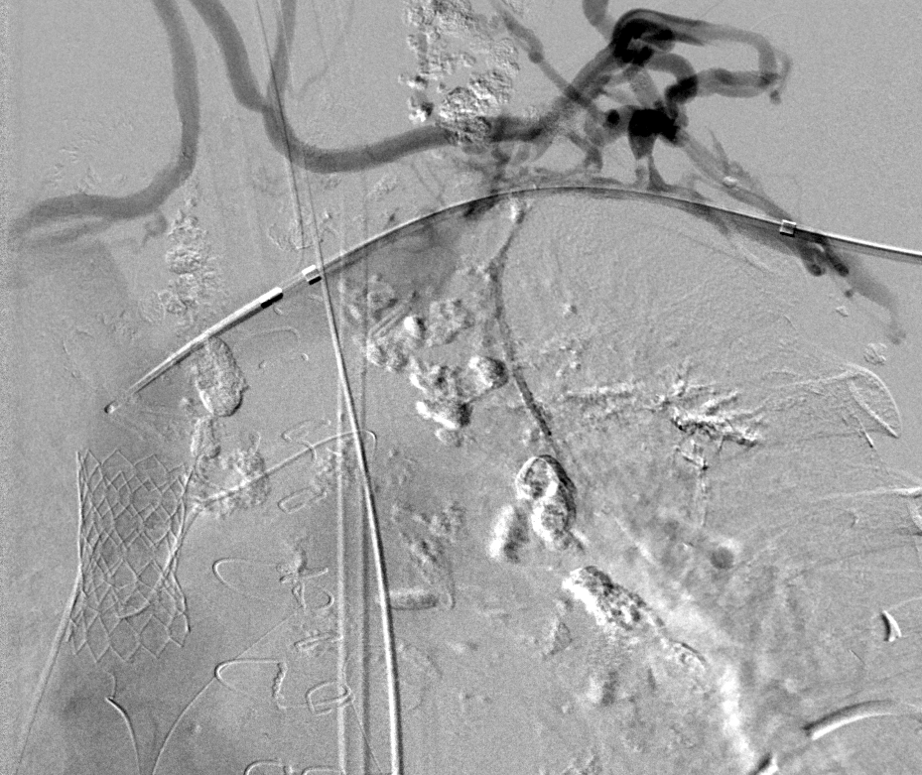
Catheter-Directed Thrombolysis

Slide 16
CDT Day #2
10/11/2016 - Left upper extremity/central venography
UniFuse catheter injected with tip occluder in place.
Continued pharmacologic (weight-based tPA) thrombolysis
Notes:
Filling of collaterals from the lateral aspect of the subclavian vein lateral to the area of stenosis and good runoff within the brachiocephalic vein centrally. However, the filling defect previously noted at the level of the IJ and subclavian venous confluences suggestive of clot persists.

Slide 17
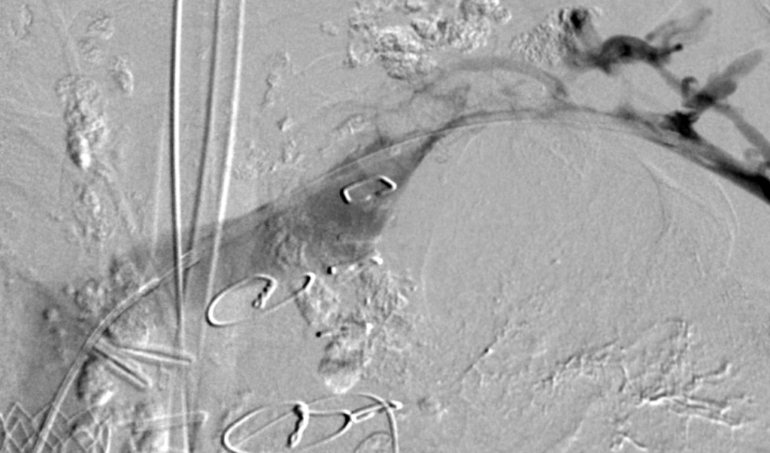
Catheter-Directed Thrombolysis

Slide 18
CDT Day #3
10/12/16 - Left upper extremity/central
Interval resolution of subacute thrombus at the junction of the left IJ and chronically stenosed medial left subclavian vein.
No angioplasty performed (avoid introducing clot into orifice)

Slide 19
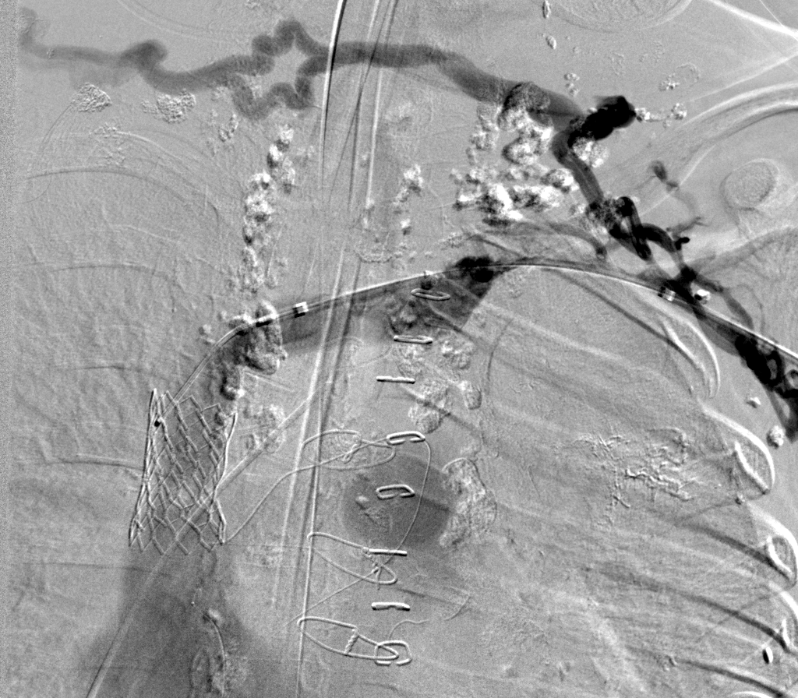
Catheter-Directed Thrombolysis

Slide 20
Pre-/Post- Outputs
Date | Right Chest Tube (mL) | Left Chest Tube (mL) | Total Output(mL)
10/5 - Lymphangiogram | 130 | 290 | 420
10/6 – SVC Stent Placed | 255 | 625 | 880
10/7 | 370 | 530 | 900
10/8 | 500 | 350 | 850
10/9 | 364 | 370 | 734
10/10 – Day#1 CDT | 220 | 180 | 400
10/11 | 90 | 260 | 350
10/12 | 20 | 200 | 220
10/13 | D/C’D | 70 | 70
10/14 |  | 40 – D/C’D | 40

Slide 21
Recent Clinical Course
Protracted CICU course but eventually discharged to floor
No reaccumulation of pleural fluid/chylothorax
Tolerating enteral feed advancement
Being treated with therapeutic lovenox
JVIR 2004; 15:511-515 (Case report)

Slide 22
Why we need to preserve an allograft

Slide 23
Alabi, Oluwasegun 4841406

