Slide 1
Case Presentation New England Society of Interventional Radiology September 12, 2016
Lauren E. Ferrara, M.D. and Michael S. Stecker, M.D.
Interventional Radiology Fellow
Brigham and Women’s Hospital

Slide 2
Disclosures
None

Slide 3
History
79 year old man with metastatic pancreatic cancer came to Dana Farber Cancer Institute to have a follow-up staging CT on 8/22/16.
At home he had been having fevers, rigors, epigastric pain and hematochezia.
Sent to clinic for rigors, abdominal pain, fever to 100.7, found to have a transaminitis → presumed cholangitis
On admission he had witnessed episodes of hematochezia and hypotensive to 90s systolic.
Overnight resuscitated with 1L NS bolus, 2 units PRBCs, 2 platelets, started on Zosyn

Slide 4
Past Medical History
Atrial fibrillation
CAD
Bradycardia, PPM 2012
Chronic Kidney Disease
Hyperlipidemia
Hypertension
GERD
Metastatic pancreatic cancer

Slide 5
Metastatic Pancreatic Cancer
Diagnosed in June 2014
Gemcitabine and paclitaxel
last dosed 8/12/16, 11 days prior
Complicated by biliary obstructions
Stenting 12/2015 covered metal stent by GI

Slide 10
ERCP December 2015
4-5 cm proximal to the ampulla the common bile duct contained a single severe localized stenosis 10 mm in length.
The main bile duct upstream from this stenosis was diffusely dilated. The largest diameter was 10 mm.
A 5 mm biliary sphincterotomy was made with a traction (standard) sphincterotome.
There was no post-sphincterotomy bleeding.
One Viabil 10 mm x 8 cm covered metal stent was placed into the common bile duct.
Bile flowed through the stent. The stent was in good position.

Slide 12
ERCP December 2015
4-5 cm proximal to the ampulla the common bile duct contained a single severe localized stenosis 10 mm in length.
The main bile duct upstream from this stenosis was diffusely dilated. The largest diameter was 10 mm.
A 5 mm biliary sphincterotomy was made with a traction (standard) sphincterotome.
There was no post-sphincterotomy bleeding.
One Viabil 10 mm x 8 cm covered metal stent was placed into the common bile duct.
Bile flowed through the stent. The stent was in good position.

Slide 13
Admission: August 2016
Ascending cholangitis suspected with plan for ERCP
Multiple episodes of BRBPR
Systolic blood pressure remained low in the 90s mmHg systolic
Tachycardic

Slide 14
Suspected Cholangitis → ERCP
Gastric mucosa and duodenum coated with fresh blood and clots.
Visibly occluded stent with blood clots and other debris from the biliary tree at the major papilla.
Balloon sweeps yielding blood clots with active and ongoing hemobilia.
Plastic biliary stent placed within the metal stent.
IR team contacted and case discussed.

Slide 17
Suspected Cholangitis → ERCP
Gastric mucosa and duodenum coated with fresh blood and clots.
Visibly occluded stent with blood clots and other debris from the biliary tree at the major papilla.
Balloon sweeps yielding blood clots with active and ongoing hemobilia.
Plastic biliary stent placed within the metal stent.
IR team contacted and case discussed.
What would you recommend?

Slide 18
IR Recommendations
Recommendation CT of the abdomen and pelvis with contrast to determine venous vs. arterial flow.
Transfer patient to IR following CT for embolization.

Slide 19
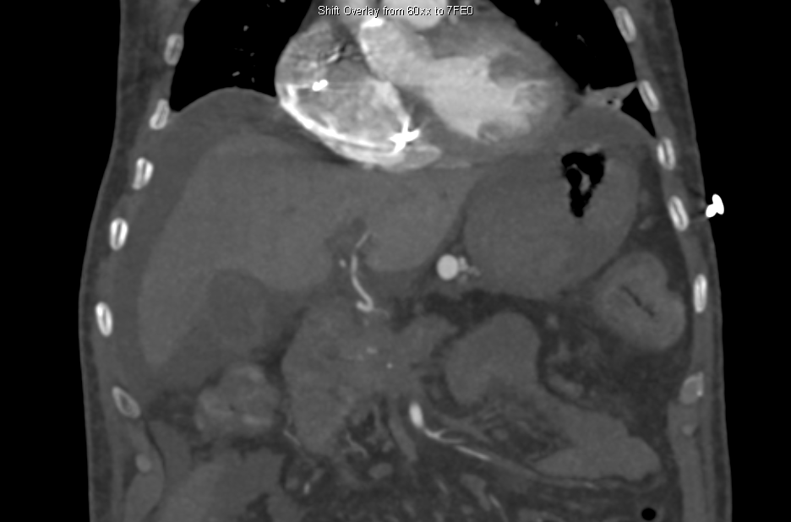

Slide 20
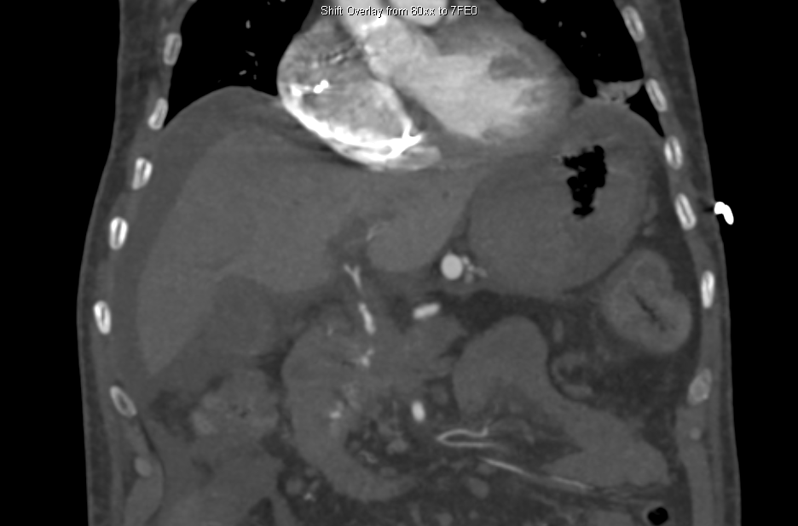

Slide 21
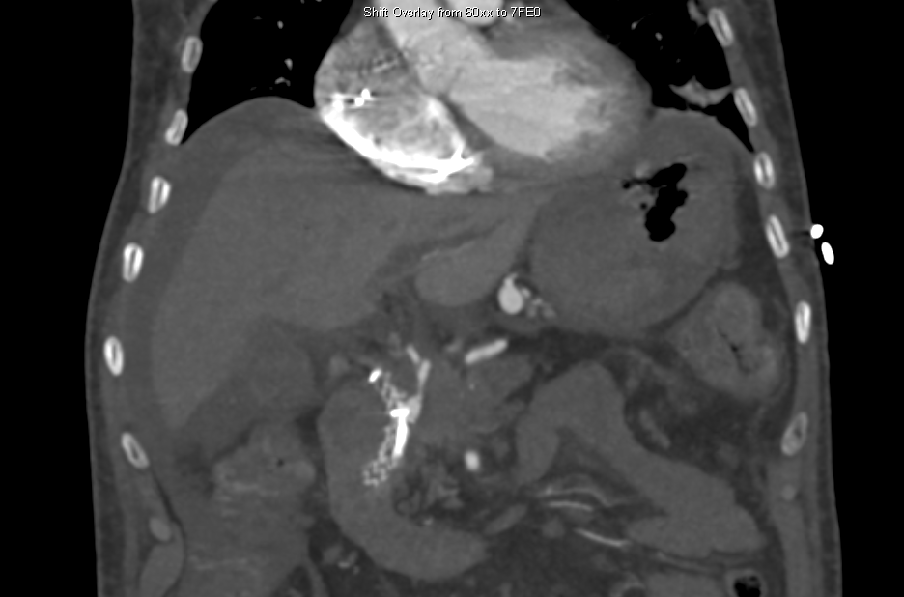

Slide 22
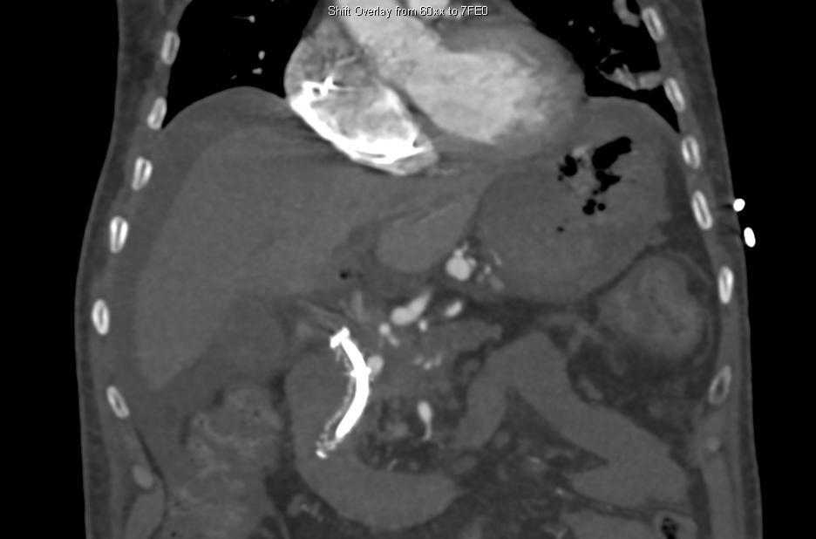

Slide 23
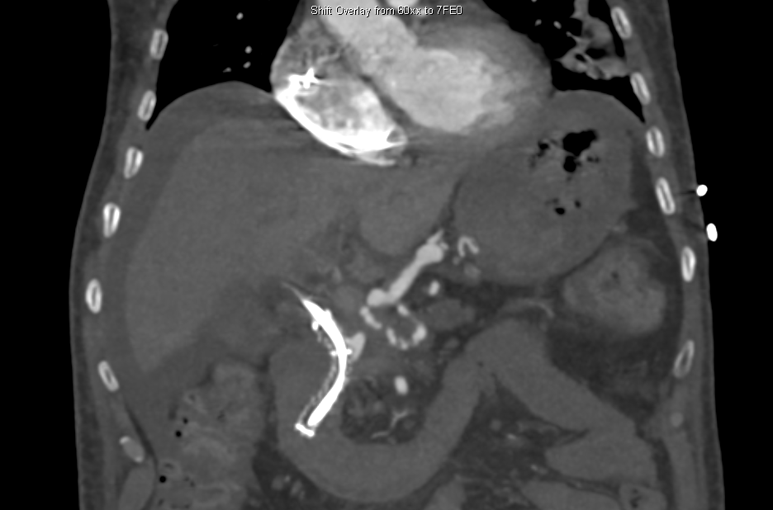

Slide 24
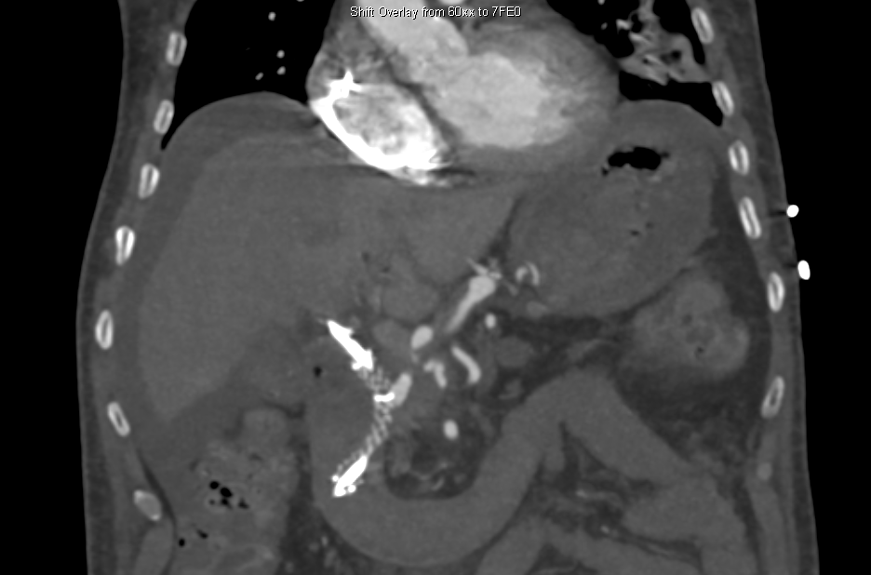

Slide 25
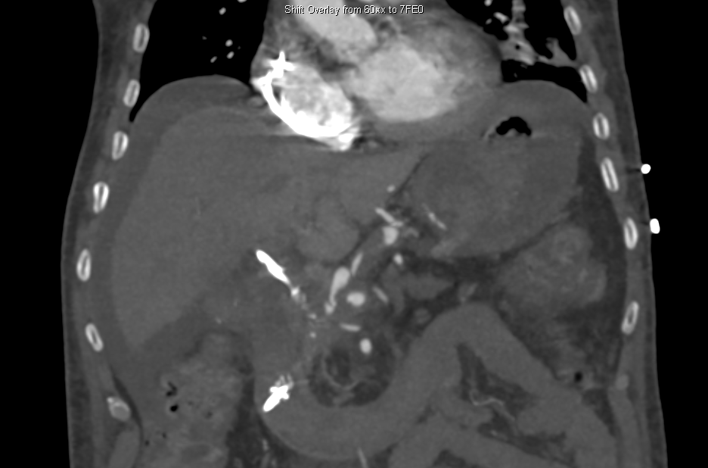

Slide 26
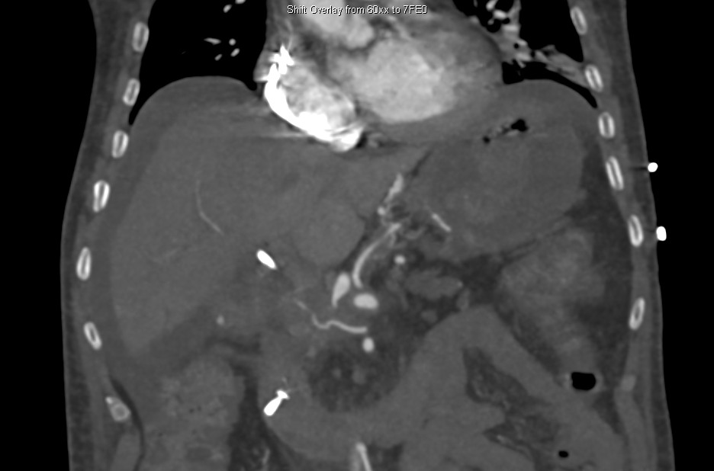

Slide 27
CT Abdomen and Pelvis
Early arterial filling of the left gastric vein indicating arteriovenous communication with early arterial filling structure immediately abutting the biliary stent raising concern for a pseudoanuerym of the adjacent gastroduodenal artery.

Slide 28
CT Abdomen and Pelvis
Early arterial filling of the left gastric vein indicating arteriovenous communication with early arterial filling structure immediately abutting the biliary stent raising concern for a pseudoaneurysm of the adjacent gastroduodenal artery.
What would you do?

Slide 29
Angiography and Embolization

Slide 30
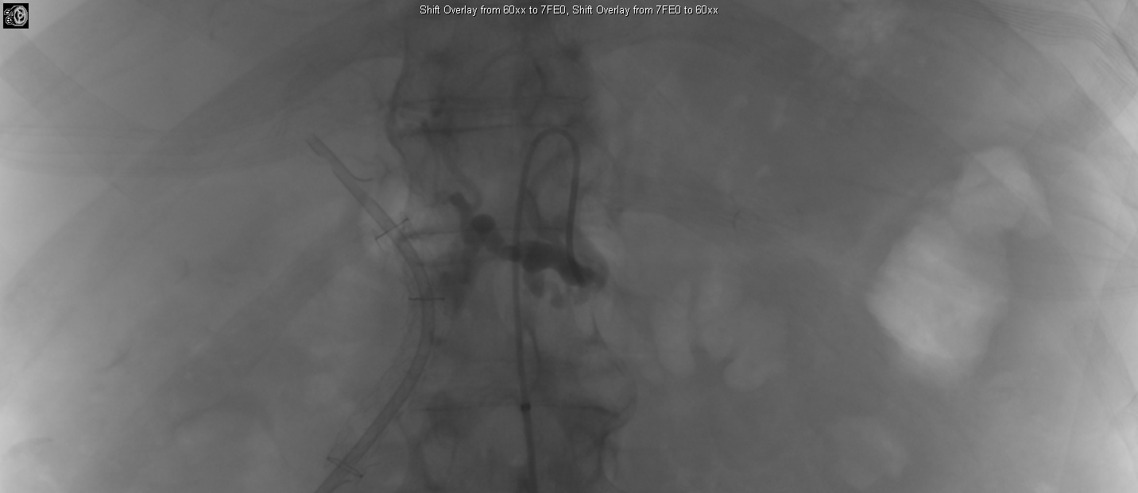

Slide 31
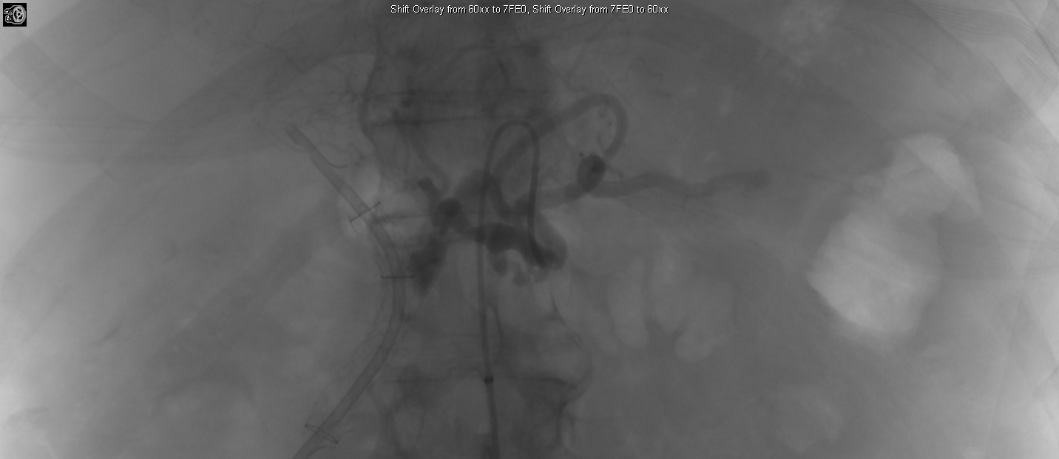

Slide 32
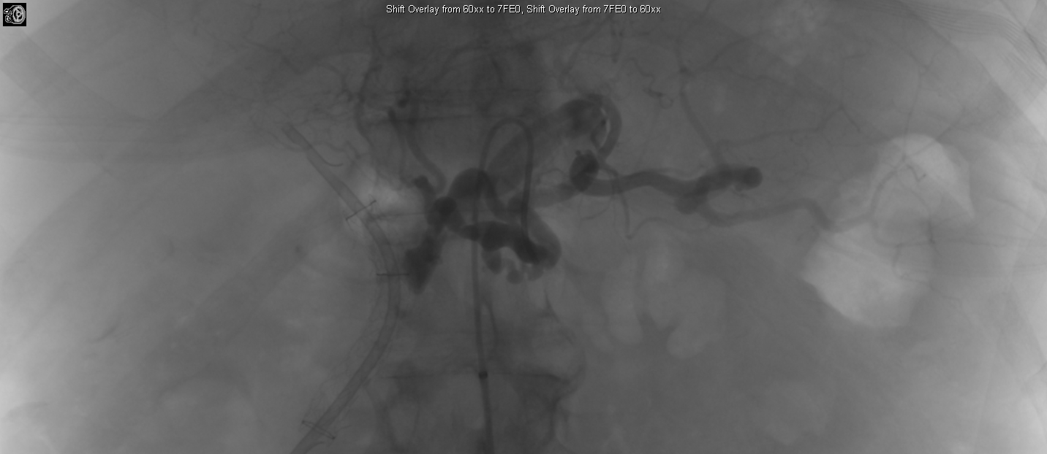

Slide 33
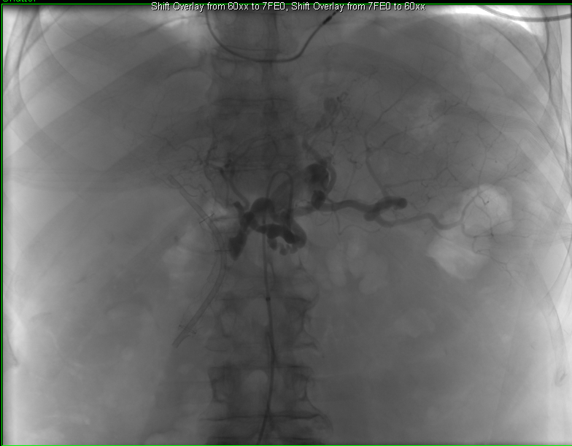

Slide 34
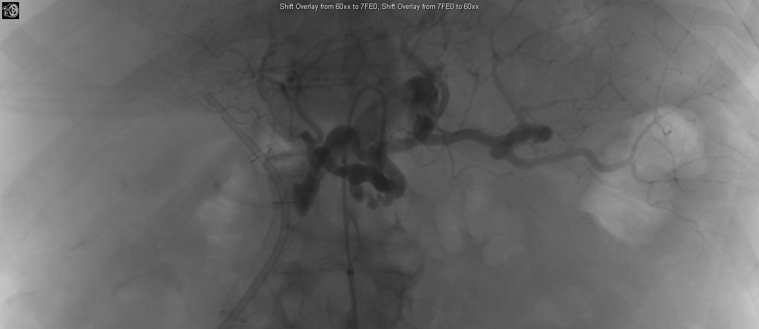

Slide 35
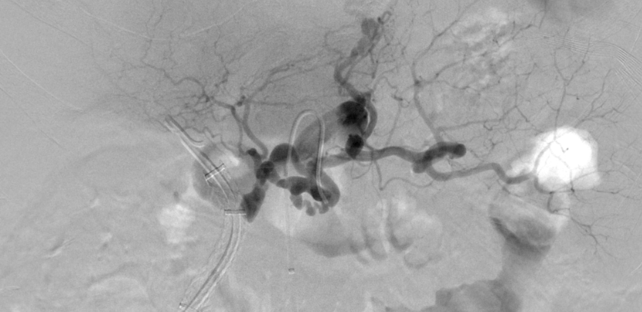

Slide 36
Angiography and Embolization
A prominent vein passing along the lesser curvature of the stomach and reaching up to the biliary stent, likely to be the left gastric vein.
This vein shows partial contrast opacification on the arterial phase images due to an abnormal arteriovenous communication with the gastroduodenal artery.
Immediately adjacent to the biliary stent, there is a rounded area of arterial pooling.
The left hepatic artery appears attenuated.
The portal vein and splenic vein are not clearly visualized, suggestive of chronic thrombosis.
Multiple associated collaterals are seen in the upper abdomen.

Slide 37
Angiography and Embolization
A prominent vein passing along the lesser curvature of the stomach and reaching up to the biliary stent, likely to be the left gastric vein.
This vein shows partial contrast opacification on the arterial phase images due to an abnormal arteriovenous communication with the gastroduodenal artery.
Immediately adjacent to the biliary stent, there is a rounded area of arterial pooling.
The left hepatic artery appears attenuated.
The portal vein and splenic vein are not clearly visualized, suggestive of chronic thrombosis.
Multiple associated collaterals are seen in the upper abdomen.
What would you do?

Slide 38
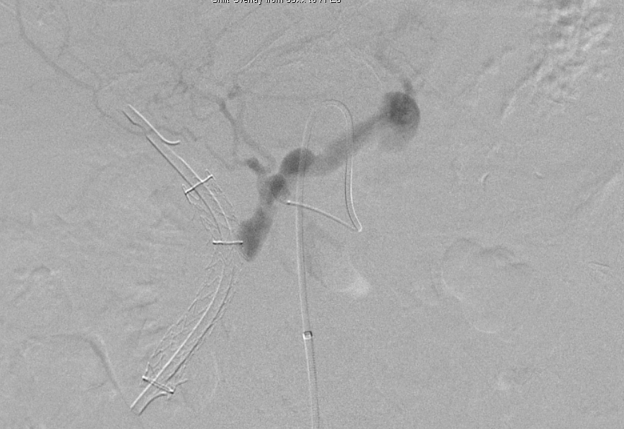

Slide 39
Coil
Through the Simmons catheter a Renegade STC microcatheter preloaded with a Fathom-14 microguidewire was used to navigate into the common hepatic artery to the level of the pseudoaneurysm.
DSA was performed again demonstrating the GDA pseudoaneurysm, AV fistula, and stenotic left hepatic artery.
The catheter was advanced as far as it would go, to the level of the left hepatic artery stenosis, and through the catheter one 6-mm and two 4-mm Nester coils were deployed in the hepatic artery over the origin of the GDA feeding the pseudoaneurysm.

Slide 40
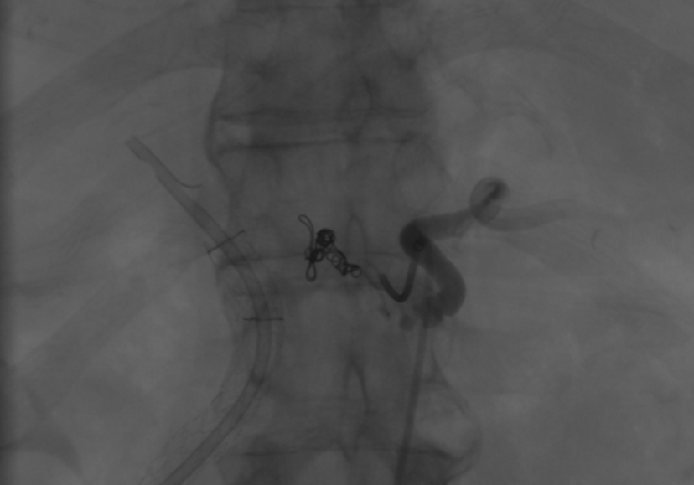

Slide 41
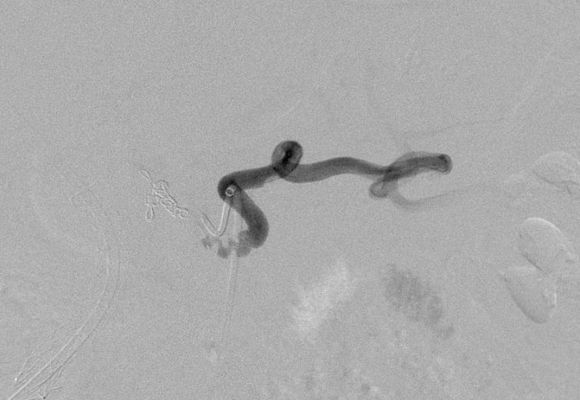

Slide 42
More Coiling
Subsequently the catheter was withdrawn and repositioned into the proximal splenic artery, as far as it would pass due to the irregular stenosis from the invading tumor, as shown on DSA angiography.
Through the catheter two 4 mm Nester coils were deployed in the proximal splenic artery.
Post coiling angiogram in the celiac artery showed no filling of the pseudoaneurysm.
There was preserved flow through the left gastric artery with collaterals filling the left hepatic artery and the splenic artery, but no further filling of the pseudoaneurysm.

Slide 43
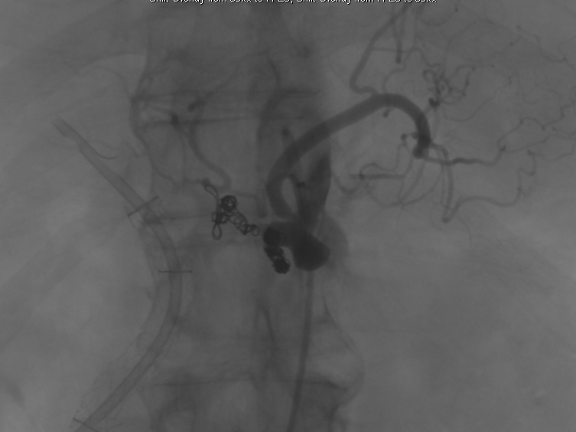

Slide 44
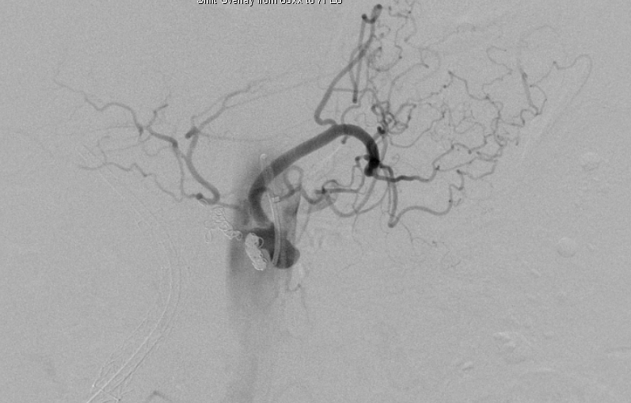

Slide 45
What would you do next?

Slide 46
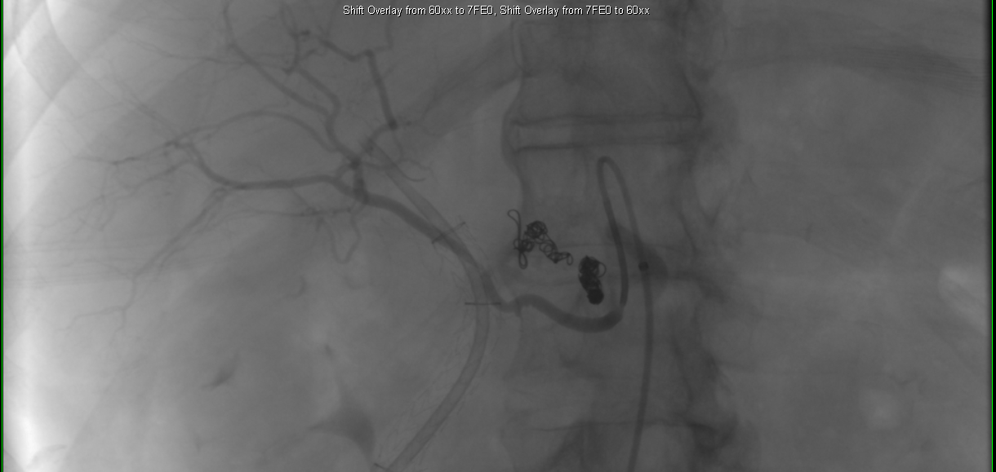

Slide 47
What artery is this?

Slide 48
Right Hepatic Artery
Where does it arise from?

Slide 49
Right Hepatic Artery
Where does it arise from?
What is the incidence of a right hepatic artery arising from the aorta?

Slide 50
Right Hepatic Artery
Where does it arise from?
What is the incidence of a right hepatic artery arising from the aorta?
The incidence of the common hepatic artery arising from the aorta is 2%

Slide 51
Right Hepatic Arteriogram
Next, the microcatheter was removed and the Simmons catheter was positioned into the right hepatic artery which had a separate origin off of the aorta.
Right hepatic angiography demonstrated no filling of the pseudoaneurysm or active extravasation, however, the artery was narrowed adjacent to the common bile duct stent.

Slide 52
Any more angiography?

Slide 53
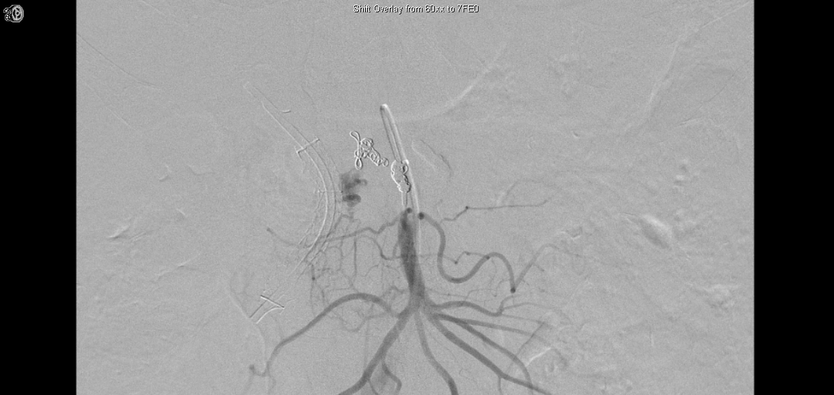

Slide 54
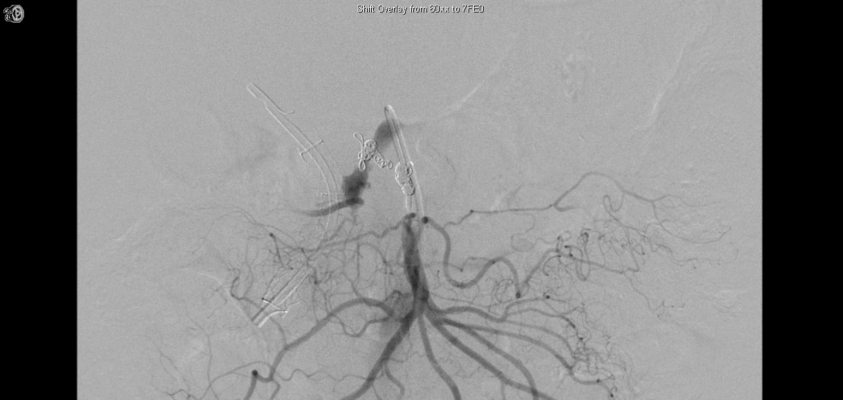

Slide 55
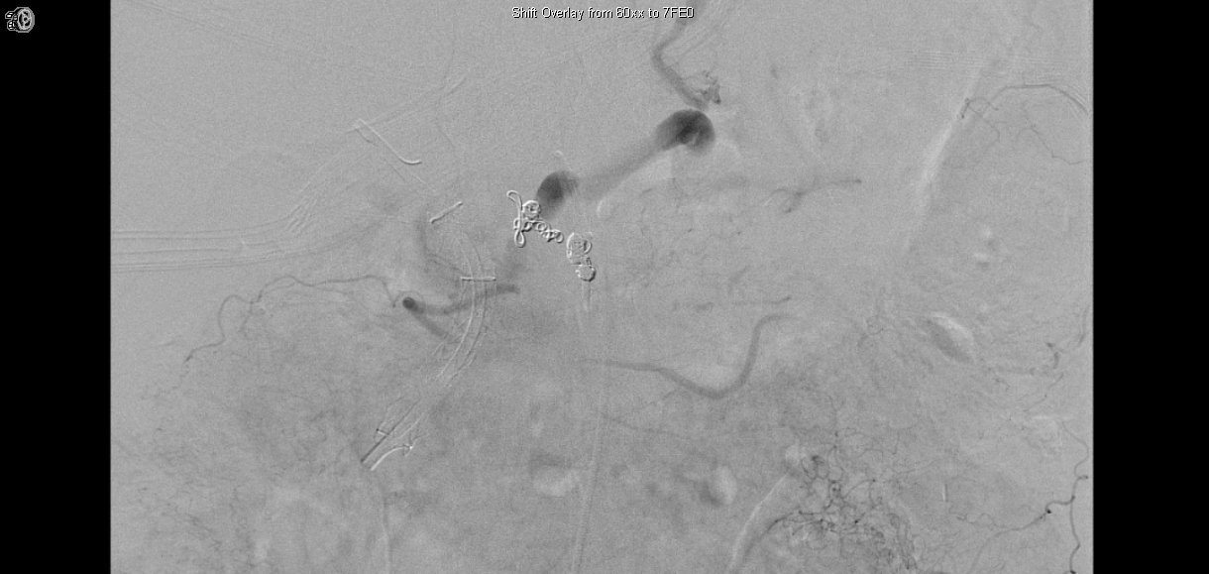

Slide 56
Superior Mesenteric Angiography
The Simmons catheter was used to select the superior mesenteric artery.
Superior mesenteric angiography demonstrated brisk filling of the pseudoaneurysm via inferior pancreaticoduodenal arcade.

Slide 57
Pancreaticoduodenal Arcade Angiography
The Renegade STC microcatheter preloaded with the Fathom-14 microguidewire was used to select the inferior pancreaticoduodenal arcade, however, access to the aneurysm could not be obtained due to vessel size.
What catheter would you try?

Slide 58
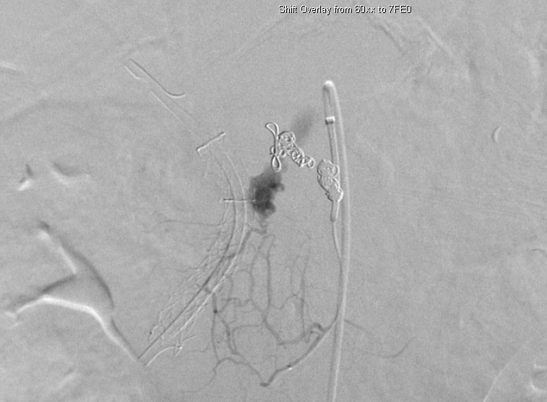

Slide 59
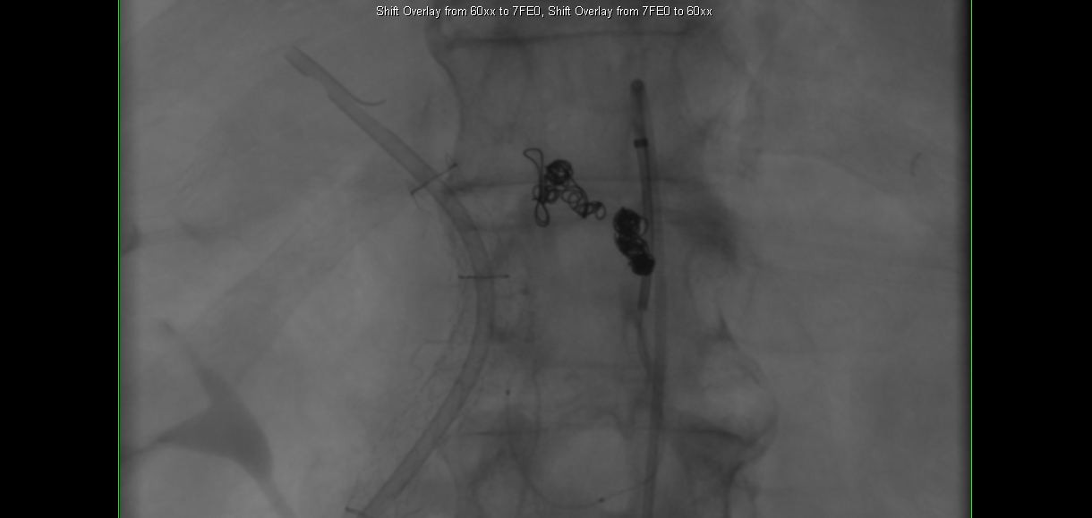

Slide 60
Microcatheter
Exchanged for an Echelon-10 microcatheter over a 0.014-inch Transcend ES wire, which was used to select one of the inferior pancreaticoduodenal arteries supplying the pseudoaneurysm.
Once in the vessel as distal as possible, DSA showed this was probably not the main supply.

Slide 61
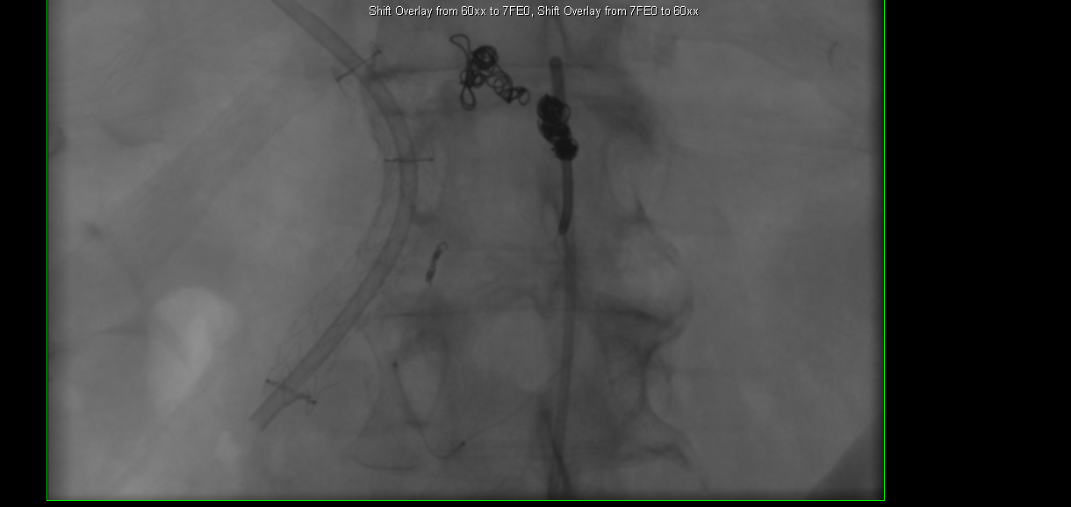

Slide 62
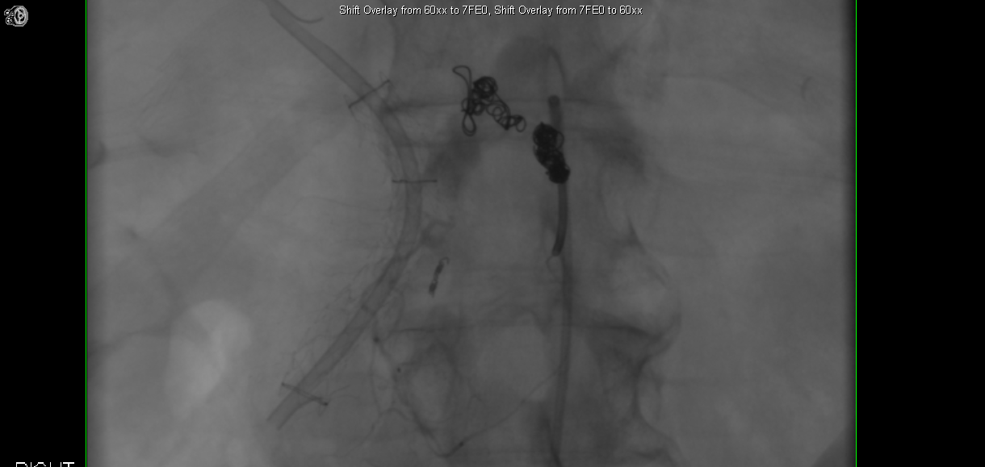

Slide 63
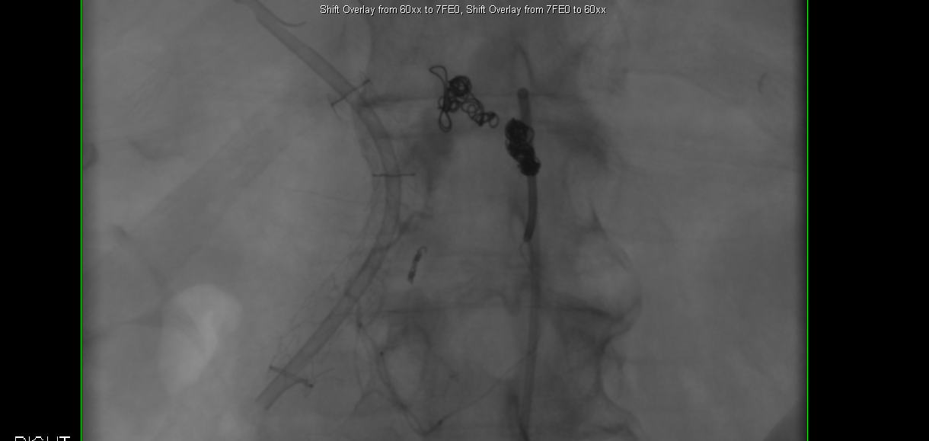

Slide 64
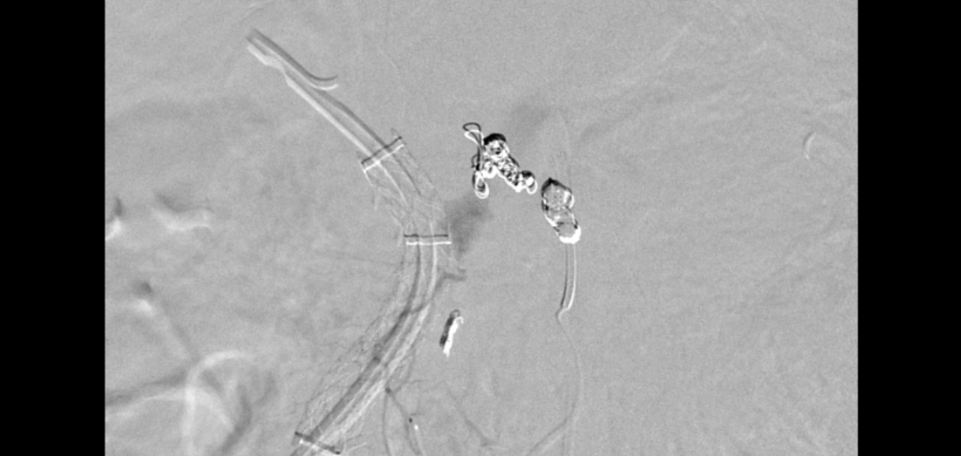

Slide 65
Dilemma
One of the inferior pancreaticoduodenal arteries supplying the pseudoaneurysm was selected.
DSA showed this was probably not the main supply, but to prevent collateralization, a Concerto 2 mm by 4 cm microcoil was placed.

Slide 66
Pancreaticoduodenal Arcade Angiography
Post coiling angiogram demonstrated occlusion of the coiled vessel, however, rapid filling of the pseudoaneurysm through other branches of the inferior pancreaticoduodenal arcade was present.
What would you do next?

Slide 67
Glue
Subsequently, the microcatheter was navigated into the main arterial supply of the pseudoaneurysm.
Due to the marked tortuosity and multiplicity of the vessels supplying the pseudoaneurysm the decision was made to use glue.
1.2 mL of Trufill glue in a 1:2 ratio of glue to Ethiodol, was injected through the Echelon-10 microcatheter which showed filling of the arteries feeding the pseudoaneurysm and the pseudoaneurysm itself.

Slide 68
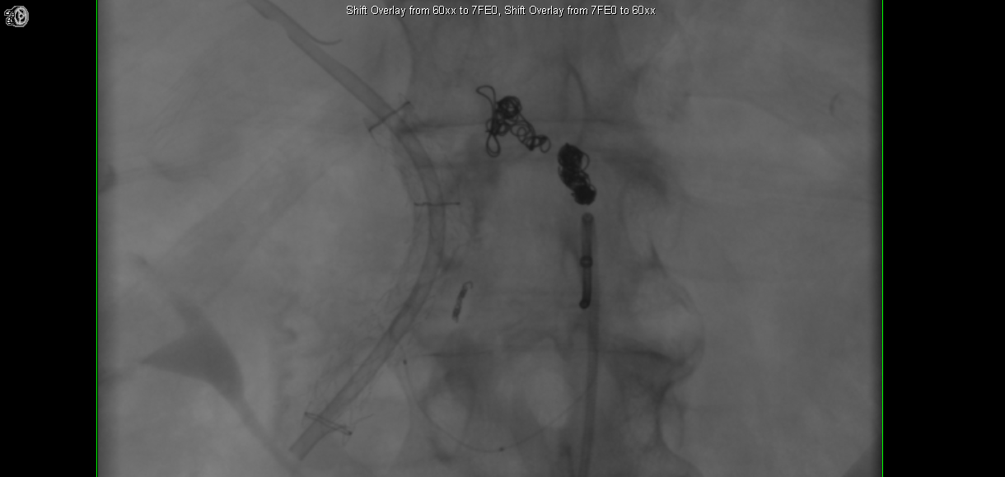

Slide 69
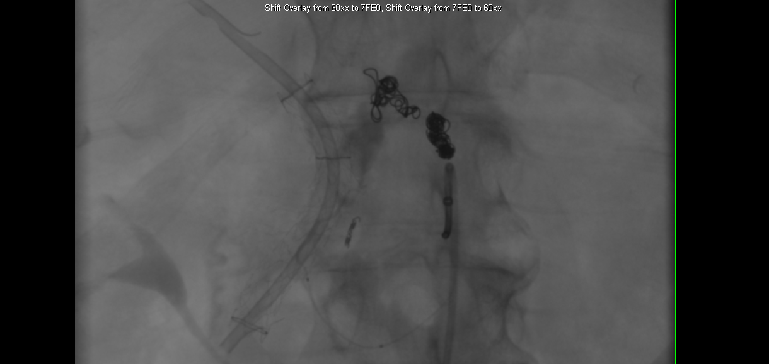

Slide 70
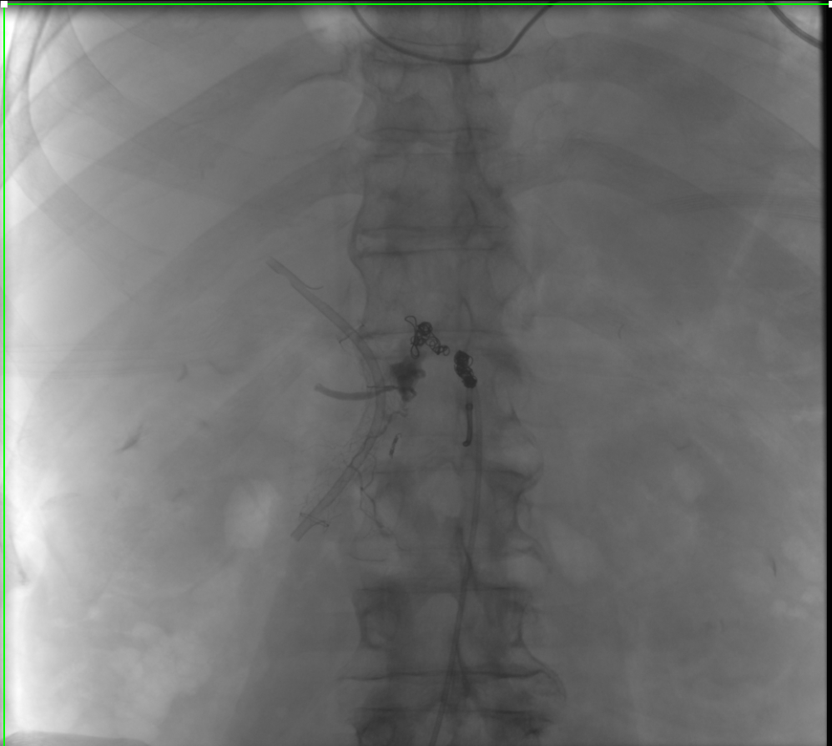

Slide 71
Post Glue Superior Mesenteric Angiogram

Slide 72
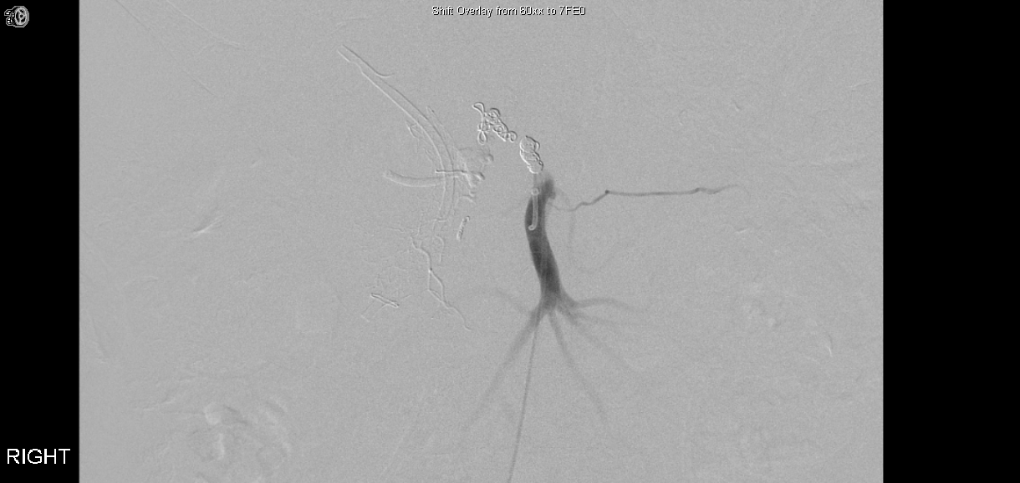

Slide 73
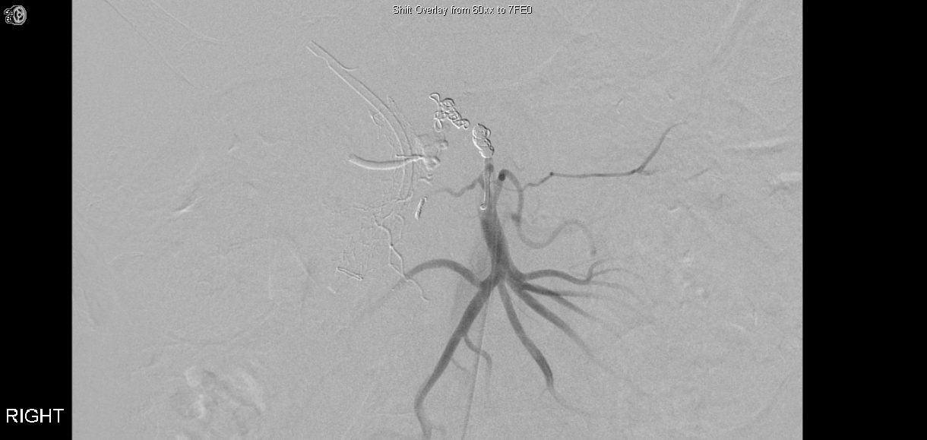

Slide 74
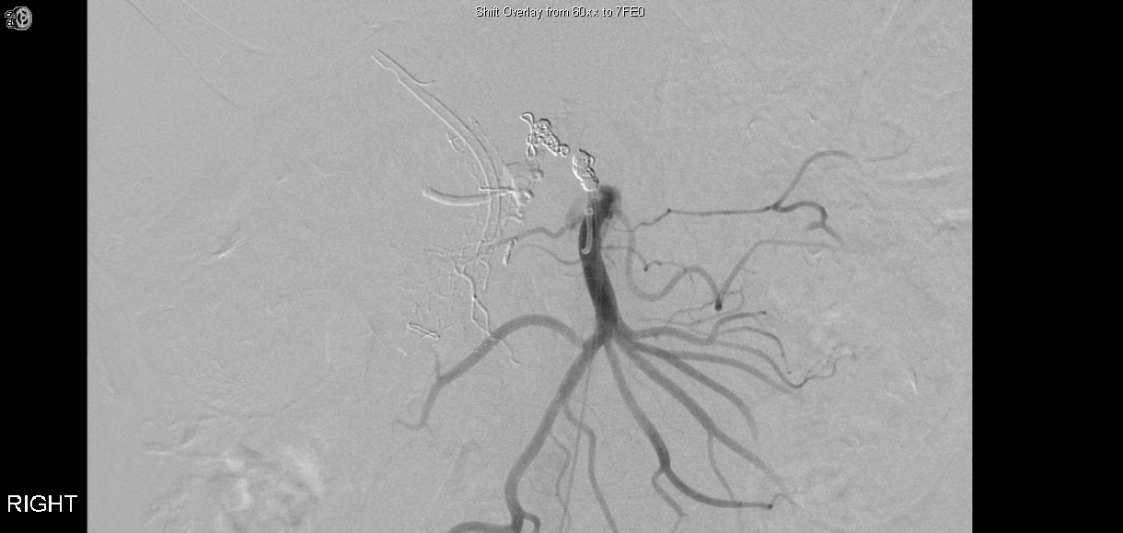

Slide 75
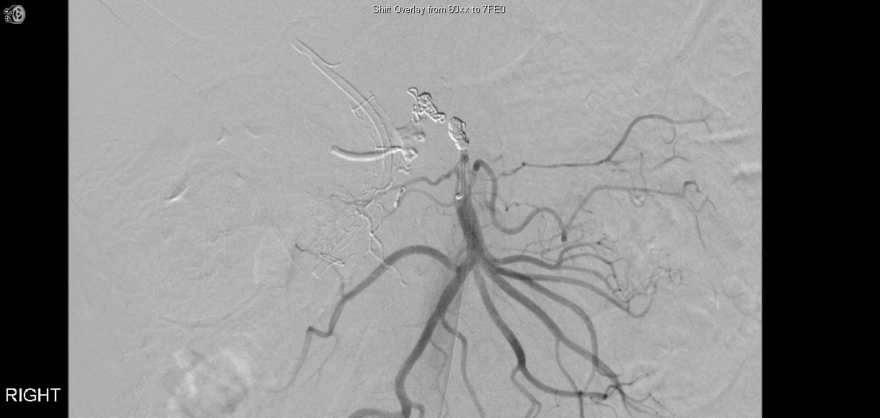

Slide 76
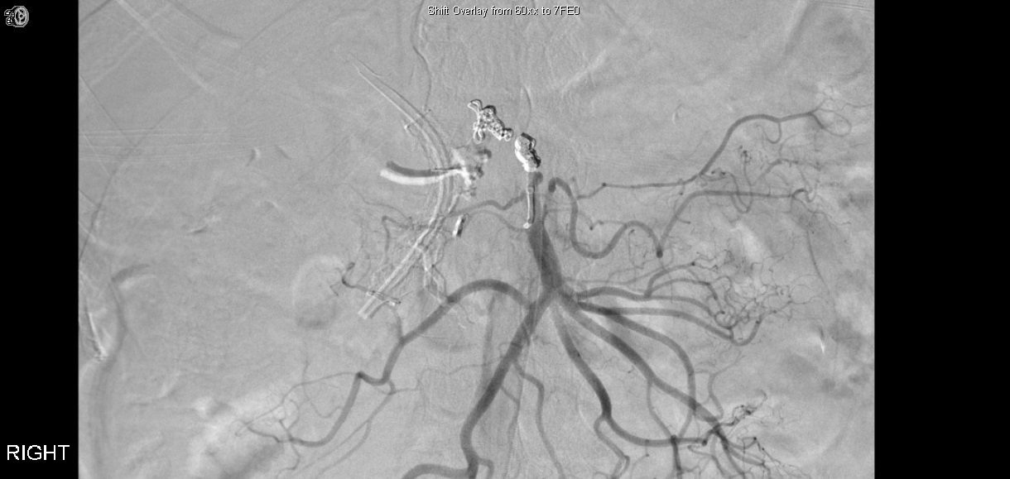

Slide 77
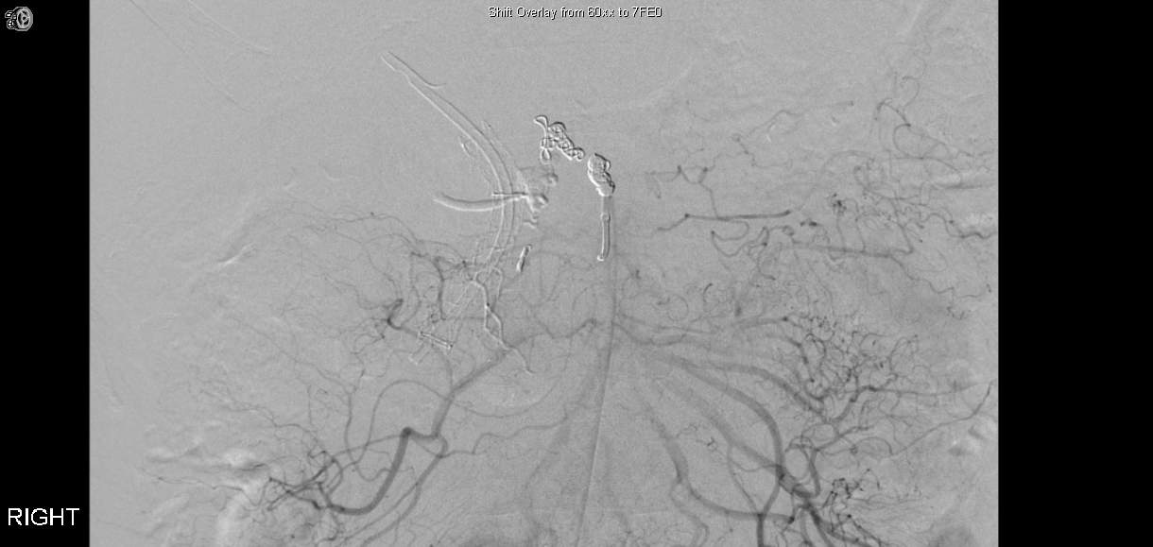

Slide 78
Post Glue Superior Mesenteric Angiogram
Occlusion of all inferior pancreaticoduodenal branches feeding the pseudoaneurysm.

Slide 79
Follow Up
The patients hematocrit stabilized
Discharge home

Slide 80
Thank you!

