Slide 1
New England Society of Interventional Radiology
Case Presentation
February 13, 2017
Lauren E. Ferrara, MD
Michael S. Stecker, MD
Brigham and Women’s Hospital

Slide 2
Incompetence of the Right Great Saphenous Vein
80 year old woman with right lower extremity discomfort.
Reports prior “stripping” procedures in 1988 & 1989; sclerotherapy in 1998 & 1999.
Notes:
24409955 - ? Take out EHIT propagation
2 year history of RLE symptoms including heaviness, fatigue, itching, throbbing, aching and restlessness. Symptoms are worsened with standing and sitting, but improved with leg elevation.
She denies history of deep vein thrombosis, bleeding varicosities, and venous ulceration. She thinks she may have had an episode of thrombophlebitis bilaterally with pregnancies in the past.
PMH: past medical history is notable for hypertension, hypercholesterolemia, blood transfusion, Graves disease, sleep apnea, osteoarthritis, kidney stones, diverticulitis, and carotid stenosis
Venous history: The findings are consistent with CEAP class 2 disease. Her VCSS is 5.

Slide 3
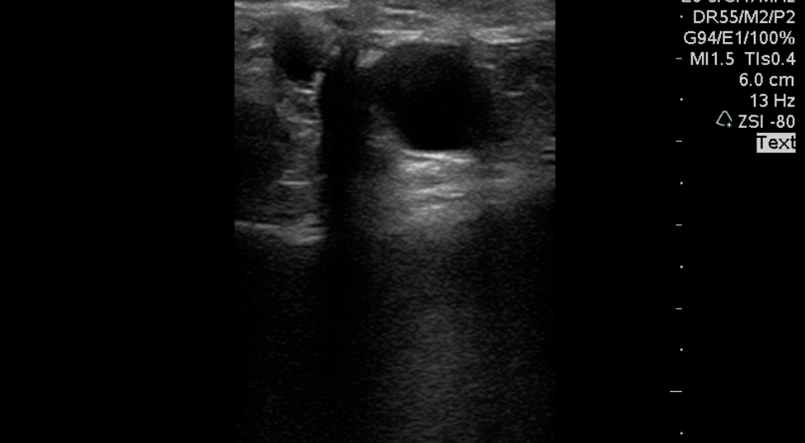
New Patient: 3/24/2016
Notes:
I performed right lower extremity vein mapping in the upright position as her prior exam was not performed with full standing, nor was there evaluation of the saphenofemoral junction which would be required to be documented for any treatment, and there was no evaluation of the small saphenous vein. The current examination demonstrates the common femoral and popliteal veins to be patent and compressible without evidence of obstruction. There was moderate reflux with Valsalva maneuver in the common femoral vein, but there was no reflux in the popliteal with distal augmentation. Incidentally noted were calcified plaques in the common femoral artery and popliteal artery. The great saphenous vein measures 7.2 mm in the upper thigh, 4.9 mm in the midthigh, 4.7 mm in the lower thigh, it is not seen in the upper calf and it measures 2.3 mm in the lower calf. The vein became very superficial in the lower thigh and was seen going right into and supplying the symptomatic varicose veins. Beginning at the saphenofemoral junction and going all the way down to about the level of the knee where the tributary came off, there was greater than 3 seconds of significant reflux on pulse wave Doppler ultrasonography with distal augmentation. The small saphenous vein measured 2.7 mm in the upper calf and 2.3 mm in the lower calf. There was no reflux on pulse wave Doppler ultrasonography with distal augmentation. There was no communication if the small saphenous with the popliteal veins behind the knee.

Slide 4
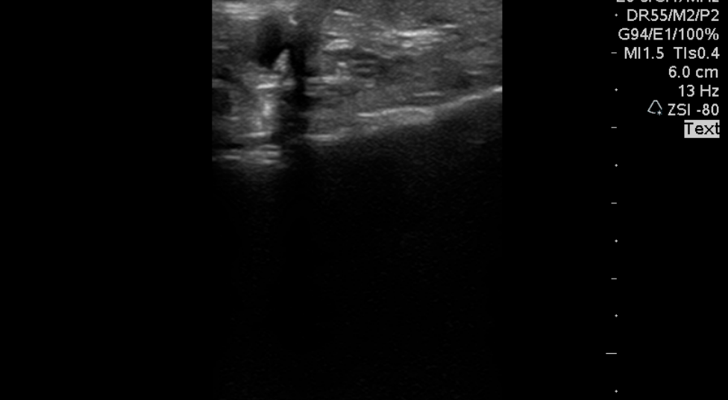
New Patient: 3/24/2016

Slide 5
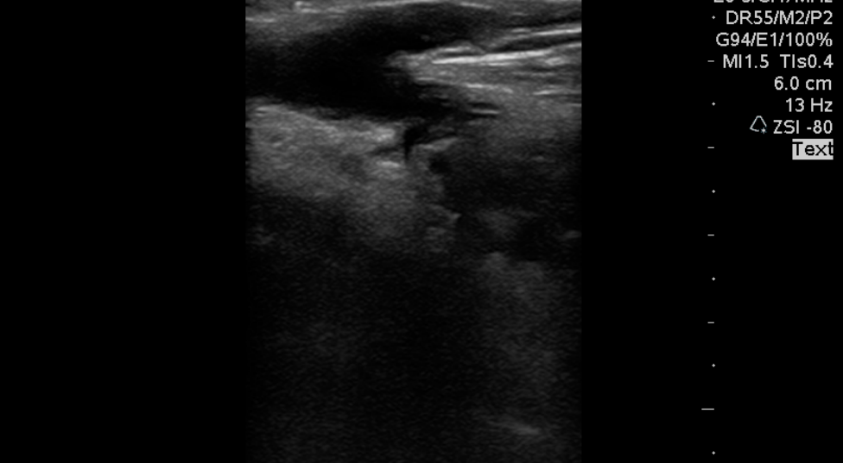
New Patient: 3/24/2016

Slide 6
Question # 1
What is the definition of venous reflux?
  A) Reversal of flow for greater than 0.5 second in the superficial veins and greater than 1 second in the deep veins
  B) Reversal of flow for greater than 1 second in the superficial veins and greater than 1 second in the deep veins
  C) Reversal of flow for greater than 1 second in the superficial veins and greater than 0.5 second in the deep veins
  D) Reversal of flow for greater than 0.5 second in the superficial veins and greater than 0.5 second in the deep veins

Slide 7
Question # 1
What is the definition of venous reflux?
  A) Reversal of flow for greater than 0.5 second in the superficial veins and greater than 1 second in the deep veins
  B) Reversal of flow for greater than 1 second in the superficial veins and greater than 1 second in the deep veins
  C) Reversal of flow for greater than 1 second in the superficial veins and greater than 0.5 second in the deep veins
  D) Reversal of flow for greater than 0.5 second in the superficial veins and greater than 0.5 second in the deep veins

Slide 8
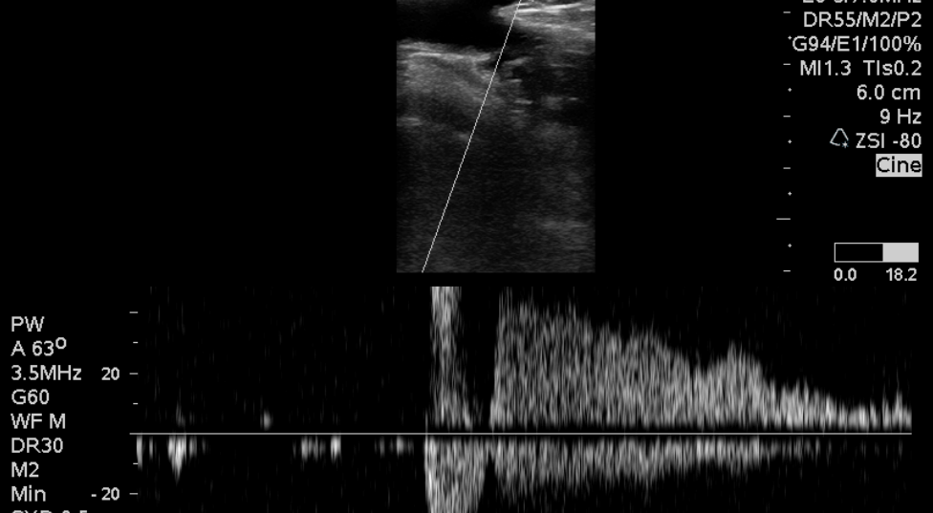
New Patient: 3/24/2016

Slide 9
Prior to Treatment
Necessary trial of compression stockings
Document failure of conservative management
Continued worsening of the VCSS
Notes:
6 week trail of compression stockings

Slide 10
Question # 2
What gradient compression stockings are appropriate before and after the procedure
  A) 20-30 mmHg, 20-30 mmHg
  B) 20-30 mmHg, 30-40 mmHg
  C) 30-40 mmHg, 20-30 mmHg
  D) 30-40 mmHg, 30-40 mmHg

Slide 11
Question # 2
What gradient compression stockings are appropriate before and after the procedure
  A) 20-30 mmHg, 20-30 mmHg
  B) 20-30 mmHg, 30-40 mmHg
  C) 30-40 mmHg, 20-30 mmHg
  D) 30-40 mmHg, 30-40 mmHg

Slide 12
RT GSV EVLT
Knee to 2 cm below SFJ:
32 cm, 2608 J
Notes:
I gave her a prescription for knee high 20-30 mmHg gradient compression stockings for that trial. I also gave her a prescription for a 30-40 mmHg thigh high stocking with belt should she go on to a procedure.

Slide 13
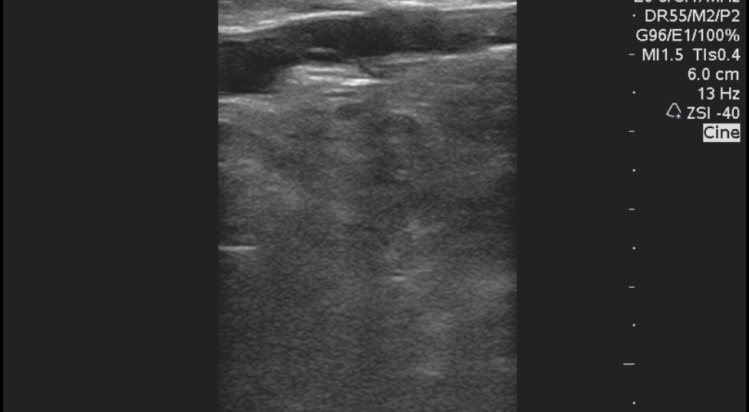
RT GSV EVLT: 5/25/2016
SFJ
Laser Tip

Slide 14
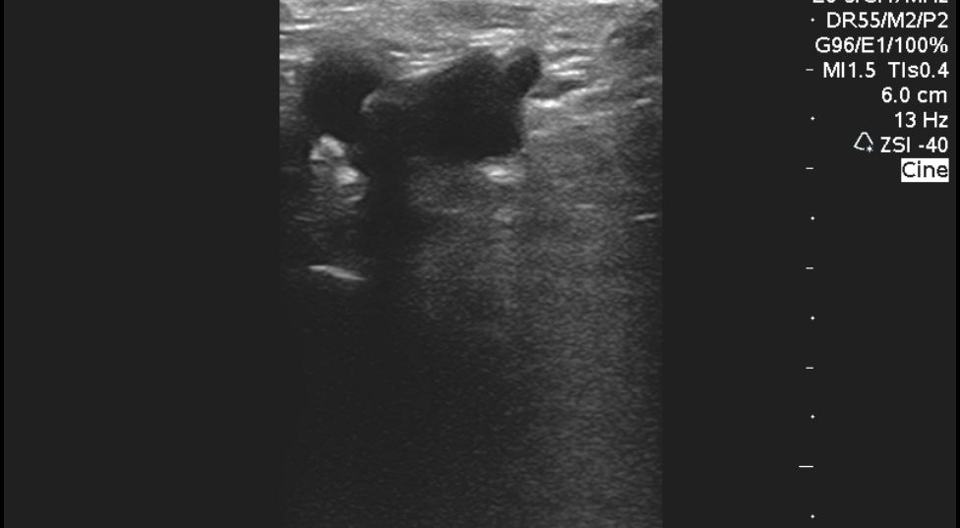
RT GSV EVLT: 5/25/2016
Notes:
Ultrasound examination of the vein during and after the procedure revealed total collapse of the vein. The common femoral vein remained normal and compressible.

Slide 15
Short Term Follow-Up
POD #15
Notes:
What is the typical follow-up interval? 2 weeks

Slide 16
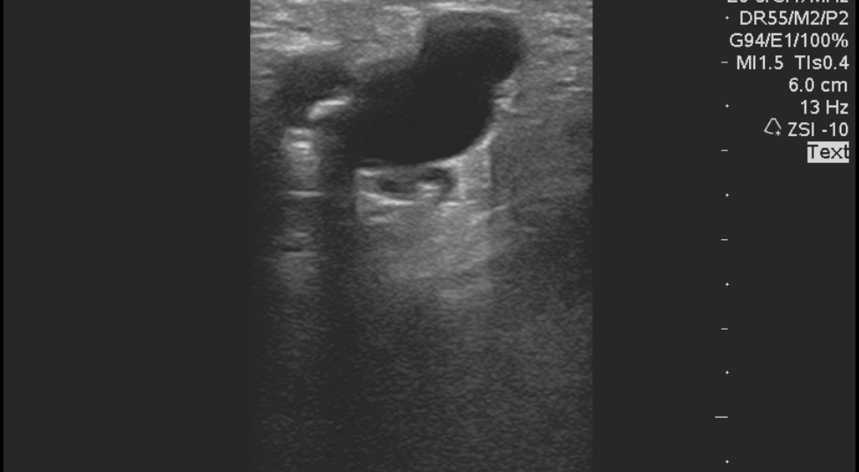
Short Term F/U: 6/9/2016

Slide 17
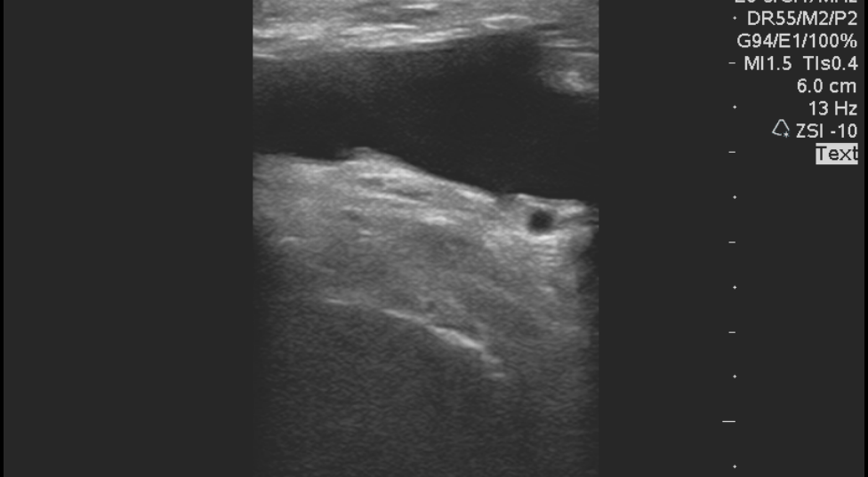
Short Term F/U: 6/9/2016

Slide 18
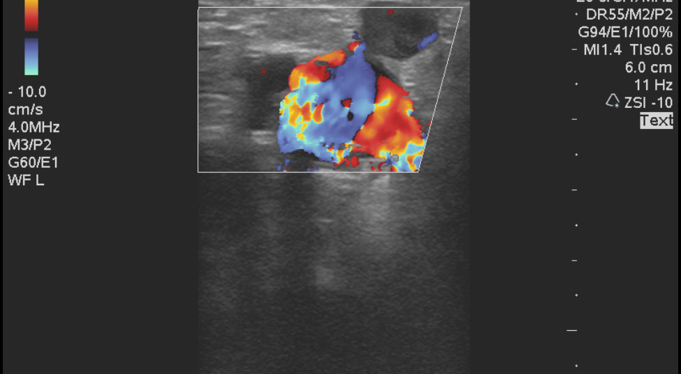
Short Term F/U: 6/9/2016
Notes:
The treated great saphenous vein is now thick-walled, echogenic, and non-compressible. Thrombus extends to the SFJ, but not into the common femoral.

Slide 19
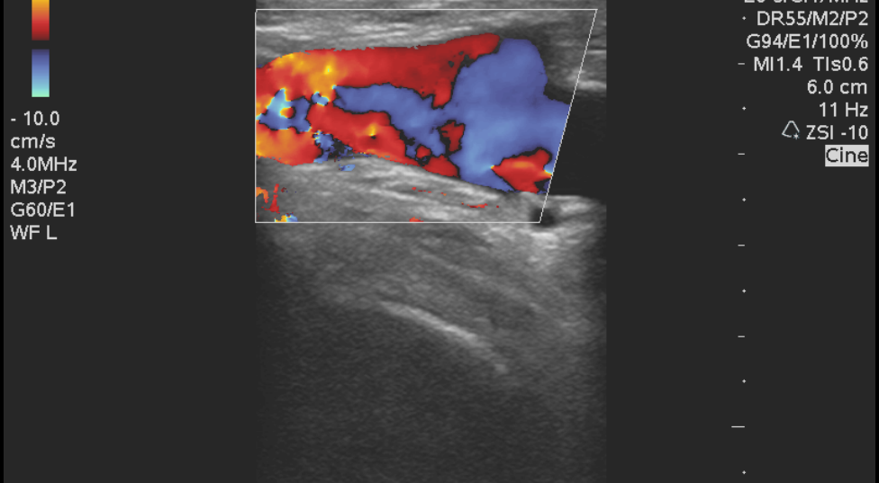
Short Term F/U: 6/9/2016

Slide 20
Question # 3
What does EHIT stand for?
  A) Endovenous Hemorrhagic Thrombosis
  B) Endothermal Heat Induced Thrombosis
  C) Endovenous Heat Induced Thrombosis
  D) Endothermal Hemorrhagic Inducted Thrombosis

Slide 21
Question # 3
What does EHIT stand for?
  A) Endovenous Hemorrhagic Thrombosis
  B) Endothermal Heat Induced Thrombosis
  C) Endovenous Heat Induced Thrombosis
  D) Endothermal Hemorrhagic Inducted Thrombosis

Slide 22
Definition of EHIT
The propagation of thrombus from the superficial vein into a more central deep vein
Four classes of EHIT – What class is this case?
Notes:
Can lead to DVT and PE

Slide 23
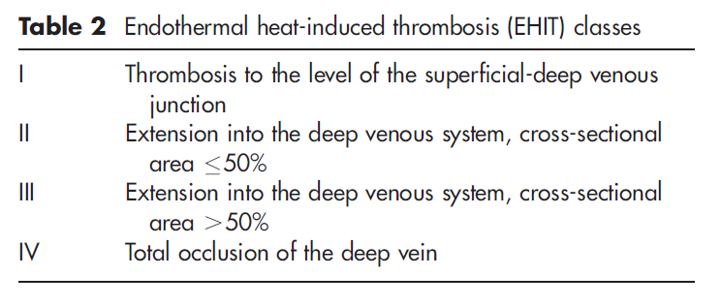
EHIT Classification

Slide 24
EHIT Classification
D. Dexter et al. Phlebology 2012;27 Suppl 1:40–45. DOI: 10.1258/phleb.2012.012S18

Slide 25
Short Term Follow-Up
EHIT Type 1:
Increased ASA from 81 mg PO QD to 325 mg PO QD for 1 month

Slide 26
Question # 4
What is the typical treatment for Type I EHIT based on the literature?
  A) Aspirin
  B) LMWH
  C) Warfarin
  D) No treatment recommended

Slide 27
Question # 4
What is the typical treatment for Type I EHIT based on the literature?
  A) Aspirin
  B) LMWH
  C) Warfarin
  D) No treatment recommended

Slide 28
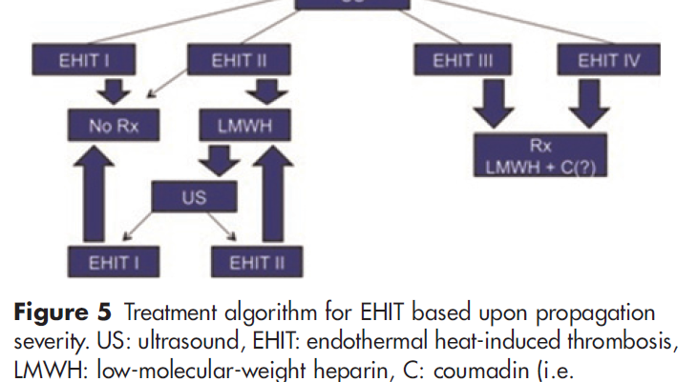
EHIT Algorithm 2012
D. Dexter et al. Phlebology 2012;27 Suppl 1:40–45. DOI: 10.1258/phleb.2012.012S18

Slide 29
Question # 5
According to the more recent literature, what is the rate of EHIT after thermal ablation treatment?
  A) Less than 0.1 %
  B) About 1%
  C) More than 5%

Slide 30
Question # 5
According to the more recent literature, what is the rate of EHIT after thermal ablation treatment?
  A) Less than 0.1 %
  B) About 1%
  C) More than 5%
Notes:
P. Marsh. Eur J Vasc Endovasc Surg (2010) 40, 521e527.

Slide 31
Long Term Follow-Up
POD #68

Slide 32
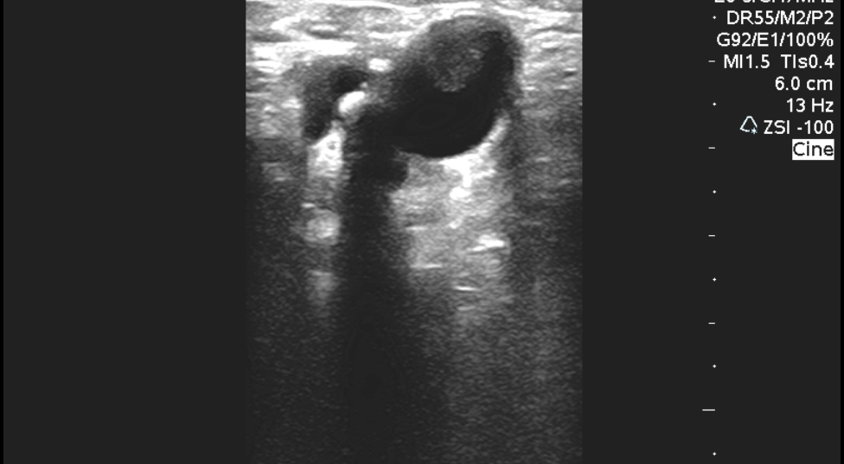
Long Term F/U: 8/1/2016

Slide 33
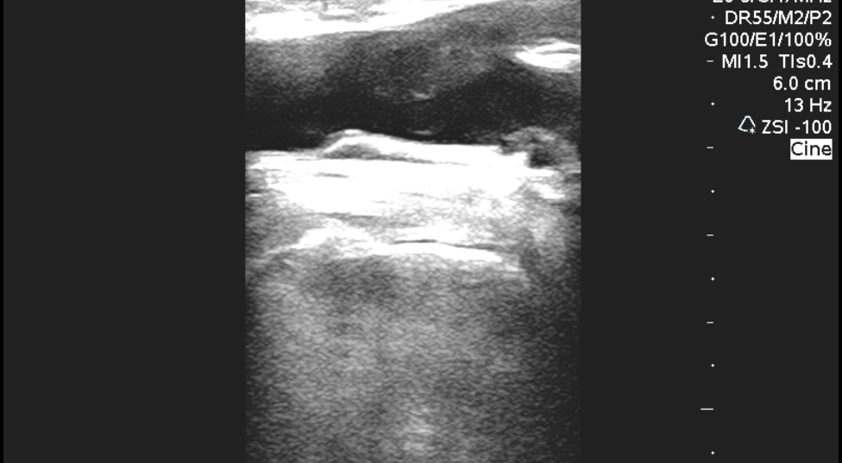
Long Term F/U: 8/1/2016

Slide 34
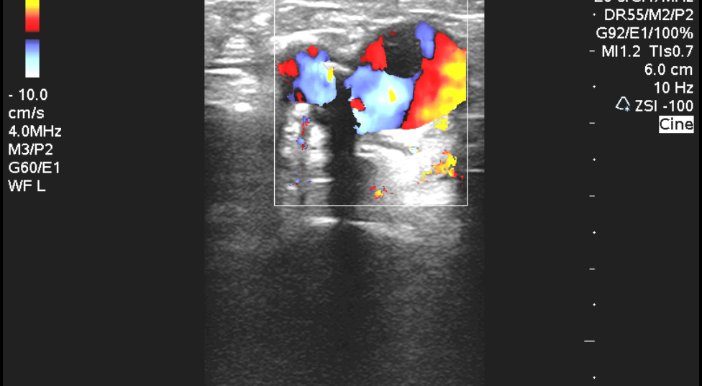
Long Term F/U: 8/1/2016

Slide 35
Question # 6
What is the EHIT classification?
  A) I
  B) II
  C) III
  D) IV

Slide 36
Question # 6
What is the EHIT classification?
  A) I
  B) II
  C) III
  D) IV
Notes:
D. Dexter et al. Phlebology 2012;27 Suppl 1:40–45. DOI: 10.1258/phleb.2012.012S18

Slide 37
Long Term Follow-Up
EHIT Type II:
Continued ASA 325 mg QD

Slide 38
EHIT Algorithm

Slide 39
Repeat Follow-Up
POD #77

Slide 40
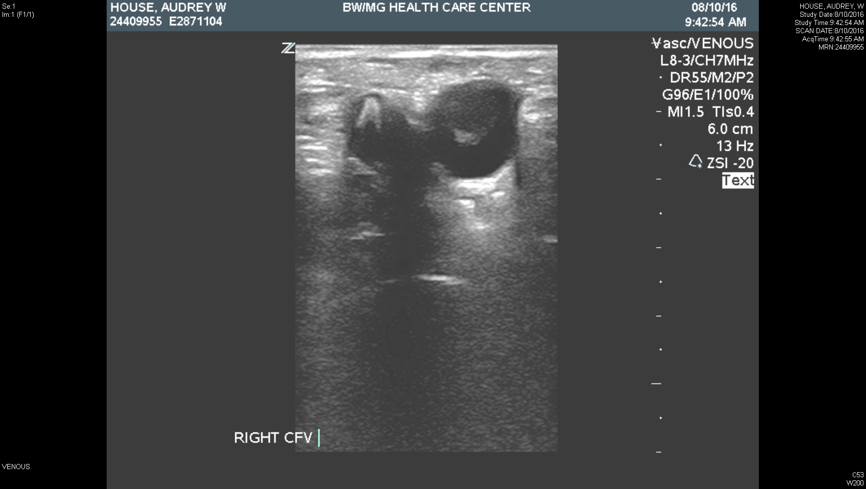
Repeat F/U 8/10/2016

Slide 41
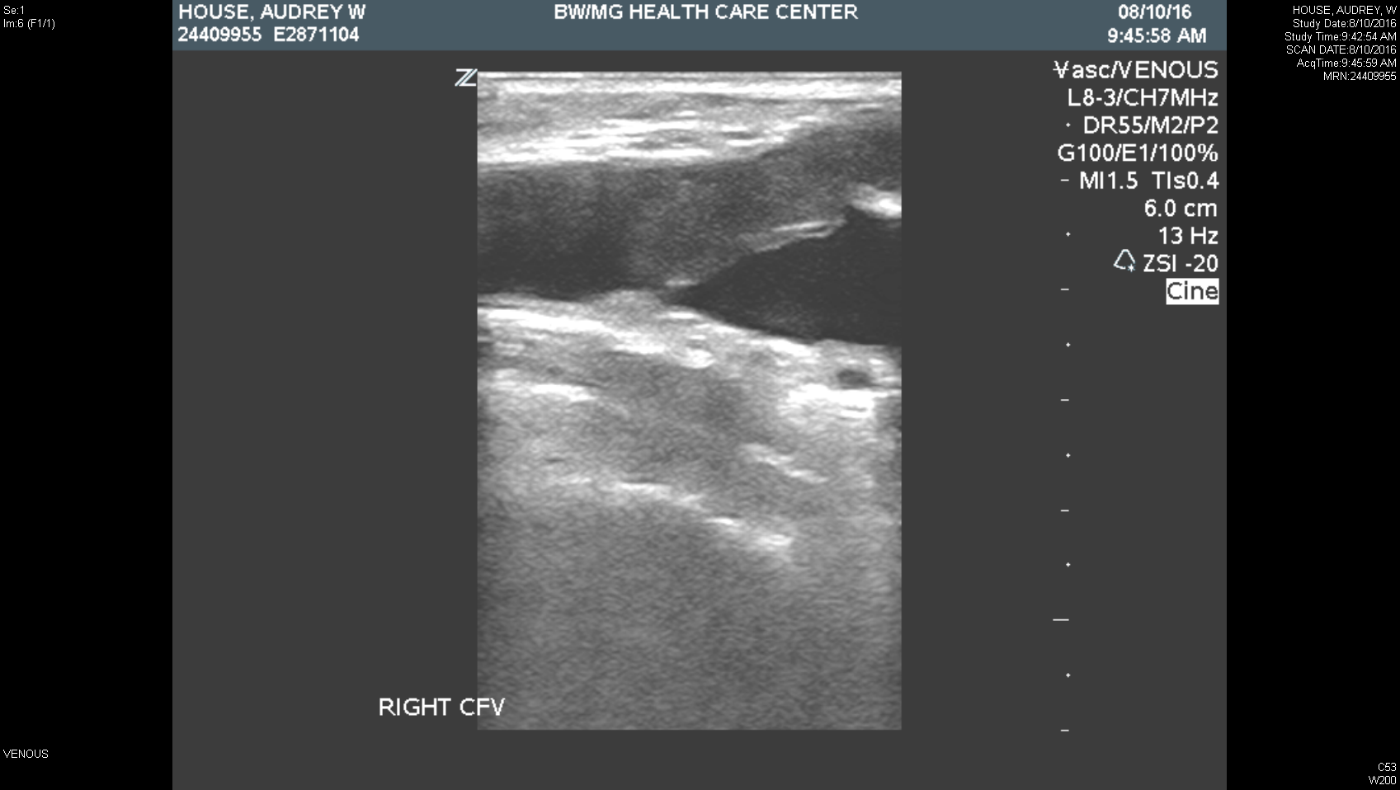
Repeat F/U 8/10/2016

Slide 42
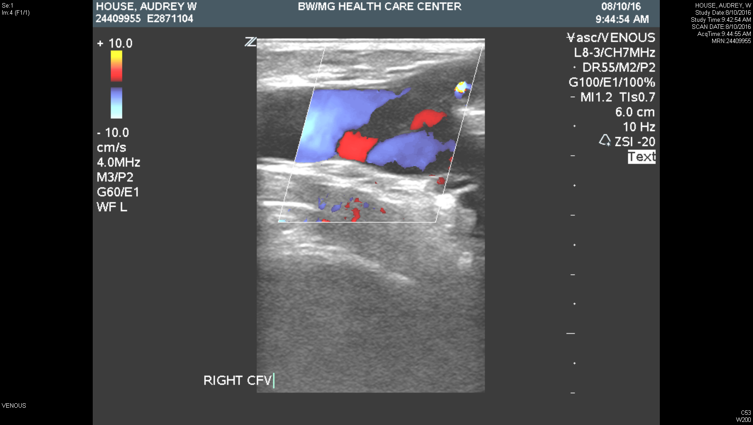
Repeat F/U 8/10/2016

Slide 43
Repeat Follow-Up #1
Progressed EHIT Type II:
Started on Eliquis 5 mg BID x5 days, then 2.5 mg BID for another 23 days

Slide 44
Question # 7
Is the rate of EHIT higher with RFA or EVLA?
  A) RFA
  B) EVLA
  C) No difference

Slide 45
Question # 7
Is the rate of EHIT higher with RFA or EVLA?
  A) RFA
  B) EVLA
  C) No difference
P. Marsh. Eur J Vasc Endovasc Surg (2010) 40, 521e527.
Notes:
P. Marsh. Eur J Vasc Endovasc Surg (2010) 40, 521e527.

Slide 46
Repeat Follow-Up
POD #83

Slide 47
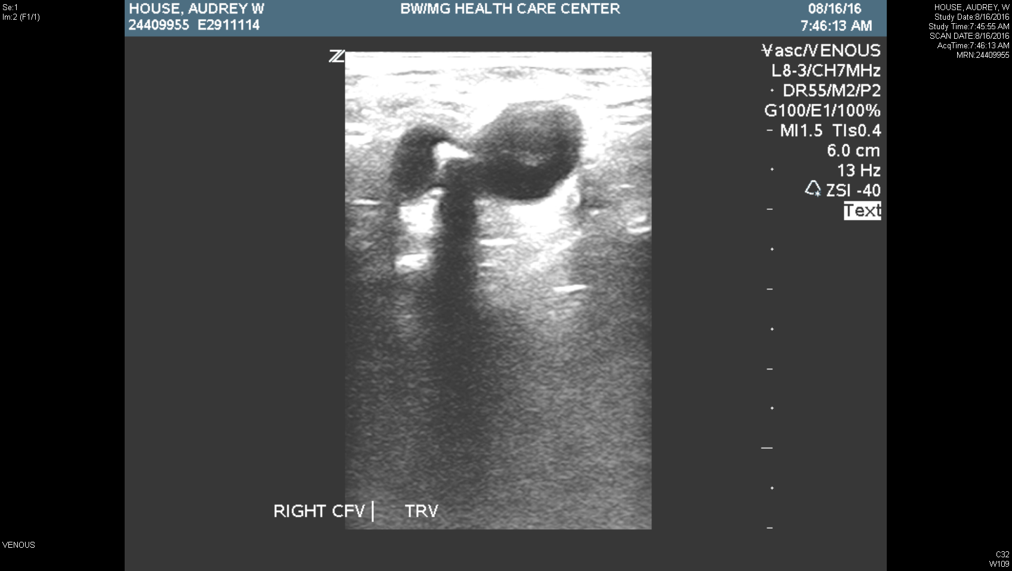
Repeat F/U 8/16/2016

Slide 48
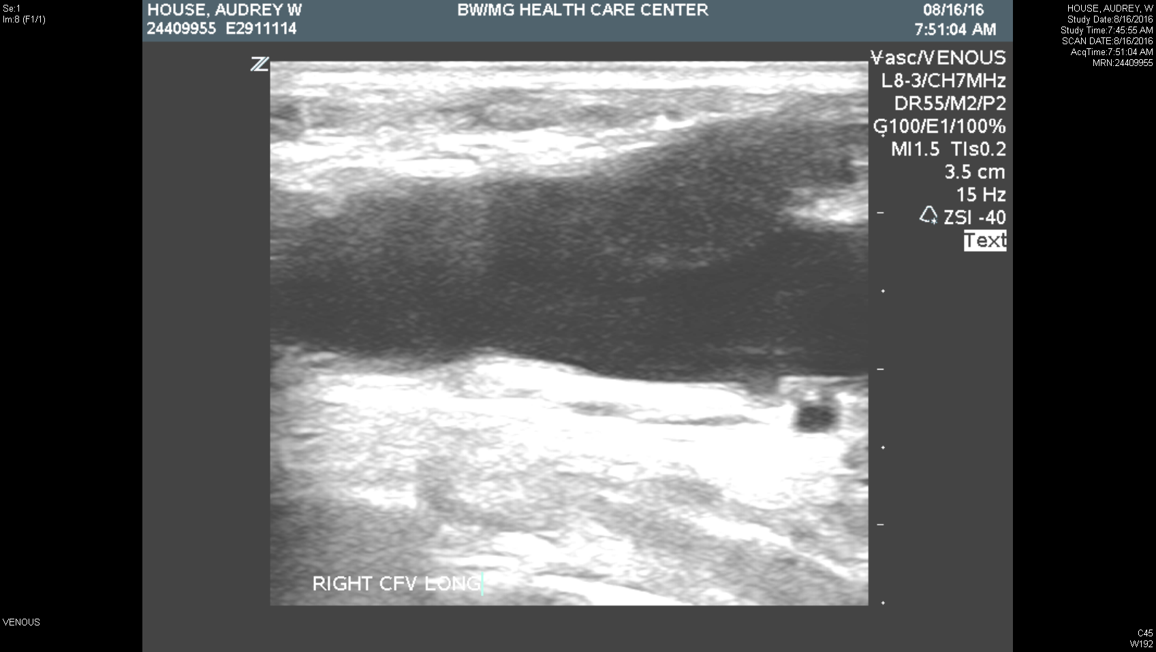
Repeat F/U 8/16/2016

Slide 49
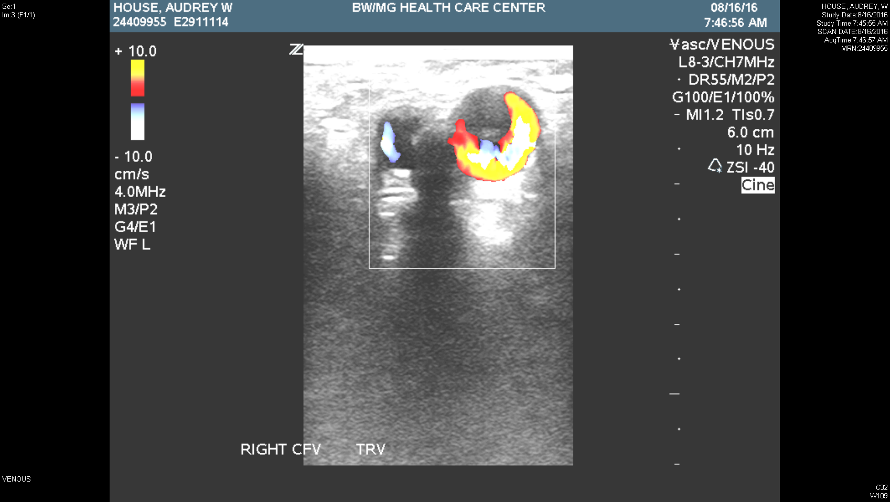
Repeat F/U 8/16/2016

Slide 50
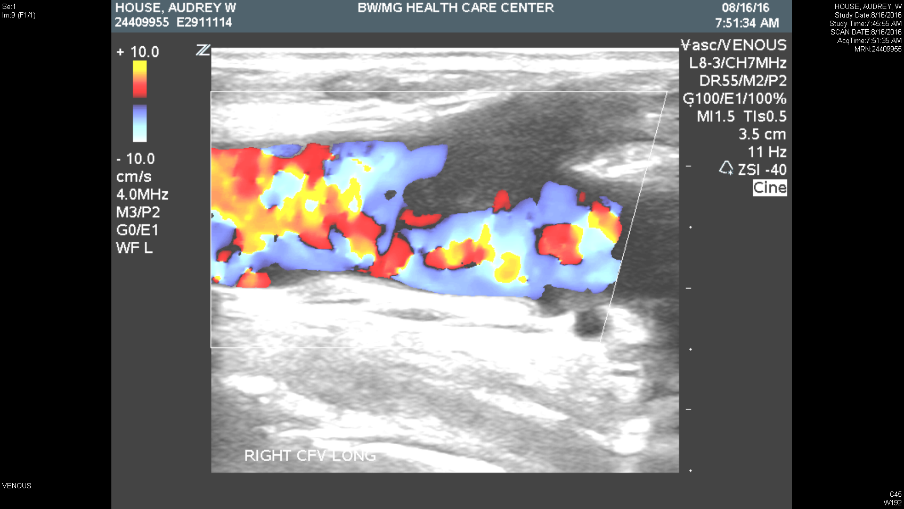
Repeat F/U 8/16/2016

Slide 51
Repeat Follow-Up #2
Improving EHIT Type II:
Continue Eliquis 2.5 mg BID

Slide 52
Repeat Follow-Up
POD #120

Slide 53
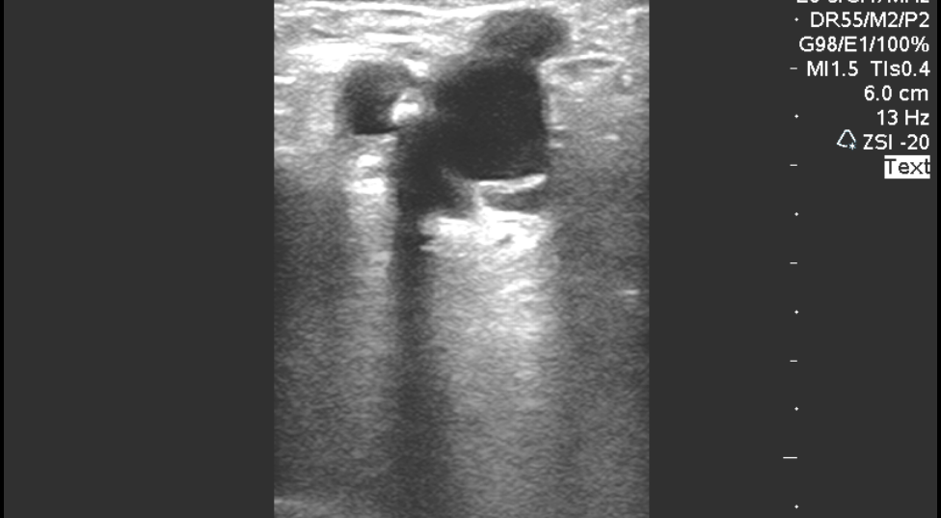
Repeat F/U 9/22/2016

Slide 54
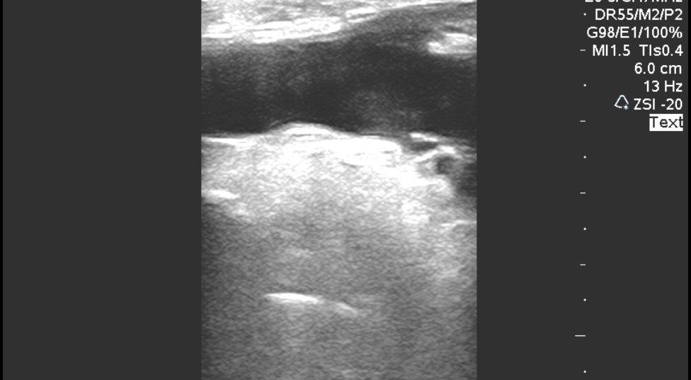
Repeat F/U 9/22/2016

Slide 55
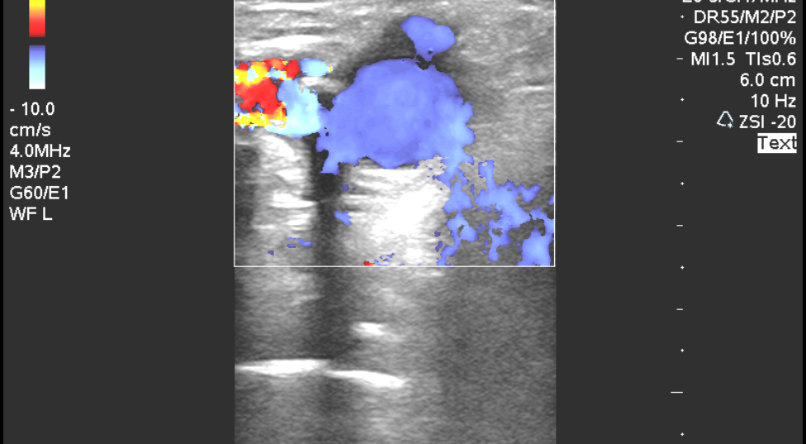
Repeat F/U 9/22/2016

Slide 56
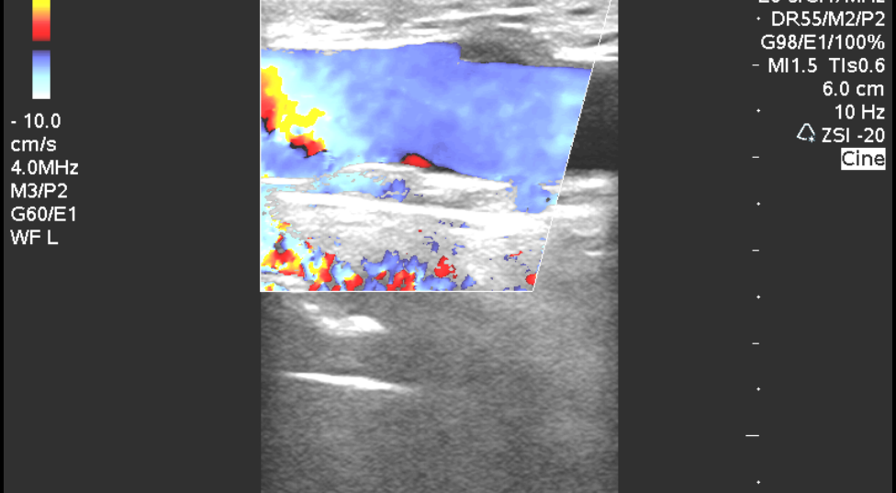
Repeat F/U 9/22/2016

Slide 57
Repeat Follow-Up #3
Improved EHIT to Type I

Slide 58
FINAL Follow-Up
POD #153

Slide 59
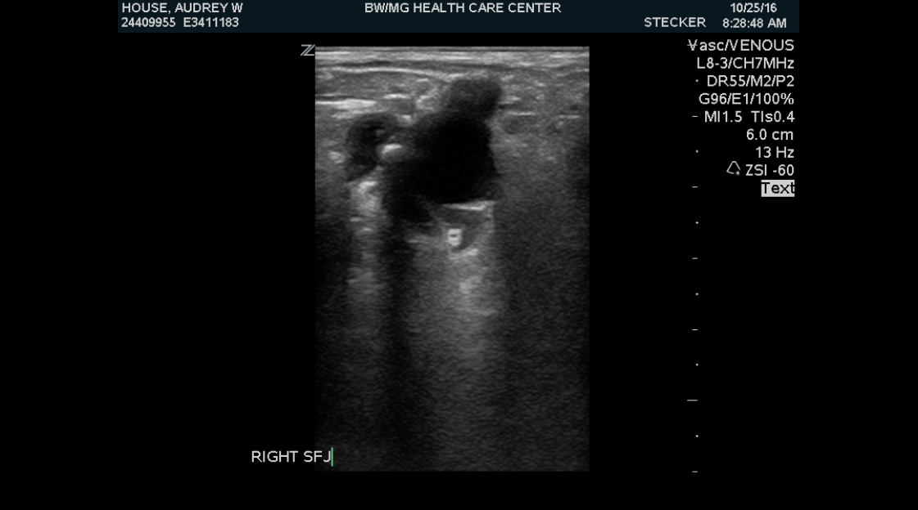
Final F/U 10/25/2016

Slide 60
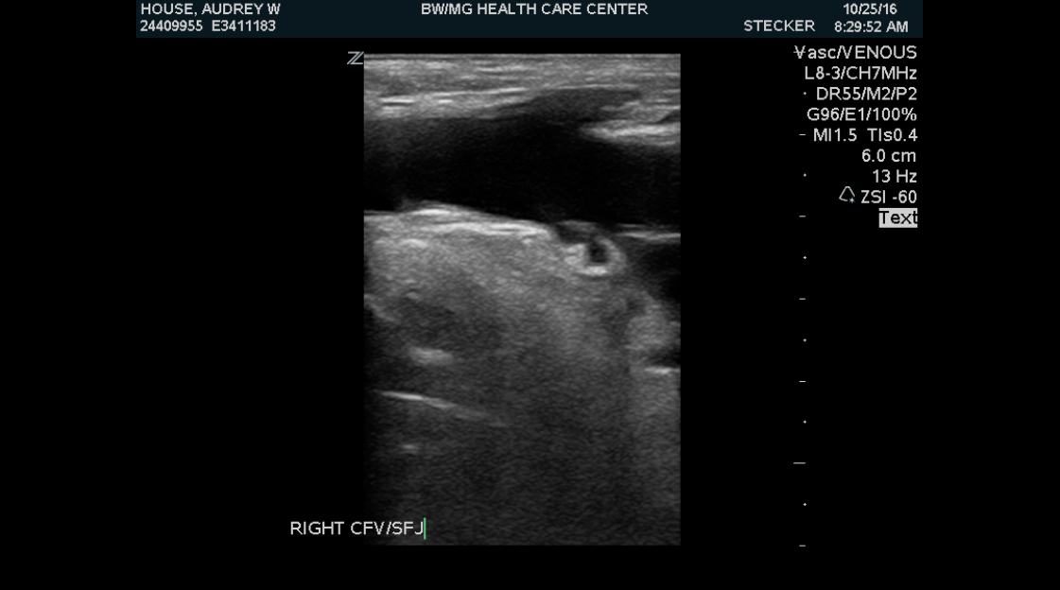
Final F/U 10/25/2016

Slide 61
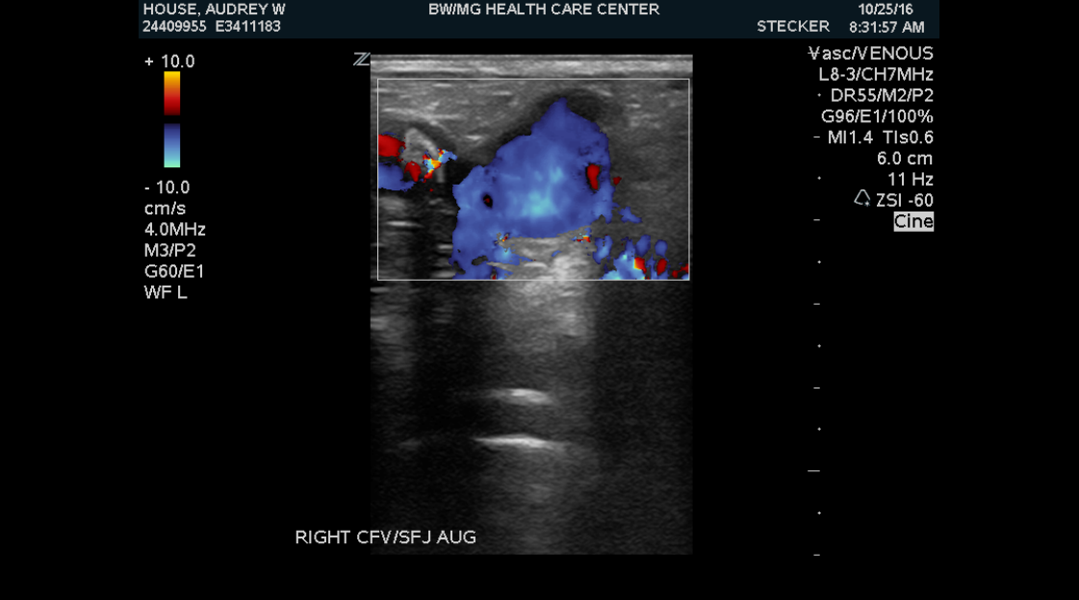
Final F/U 10/25/2016

Slide 62
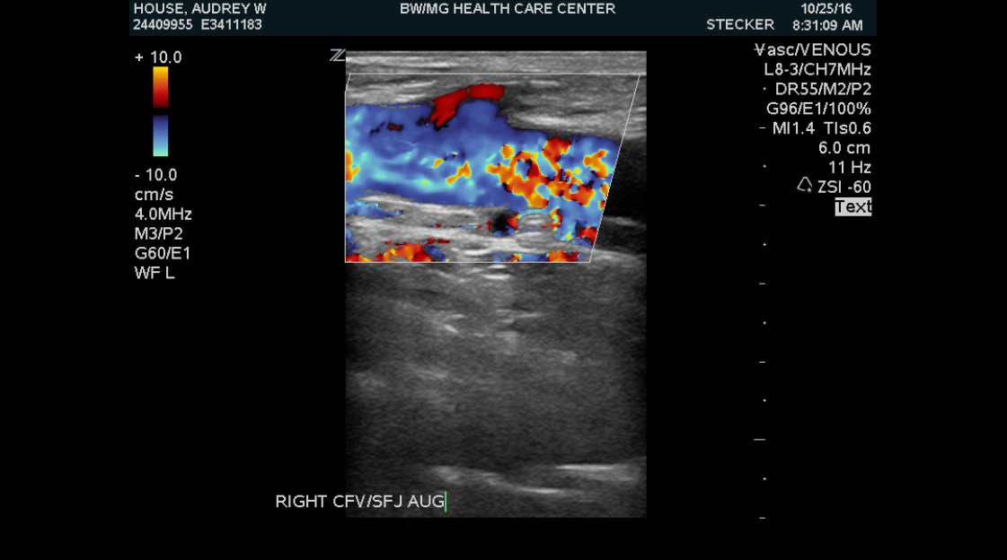
Final F/U 10/25/2016

Slide 63
FINAL Follow-Up
Resolved EHIT
Completed Eliquis 10/8/2016

Slide 64
Questions
Would you have treated the patient differently?
Should we consider the newer anticoagulants for treatment of EHIT over the traditional treatment?
Other experiences with EHIT?

Slide 65
Thank you

Slide 66
References
D. Dexter et al. Phlebology 2012;27 Suppl 1:40–45. DOI: 10.1258/phleb.2012.012S18
S. Kundu J Vasc Interv Radiol 2007; 18:1073–1080
P. Marsh. Eur J Vasc Endovasc Surg (2010) 40, 521e527.

