Slide 1
Sudhen B. Desai,MD
Fellow, Pediatric Radiology
Boston Children’s Hospital
NESIR 5.8.17

Slide 2
Hemoptysis
Hemoptysis in 11/2014 (6 years old)
Presented with large volume hemoptysis in the setting of a coughing spell
Admitted to the MSICU
Work up at the time included:
ORL bedside flexible nasopharyngoscopy, which was normal
CTA showed no vascular abnormality and no evidence of bronchiectasis or AVM
Extensive laboratory investigations including autoantibody testing which was normal (including ASO, dsDNA, ANCA, ANA, cardiolipin panel (except cardiolipin IgM, which was elevated at 15), DNase-B, anti-GBM, anti-Smith, SS/Ro, and SS/La). IgG, IgA, IgM, C3, C4, IgE, and TTG were all normal. Anti-ribonucleic protein was negative. A PPD was placed, which was negative at 2 mm of induration.
Infectious workup showing: Mycoplasma titers elevated for IgG and IgM at 0.92 and 1.93, respectively - not confirmed by BAL. Sputum culture on arrival, which grew Moraxella. She received empiric treatment with azithromycin and augmentin.
Flexible bronchoscopy which showed a normal anatomy with a friable mucosa which was mildly edematous. There were rare, clear secretions. There was sequential aliquots in the left lower lobe, which returned more bloody samples than the preceding samples, consistent with ongoing bleeding in that area. On the right side, anatomy was normal with friable mucosa and rare, clear secretions. The right middle lobe return was non-bloody initially, but sequential aliquots became more bloody, similar to the left side. BAL cultures were positive for parainfluenza type 2, both on the DFA sample as well as the supplemental culture. Her respiratory culture and gram stain were negative. She did have a sputum culture on admission, which was positive for abundant Moraxella. All other cultures, including AFB, fungal, Legionella, MRSA, nocardia, routine respiratory culture and gram stain, adenovirus, PCR, CMV, shell vial, influenza, and PJP, were all negative. On her BAL, her BAL mycoplasma PCR was negative. Her aspergillus galactomannan on her BAL negative.
Normal upper GI endoscopy.
Evaluation by hematology: "There are multiple types of von Willebrand disease and though her low level is mild, she could possibly have a type 2 von Willebrand's disease given her testing results on repeated occasions. This is a qualitative defect in von Willebrand factor that least to decreased functioning of his protein. However, given that she has no family history and she has not had any other bleeding symptoms in her life apart from this episode of hemoptysis (which would be very unusual presentation of a case of type 2 vWD), she most likely only has low levels of von Willebrand factor and not true vWD."

Slide 3
Hemoptysis
Hemoptysis in 11/2014 (6 years old)
Her hemoptysis was thought to be secondary to infection
Subsequent outpatient evaluation found borderline vW for which was seen by hematology. She was also followed by Renal for microscopic hematuria thought to be related to related to thin basement membrane disease. She had a normal sonographic evaluation of the kidneys and bladder.

Slide 4
4.17.17
Occurred 7.20am when she was coughing leading to blood-stained sputum, and later small clots as well as 8-10oz of bright red blood.
ED work-up OSH:
Chest x-ray which was reported nonfocal
CBC with a Hg of 11.8, WBC of 7 and Plts of 381
U/A which revealed 2+ blood and 3-5 RBCs per high powered field on microscopy

Slide 5
4.17-18.17
UA with 1+ blood, SG >1.045, 15 RBCs
Stool guiac positive but no gross blood
ORL bedside scope with no signs of bleeding
10:20pm: 50 mL hemoptysis (not hematemesis, per patient) over multiple coughs
IR notified: overnight embolization only if hemodynamic instability
Given IV fluids (100 mL/hr), started Amicar 5g q6hrs, gave DDAVP, started IV pantoprazole 40mg q12hrs (no clear GI source though)
CBC stable: Hgb 11.6 -> 11.4; chem with normal Na (140)
Hematology recommended DDAVP instead of Humate unless hemoptysis >200 mL; recommended no IV fluids or free water for 12-24 hrs after DDAVP given
CXR unchanged
Discussion with Pulm fellow and attending: added-on for bronch
EKG with sinus arrhythmia (irregular rhythm noted on monitor)

Slide 6
4.18-26.17
Work-up including Renal, Rheum, ORL, Genetics, Vascular Anomalies consults all negative
PET/CT negative
Planned for angio/embo based on IR review of CTA (current and prior)

Slide 7
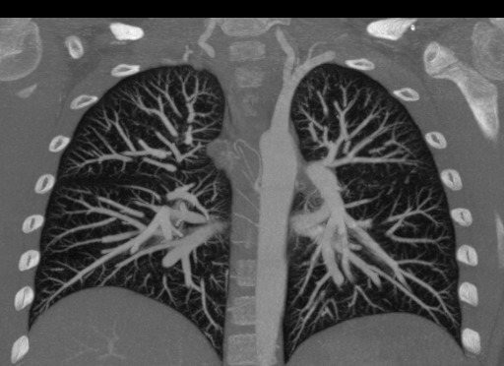
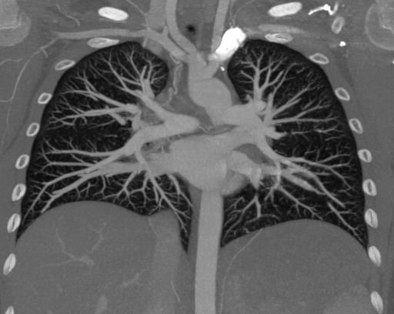
CTA

Slide 8
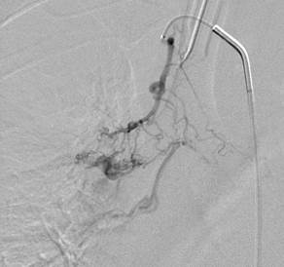
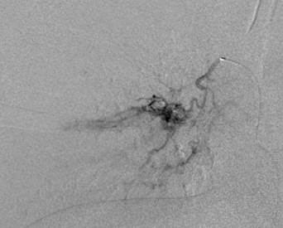
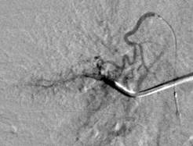
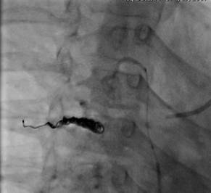
Angio/Embo 4.27.17

Slide 9
Angio/Embo 4.27.17

Slide 10
Any thoughts???
Outcome
Follow-up

