Slide 1
Endovascular Stenting of a Left Ventricular Assist Device (LVAD) Outflow Graft Stenosis
Will Johnson, MD
Neil Halin, DO
Tufts Medical Center
Cardiovascular and Interventional Radiology
NESIR Meeting 2/13/2017

Slide 2
Patient Case
47 Y M hx of NICM, LVEF 10-15%, EtOH abuse
Heartware LVAD as bridge to transplant 3/13/2014
Heartware LVAD Exchange due to thrombus 2/18/2015
Persistent low flows on LVAD
Currently in 2-3 L/min range; previously had been 3.5 to 4.5 L/min
Admitted to Tufts MC for further workup
CTA Chest obtained

Slide 3
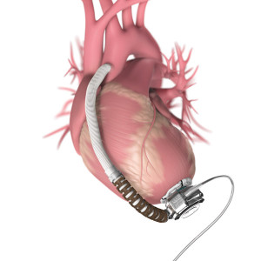
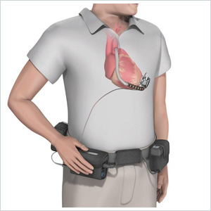
Heartware LVAD

Slide 4
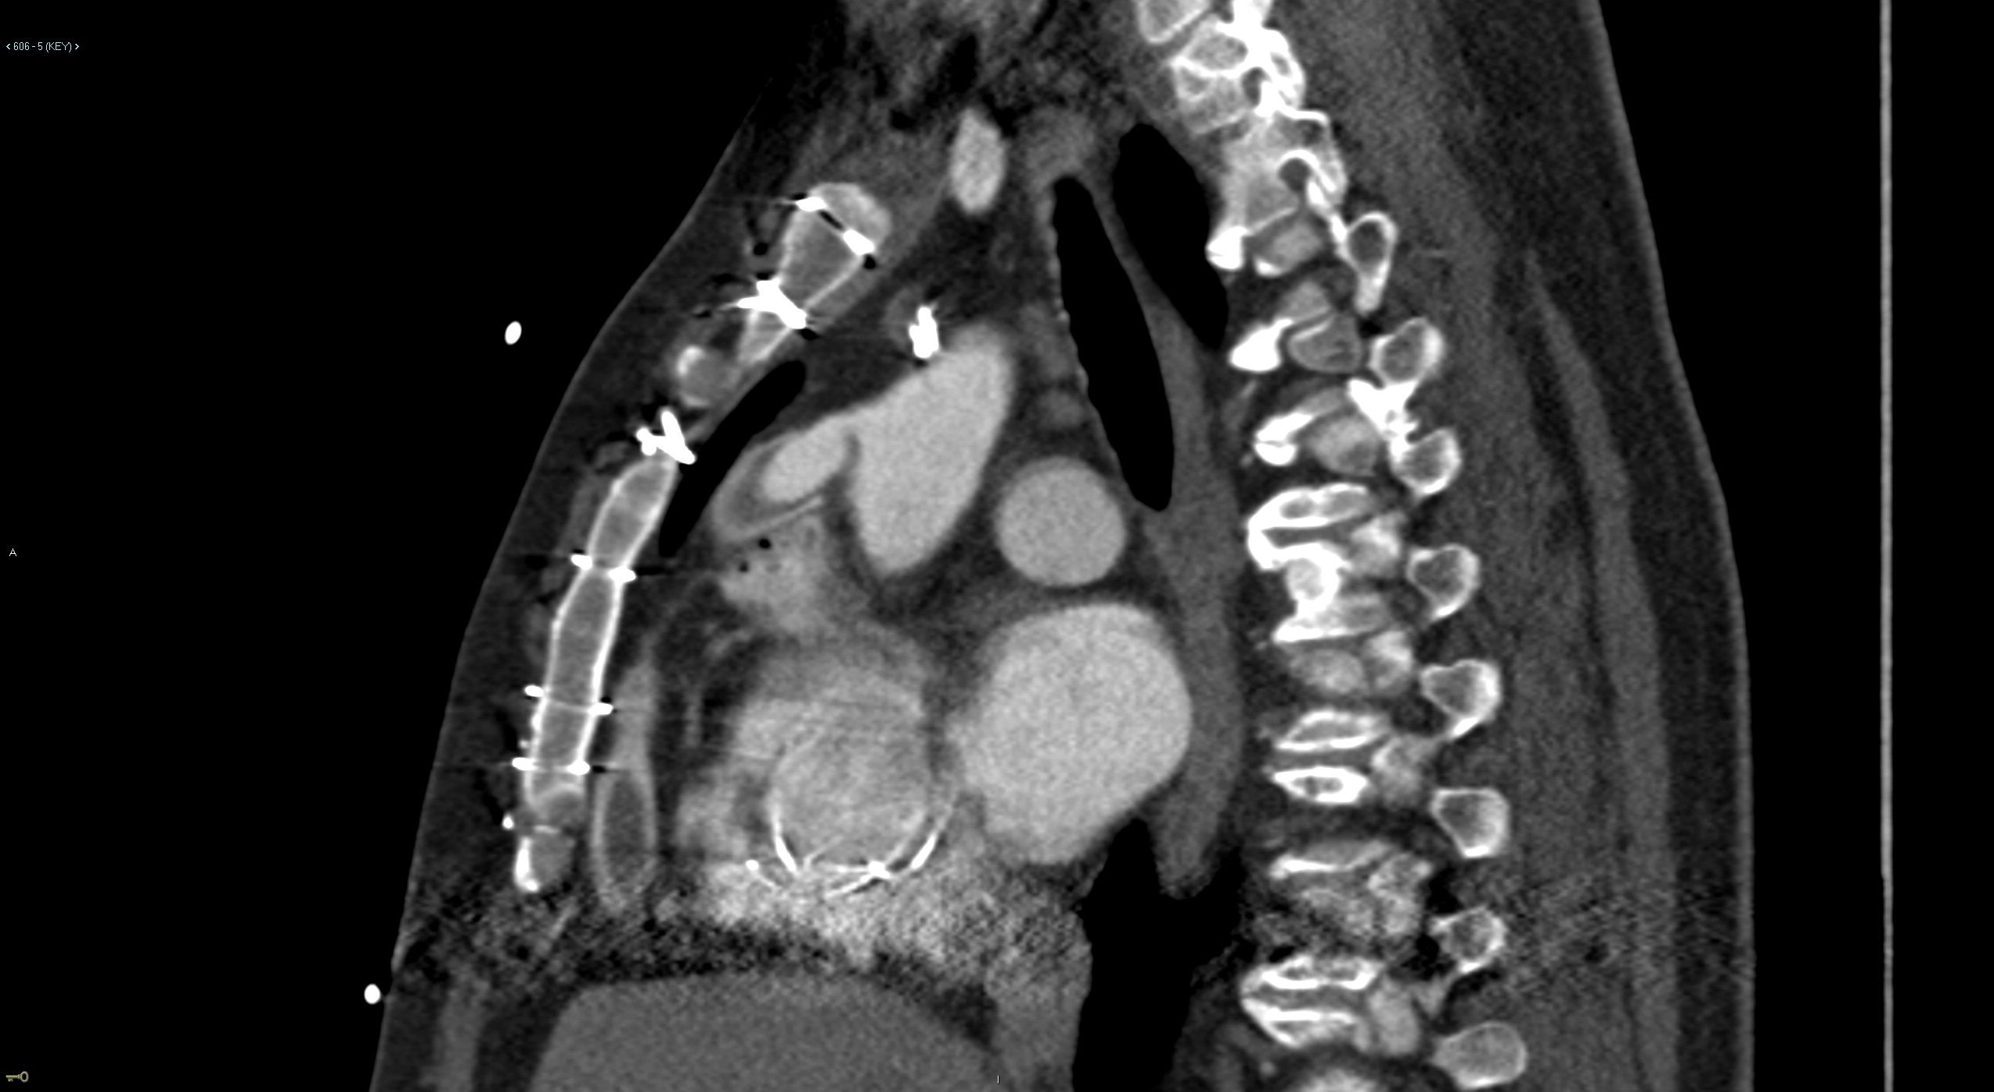

Slide 5
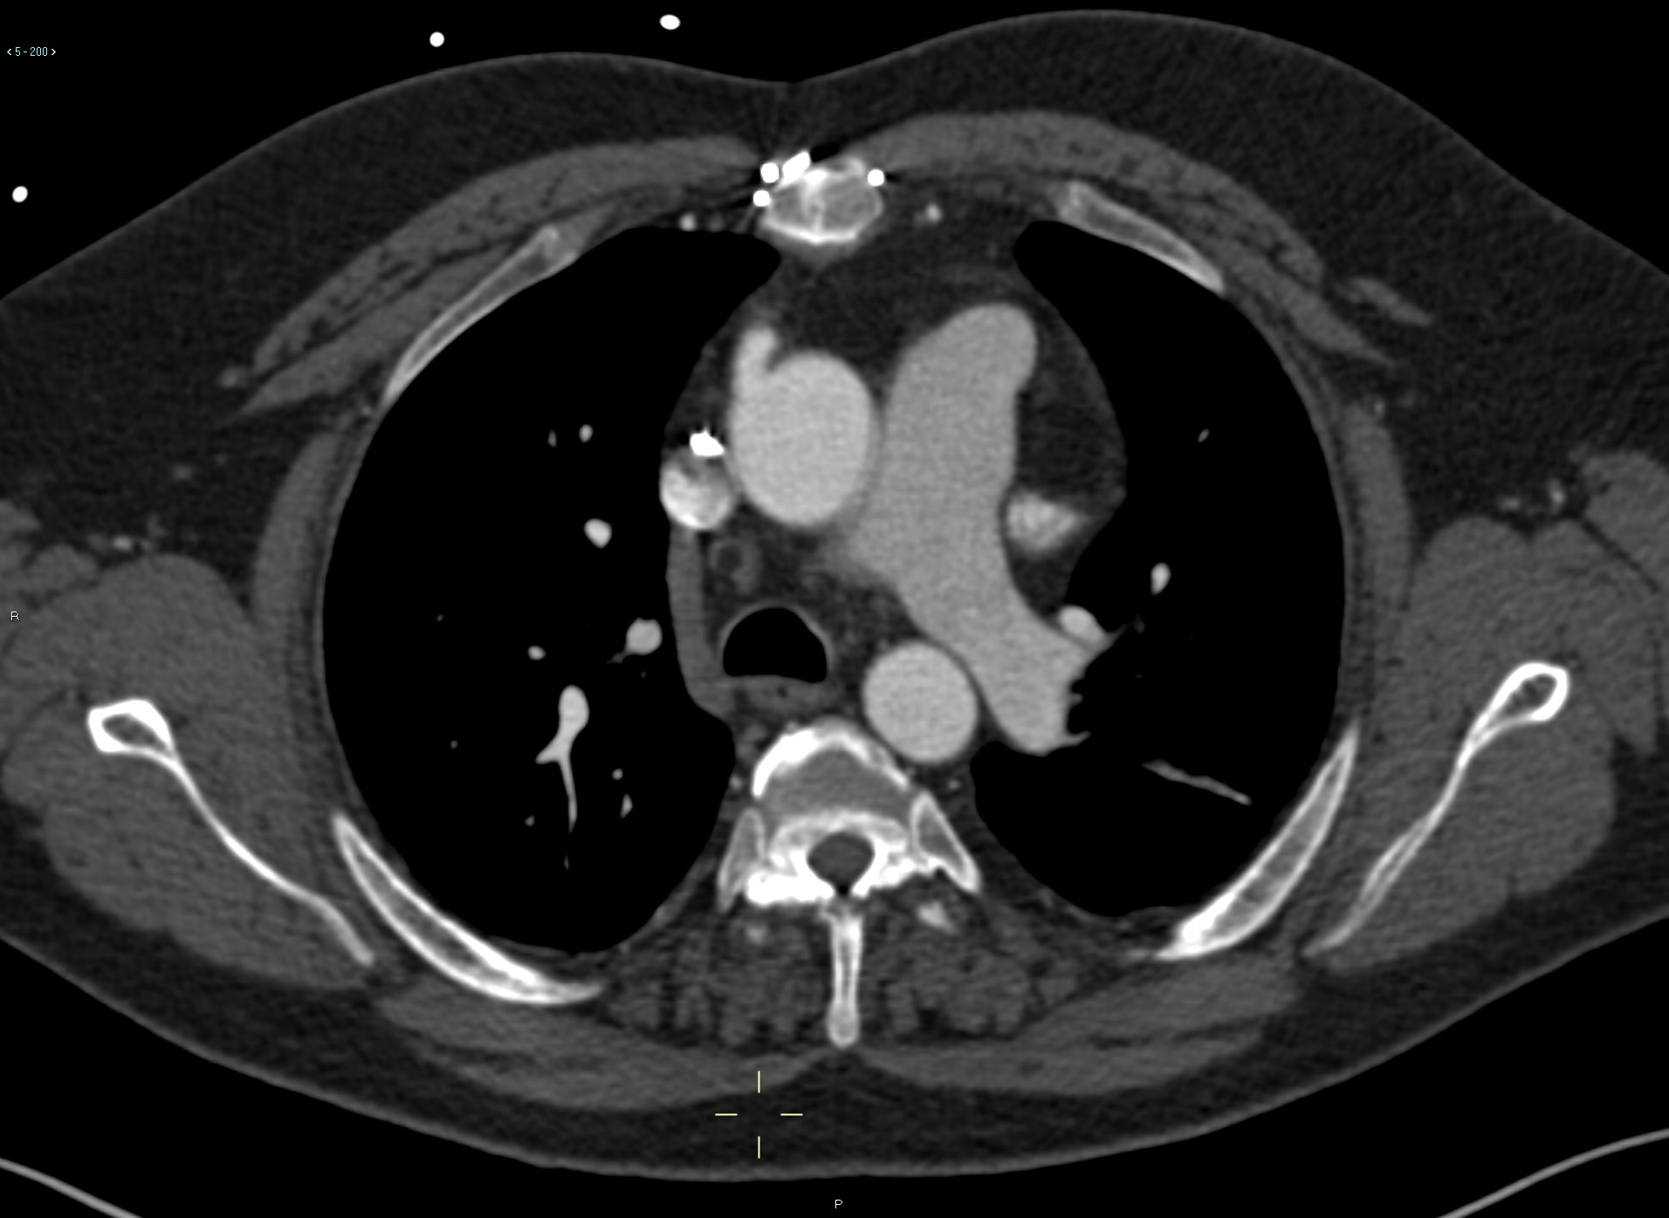

Slide 6
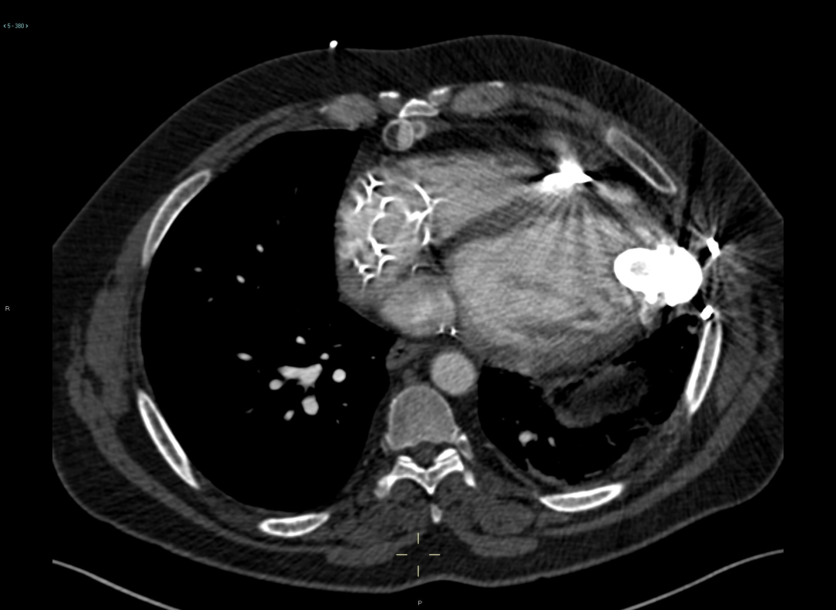

Slide 7
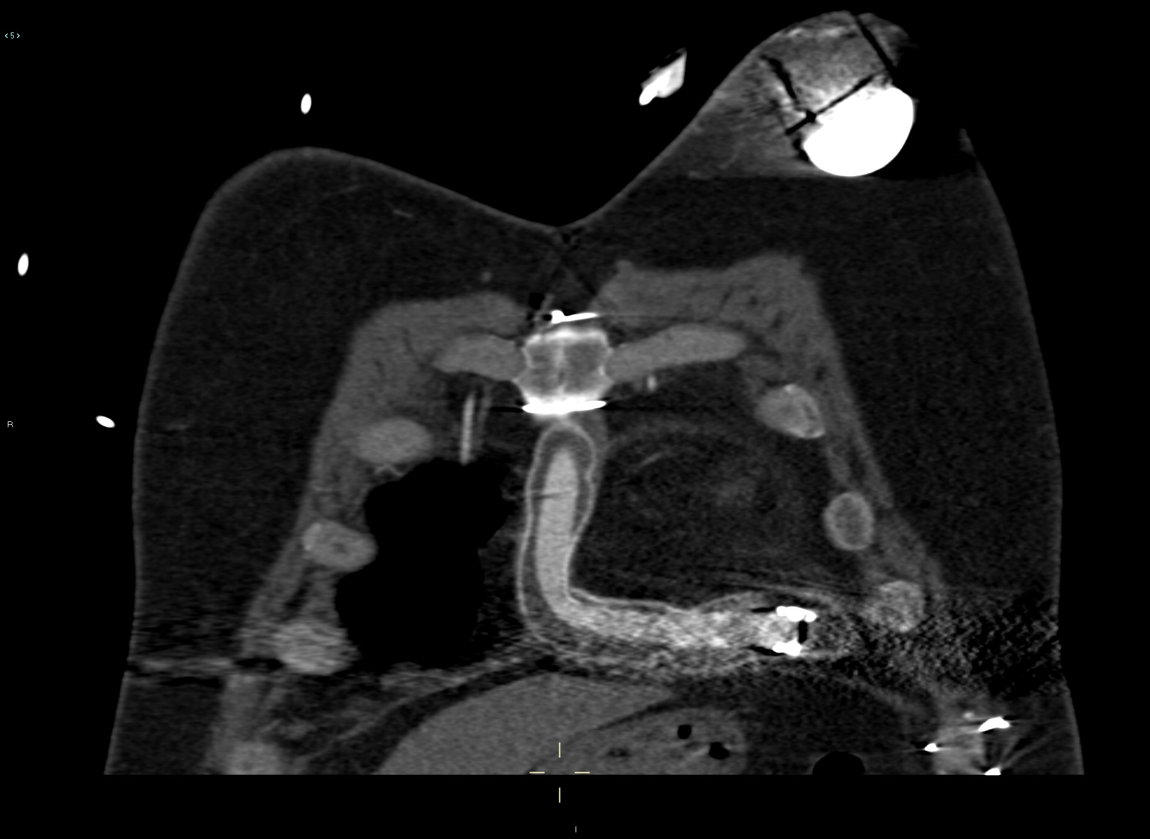

Slide 8
LVAD Outflow Graft Stenosis
Multidisciplinary Meeting
-Cardiothoracic Surgery
-Interventional Radiology
-Heart Failure
LVAD exchange with CT surgery
Thoracotomy/open surgery
High morbidity
Second LVAD exchange in < 2 years
Endovascular Approach
Lower morbidity
Familiarity with approach
No thrombus seen on CT

Slide 11
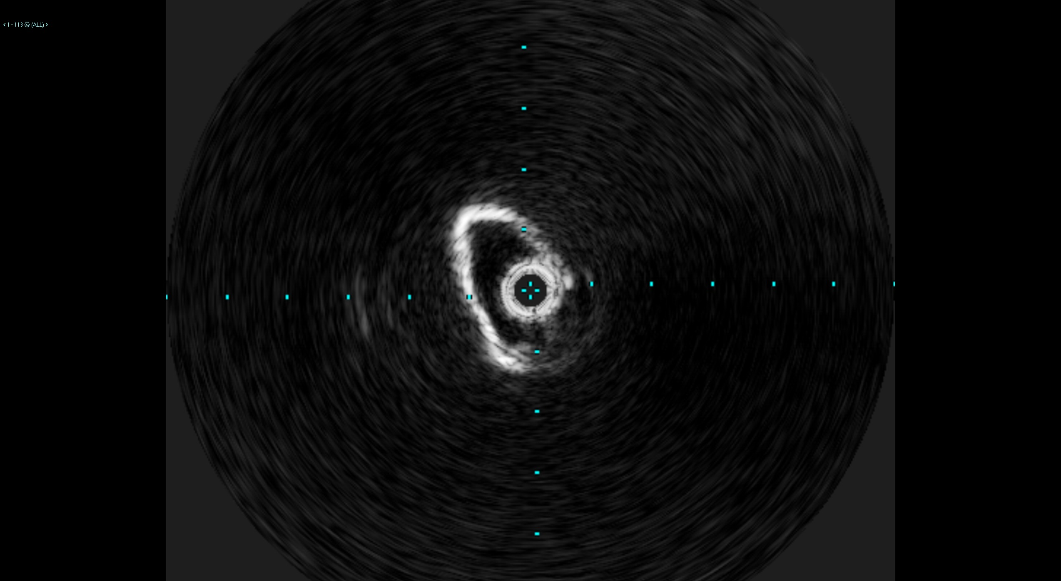

Slide 14
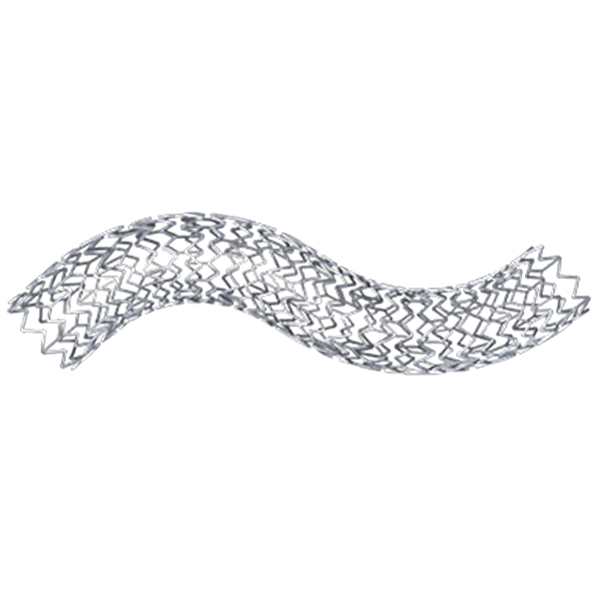
LVAD Outflow Graft Stenosis
Balloon Expandable Bare Metal Stent
No thrombus
Appropriate for kink
Covered Stent
Thrombus
Pseudoaneurysm
Hematoma

Slide 15
LVAD Outflow Graft Stenosis
Balloon Expandable Stents in areas of stenosis
10 mm x 37 mm Boston Scientific (proximal stenosis)
10 mm x 37 mm Visi-Pro Balloon (distal stenosis)
LVAD motor RPM decreased during ballooning
LVAD RPM’s returned to normal following stent placement

Slide 19
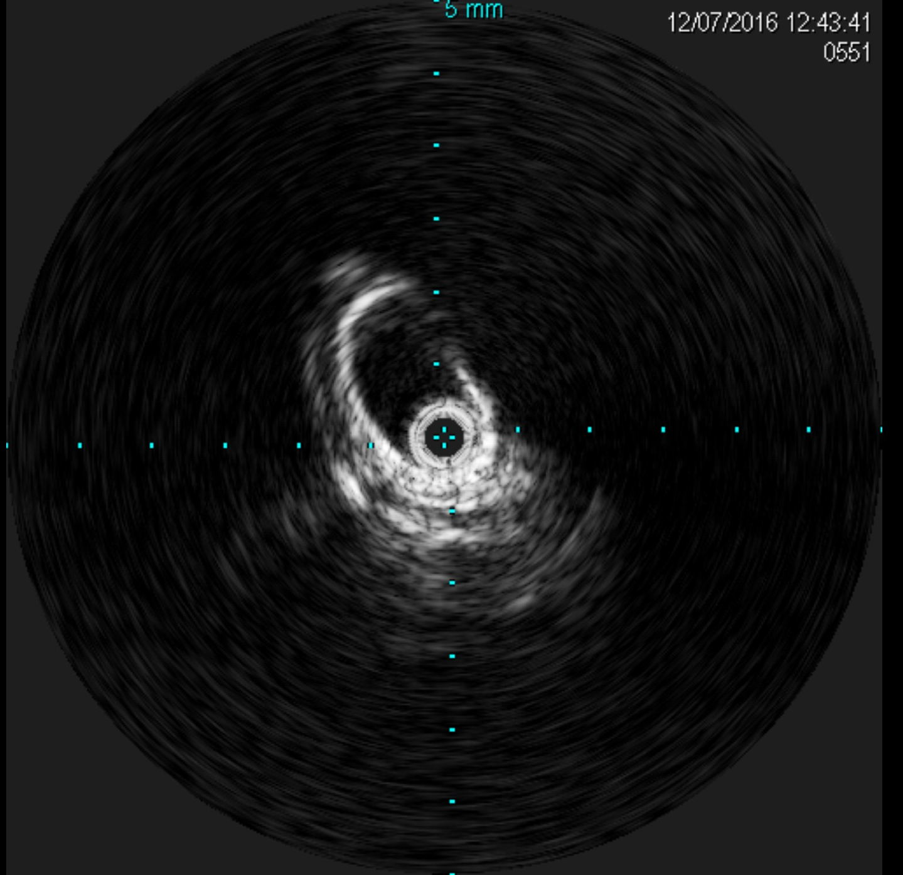

Slide 21
Post Procedural
LVAD flow
Improved to 4.9 L/min from 1.9 L/min prior to procedure
Pulsatility
BP waveform demonstrated pulsatility prior to procedure indicating LV participation
Monophasic, suggests offloading of left ventricle by LVAD
Discharged POD 4
LVAD flows 5-6 L/min by time of DC

Slide 22
Post Procedure
Outpatient F/U 1 month post op
Improved energy
Mild dyspnea on exertion, otherwise minimal heart failure symptoms
One dose of torsemide due to dietary indiscretion
Improved flow (one low flow alarm)
No hospitalizations
UNOS 1A for heart transplant

Slide 23
Literature Review

Slide 24
Literature Review

Slide 25
Acknowledgements
Neil Halin, DO
Tufts Medical Center, Cardiovascular and Interventional Radiology
Tufts Medical Center, Department of Radiology

Slide 26
References
Pham, D.T., Kapur, N.K., Dermody, M, Halin, N. (2015). Stenting of an outflow graft obstruction after implantation of a continuous-flow, axial-flow left ventricular assist device. The Journal of Thoracic and Cardiovascular Surgery, 150, e11-12
Ganapathi, A., Andersen, N., Prastein, D., Hashmi, Z., Rogers, J., Milano, C., McCann, R., Hughes, G.C. (2013) Endovascular Stent Grafting of a Left Ventricular Assist Device Outflow Graft Pseudoaneurysm. Circ Heart Fail, 6, e16-e18
Hanke, J., ElSherbini, A., Rojas, S., Avsar, M., Shrestha, M., Schmitto, J. (2016) Letters to the Editor: Aortic Outflow Graft Stenting in Patient with Left Ventricular Assist Device Outflow Graft Thrombosis. Artificial Organs, 40(4): 414-418
Ahmad, F., Sauer, A., Ricciardi, M. (2016) Endovascular Repair of Ventricular Assist Device Outflow Cannula Stenosis. Catheterization and Cardiovascular Interventions. Published online 10/12/2016
El Sabbagh, A. Al-Hijji, M. Gulati, R., Charanjit, S., Pollak, P., Behfar, Atta. Percutaneous Stenting of a Left Ventricular Assist Device Outflow Kink. (2016) Cardiovascular Interventions. 9(24): e229-e231
Abraham, J., Remick, J., Caulfield, T., Puhlman, M., Evenson, K., Ott, G., Kirker, E. (2014) Left Ventricular Assist Device Outflow Cannula Obstruction Treated with Percutaneous Endovascular Stenting. Circ Heart Fail, 8, 229-230

