Slide 1
Case report : Percutaneous Embolization of a Congenital Aortocaval Fistula with Coils.
Dr. Murali Surnedi (IR fellow)
Dr. Ahmad Alomari MD Msc FSIR.
Chief of IR
Boston Children’s Hospital

Slide 2
7-month-old boy with bruit over the right upper abdomen.
Limited echo: normal.
MRI: Large communication from upper aorta/celiac axis to the upper IVC.
Referred to Vascular Anomalies Center at BCH.
Closure recommended.

Slide 3
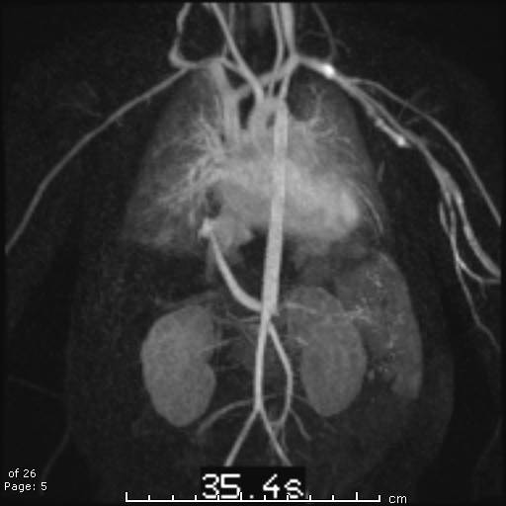
Enlarged artery arising from the anterior aspect of the upper abdominal aorta at the level of the celiac artery and runs between upper IVC.
Tapering of aorta distal to vessel.
This artery runs posterior to the upper IVC and connects directly to the IVC.
The course of the artery could be that of a markedly dilated right inferior phrenic artery.
Notes:
Enlarged artery arising from the anterior aspect of the upper abdominal aorta at the level of the celiac artery and runs between the upper abdominal aorta and the intrahepatic IVC. This artery runs posterior to the upper IVC and connects directly to the upper IVC.
Started with right groin access with 3 Fr Bernstein without sheath. Aortogram was performed.

Slide 4
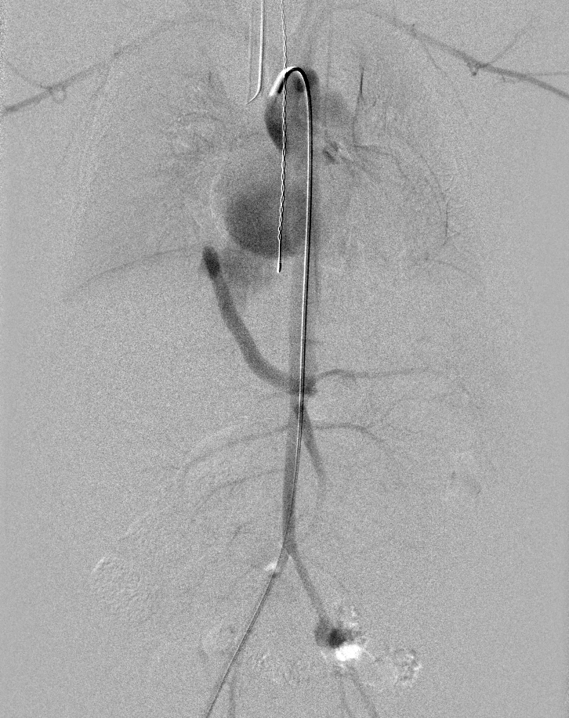
Right groin access with 3 Fr Bernstein without sheath.
5 mm vessel from upper aorta to upper IVC.
Tapering of aorta: 8 mm proximal to the fistula and 4-5 mm distal.
Notes:
Started with right groin access with 3 Fr Bernstein without sheath. Aortogram was performed.

Slide 5
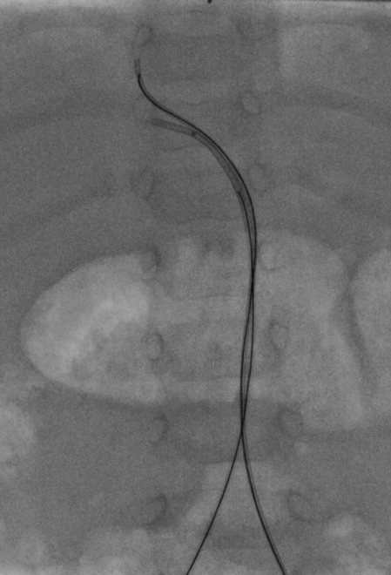
Unsuccessful attempt to deploy 12 mm x 20 cm 0.018” Interlock coil.
Femoral access upsized to short 4 Fr Kumpe with STC renegade microcatheter was also unsuccessful; due to brisk flow within the fistula.
Left femoral access with 3 Fr Bernstein (without sheath) : 8 mm x 20 cm interlock coil was partially deployed in the superior aspect of the artery
2
12 mm x 20 cm coil was successfully deployed via right access.
Notes:
Tried to coil a 12 mm x 20 cm; 0.018” IDC- unsuccessful attempt. Then Upsized to 4 fr Kumpe and renegade microcatheter - still cannot coil due to brisk flow within the fistula.

Slide 6
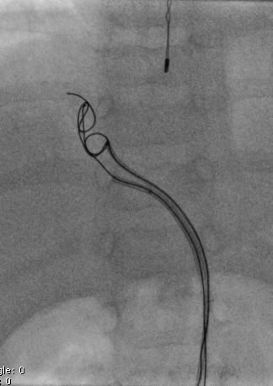
Attempt to fully deploy the partially deployed coil via left access was unsuccessful due to disconnection between the coil and the pusher mandrill (failure of locking mechanism).
Notes:
Tried to coil a 12 mm x 20 cm; 0.018” IDC- unsuccessful attempt. Then Upsized to 4 fr Kumpe and renegade microcatheter - still cannot coil due to brisk flow within the fistula.
Left groin access with 3 Fr Bernstein (without sheath) was introduced into aorta and advanced into the fistula. 8 mm x 20 cm interlock coil was partially deployed in the superior aspect of the fistula; 12 mm x 20 cm coil was successfully deployed.
Attempt to fully deploy the partially deployed coil was unsuccessful due to disconnection between the coil and the pusher mandril (failure of locking mechanism).

Slide 7
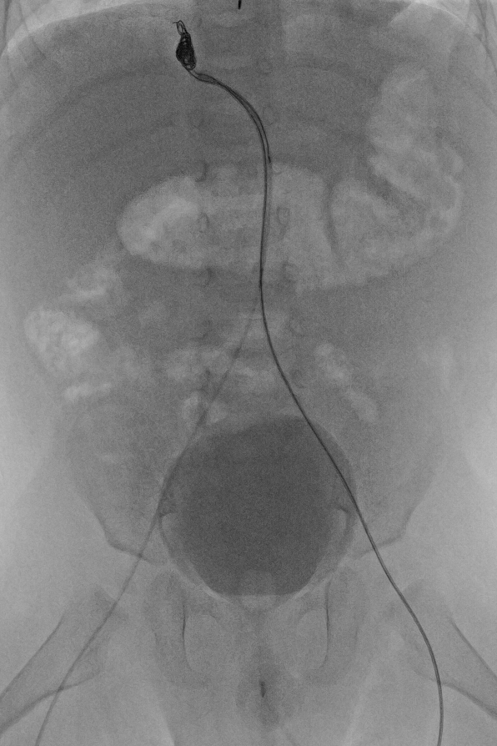
3 French Bernstein catheter was cut at its exit in the groin but we were unable to retrieve the coil which started to unravel into a thinner wire.
The catheter was removed and exchanged for a 20-gauge Angiocath catheter to reduce the access profile.
Notes:
3 French Bernstein catheter was cut at its exit in the groin but we were unable to retrieve the coil which started to unravel into a thinner wire. The catheter was removed and exchanged for a 20-gauge Angiocath catheter to reduce the access profile.

Slide 8
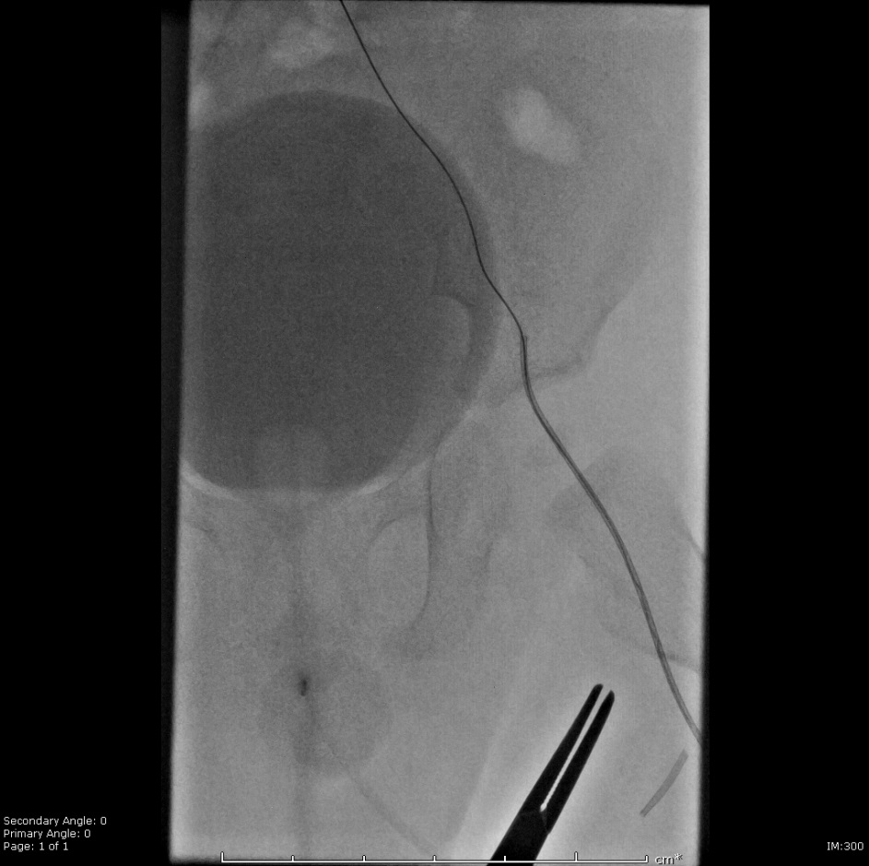
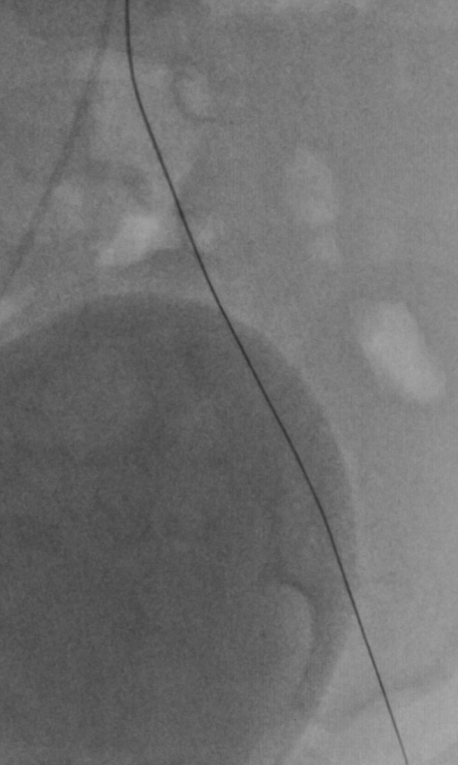
IV heparin (50 u/kg).
Eventually with very gentle and slow retraction of the elongated coil, the partially deployed coil was completely removed through the 20-gauge Angiocath catheter.
Notes:
Intravenous heparin (50 units per kilogram) was administered. Eventually with very gentle and slow retraction of the elongated coil, the failed 8 mm x 20 cm coil was completely removed through the 20-gauge Angiocath.

Slide 9
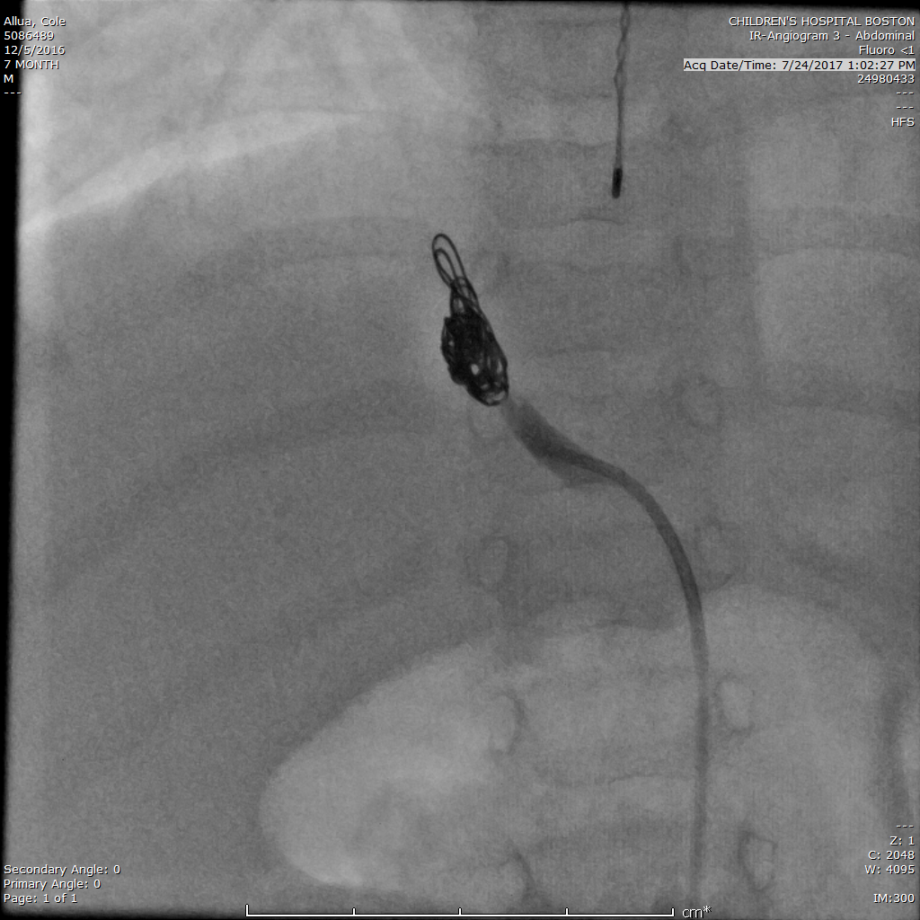
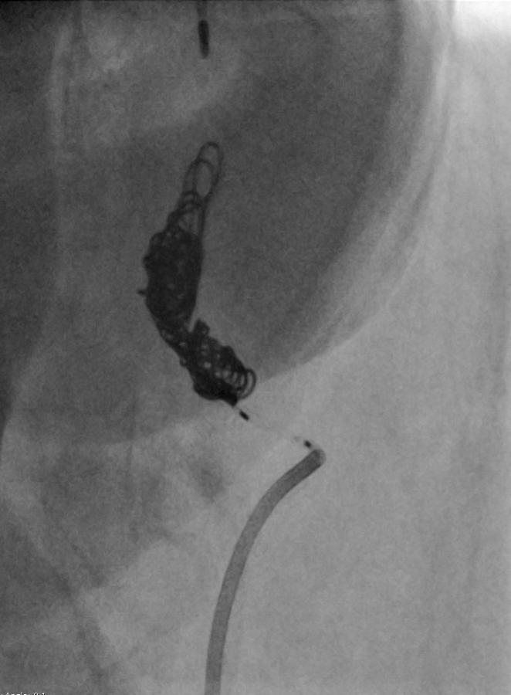
10mm x 20 cm and 6 mm x 20 cm (x3) Interlock coils were deployed
Aortogram.
Notes:
Next, a 10mm x 20 cm and 6 mm x 20 cm (x3) interlock coils were deployed in the abnormal artery using the right groin access. Contrast was injected through the existing 4 French Kumpe in the arterio-caval fistula and postembolization angiogram of this artery was performed. This showed complete occlusion of the fistula without residual flow.

Slide 10
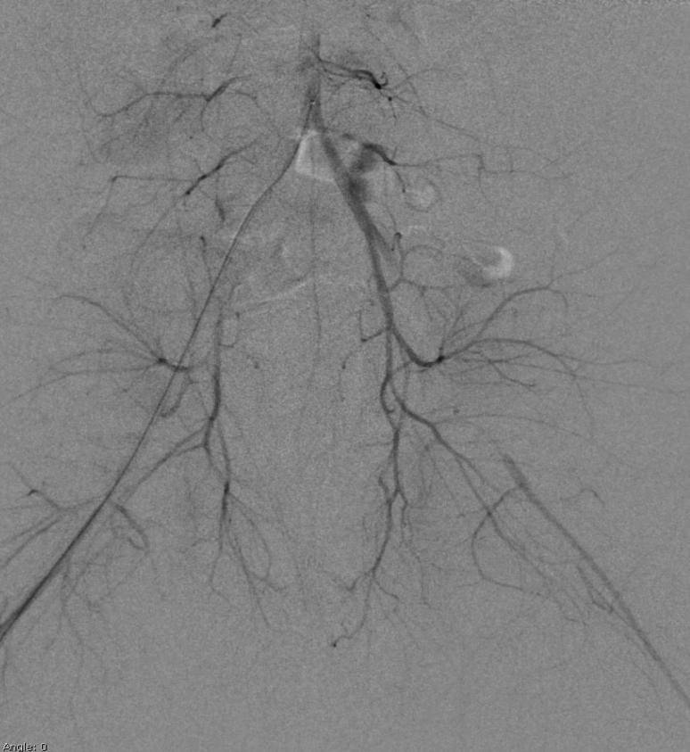
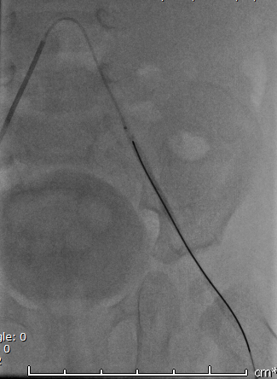
The Renegade microcatheter/Kumpe catheter combo was retracted into the lower abdominal aorta.
Angiography: Missing left external iliac artery.
Selective angiography after saline flushing of common iliac artery: Restoration of flow with narrowing of access segment- expected finding.
Discharged next day home.
Notes:
Under fluoroscopy, the left common iliac artery was cannulated through the right femoral access by advancing the renegade microcatheter over 016 guidewire. Angiography of the left pelvis and left lower extremity was performed. Next, the renegade catheter was removed. 4 French Kumpe catheter was advanced to the proximal descending aorta. Contrast was injected and angiogram was performed

Slide 11
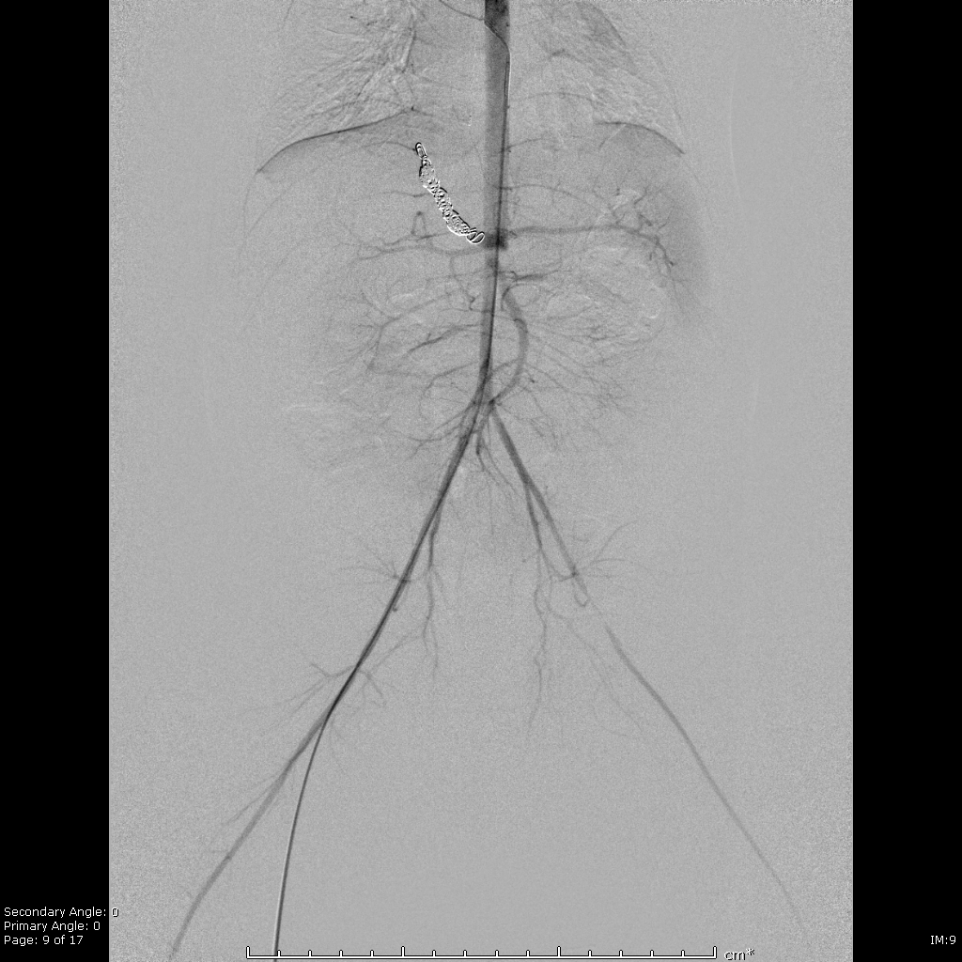
Notes:
Admitted overnight for observation. Discharged next day home.

Slide 12
Intention was to minimize access in a small infant.
3 Fr 0.025” Bernstein catheter.
The Interlock-18 fibered IDC coils are designed to be delivered through an 0.021" ID
Notes:
The American Journal of Gastroenterology (2002) 97, 1896–1900; doi:10.1111/j.1572-0241.2002.05911.x
24 newborns
Outer diameter 3 F: 1 mm, 4 Fr 1.35 mm, 4 Fr sheath 2 mm

Slide 13
Recommendations
Avoid using 0.018” IDC coils via larger catheters.
Other options:
Amplatzer plug – Two case reports; 73 year old man s/p AAA repair developed Aortocaval fistula and 3 year old girl with congenital Aortocaval fistula.
Penumbra coils.
Transjugular access.
Trancatheter closure of Aortocaval Fistula with the Amplatzer Duct Occluder. J Endovasc Ther 2005;12:134-137

Slide 14
Other options:
AMPLATZER Vascular Plugs:
AMPLATZER Vascular Plug: 4-16 mm, 4-6 Fr Sheath
AMPLATZER Vascular Plug II: 3-22 mm, 4-7 Fr Sheath
AMPLATZER Vascular Plug III: 4-14 mm, 4-7 Fr Sheath
AMPLATZER Vascular Plug 4: 4-8 mm, 0.038” cath
Penumbra coils.
Transjugular access.

Slide 15
Aorto-caval fistulas are uncommon but are associated with
AAA rupture,
Aortitis,
Marfan syndrome,
congenital myxedema or penetrating abdominal trauma.
Complications:
Left to right shunting
Congestive heart failure.
Pulmonary Hypertension.
Erosion or rupture of aorta into the vena cava causes sudden onset of abdominal pain, shortness of breath and high output cardiac failure.
Unusual fistulas and connections in the cardiovascular system: A pictorial review. World J Radiol: 2014May28;6[5]:169-176.
Aortocaval Fistula. 2006 by the American College of Surgeons. Elsevier Inc.
Percutaneous embolization of a congenital Aortocaval fistula - clinical case. Rev Port Cardiol 2003;22[9]:1101-1106.
Trancatheter closure of Aortocaval Fistula with the Amplatzer Duct Occluder. J Endovasc Ther 2005;12:134-137.

