Slide 1
New England Society of Interventional Radiology November 14, 2016
Case Presentation
Aaron L. Harman, MD and Chieh-Min Fan, MD
Interventional Radiology
Brigham and Women’s Hospital

Slide 2
Disclosures
None

Slide 3
Case
39F with history of familial pulmonary hypertension on epoprostenol, on transplant list, p/w hemoptysis estimated at 300-500 mL
At current presentation, hypotensive and hypoxic
Prior episode of hemoptysis 1.5 months prior treated with bronchial artery embolization
Notes:
prior embolization with 2 vials of 500 micron Embozene microspheres

Slide 4
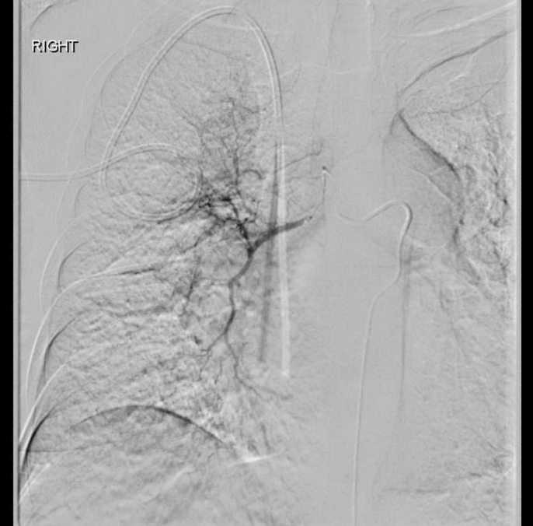
Case
39F with history of familial pulmonary hypertension on epoprostenol, on transplant list, p/w hemoptysis estimated at 300-500 mL
At current presentation, hypotensive and hypoxic
Prior episode of hemoptysis 1.5 months prior treated with bronchial artery embolization
Notes:
prior embolization with 2 vials of 500 micron Embozene microspheres

Slide 6
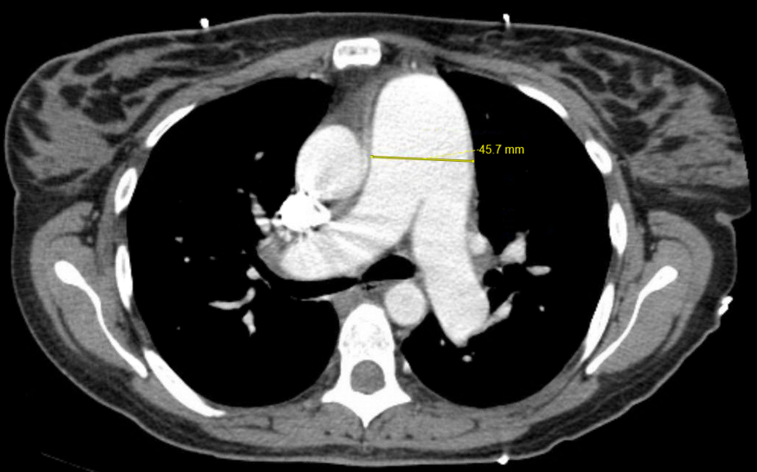

Slide 8
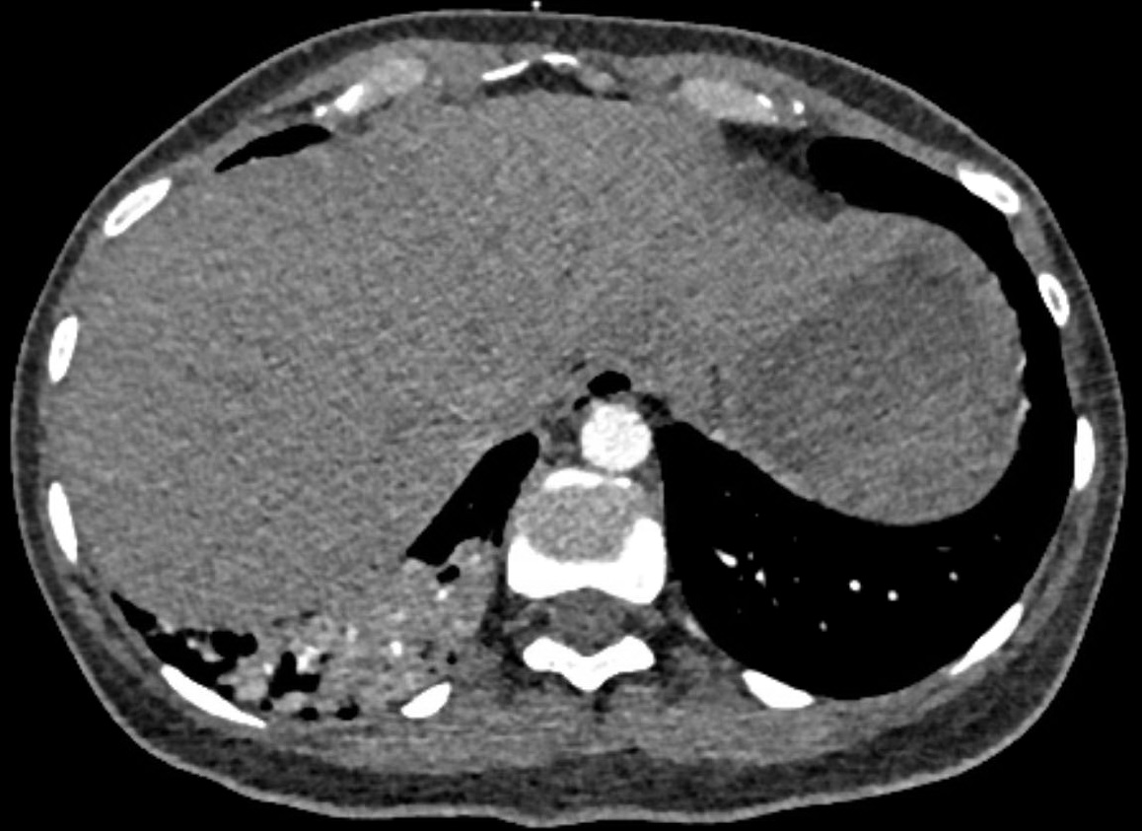
1.5 months prior
Notes:
A month and a half earlier it wasn’t there

Slide 9
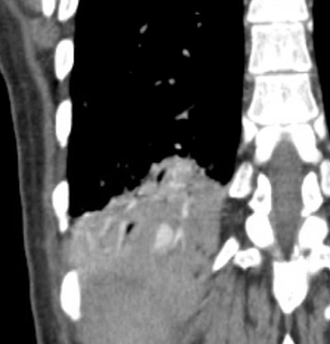
Coronal

Slide 10
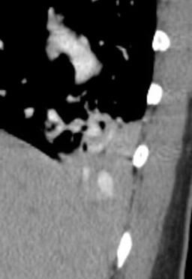
Coronal
Sagittal

Slide 11
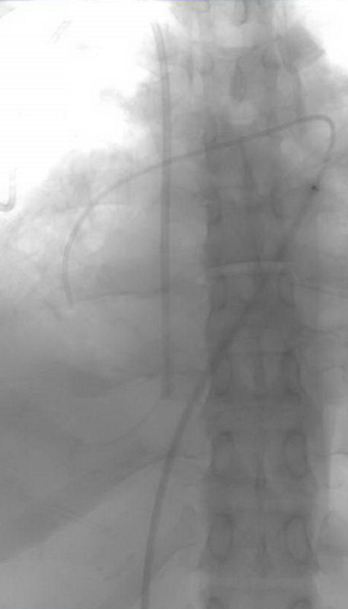
Attempt #1
Systemic BP 90s/50s
Main PA systolic and diastolic pressures measured at 130s and 50s respectively.
Notes:
Above PA systolic of 100 mm Hg or MAP of 60 mm Hg, be cautious

Slide 12
Attempt #1
Systemic BP 90s/50s
Main PA systolic and diastolic pressures measured at 130s and 50s respectively.
Is this normal?
Notes:
Why you won’t see a big 30 for 60 injection in the main PA (because it would increase the afterload of the right heart too much)

Slide 13
Attempt #1
Systemic BP 90s/50s
Main PA systolic and diastolic pressures measured at 130s and 50s respectively.
Is this normal? NO.

Slide 14
Attempt #1
Systemic BP 90s/50s
Main PA systolic and diastolic pressures measured at 130s and 50s respectively.
Which is the normal PA systolic pressure range?
A) 2-6 mm Hg
B) 15-30 mm Hg
C) 60-90 mm Hg
D) 90-140 mm Hg
Notes:
A) Right atrial pressure, C) DBP, D) SBP

Slide 15
Attempt #1
Systemic BP 90s/50s
Main PA systolic and diastolic pressures measured at 130s and 50s respectively.
Which is the normal PA systolic pressure range?
A) 2-6 mm Hg
B) 15-30 mm Hg
C) 60-90 mm Hg
D) 90-140 mm Hg
Notes:
Right atrial pressure, C) DBP, D) SBP
Above PA systolic of 100 mm Hg or MAP of 60 mm Hg, be cautious

Slide 16
Attempt #1
Systemic BP 90s/50s
Main PA systolic and diastolic pressures measured at 130s and 50s respectively.
With even small hand injections of contrast, the SBP dropped into 80s despite pressors.
Therefore, the procedure was terminated.

Slide 17
Attempt #2
Notes:
The next day
R common fem vein, 7 Fr sheath, 5 Fr Grollman catheter used to select the right PA and exchanged for a 5 Fr Davis,

Slide 24
What’s
This?

Slide 33
Notes:
Four 0.018 2 mm x 4 cm tornado coils, gelfoam slurry

Slide 37
Case continued
Following the procedure, the patient clinically improved, decreased oxygen requirement.
The patient was discharged 6 days later.
2 months later presented with hemoptysis.

Slide 38
Sagittal
Notes:
7 Fr sheath, 5 Fr Davis, Renegade STC with Fathom microwire
PA pressures low- to mid-100s systolic and 80s diastolic
2 mm x 4 cm Tornado coil – nontarget into more lateral PA subsegmental branch
2:1 mixture of Trufill liquid glue and Ethiodol

Slide 39
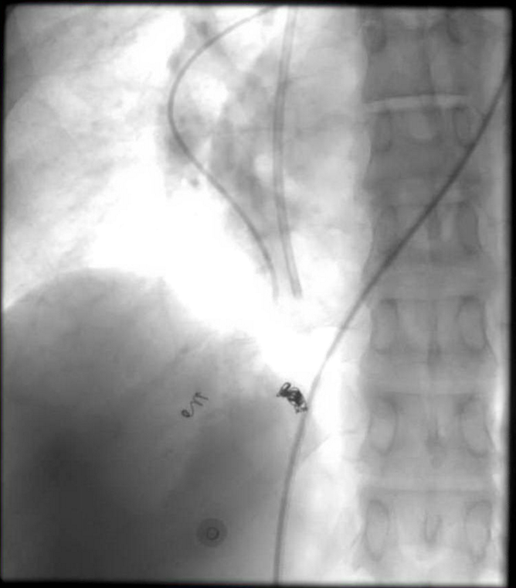

Slide 40
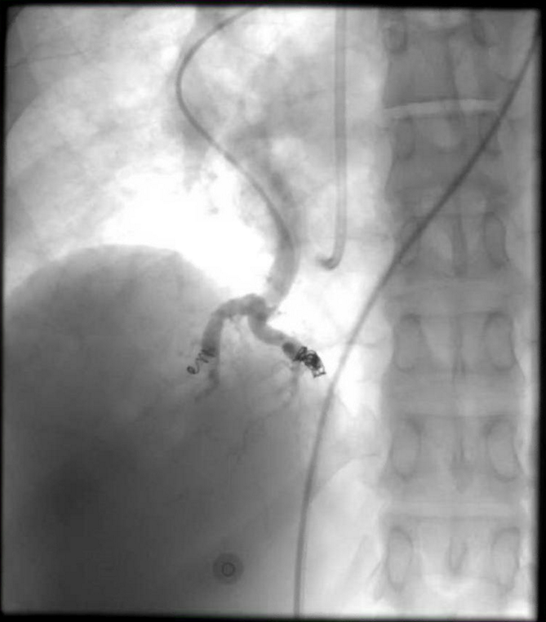

Slide 41
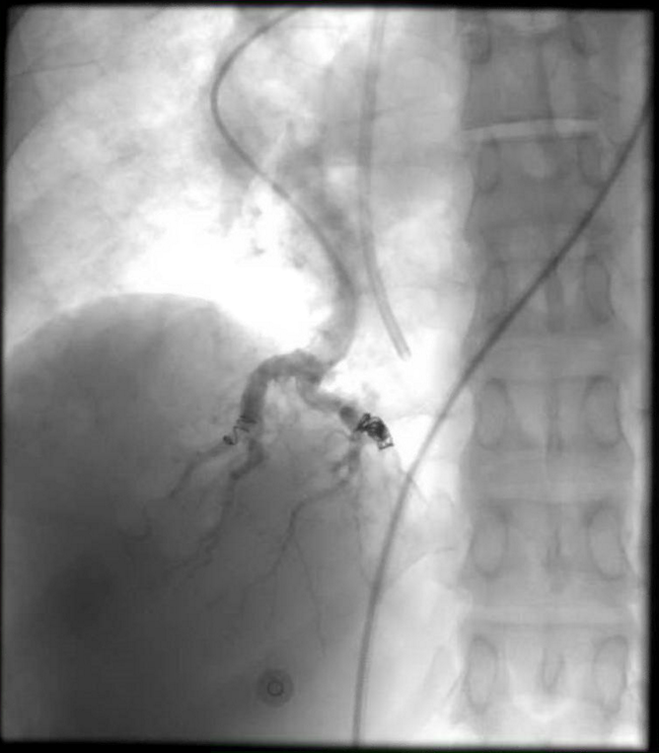

Slide 42
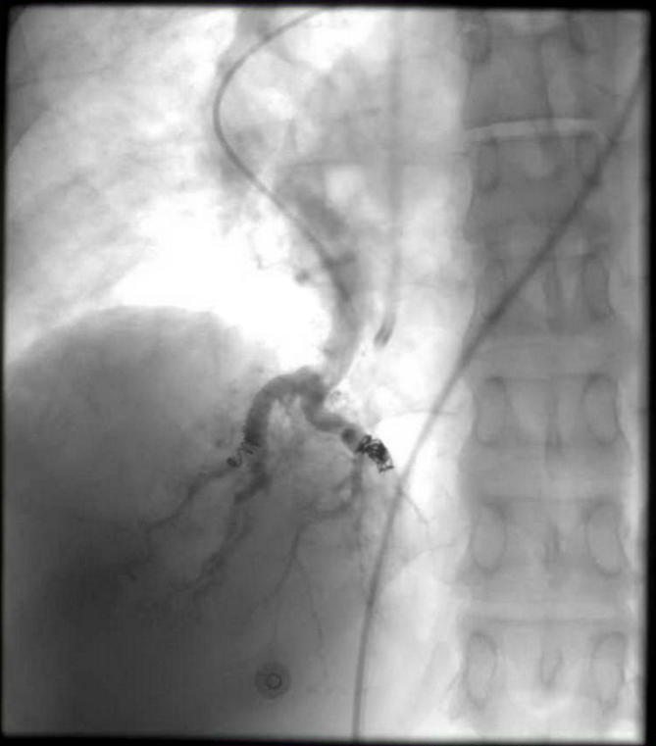

Slide 43
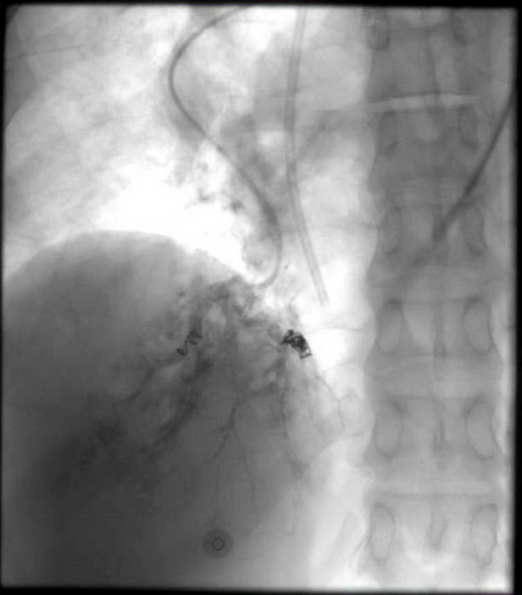

Slide 44
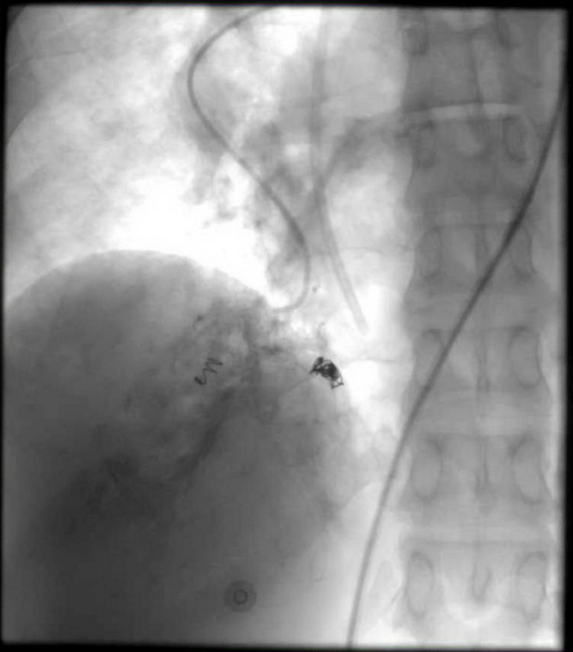

Slide 45
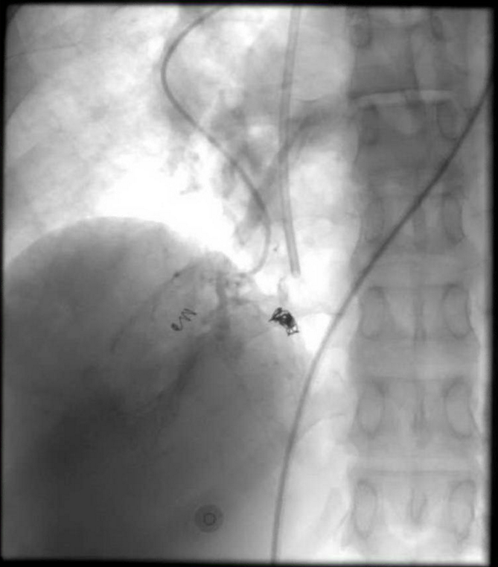

Slide 46
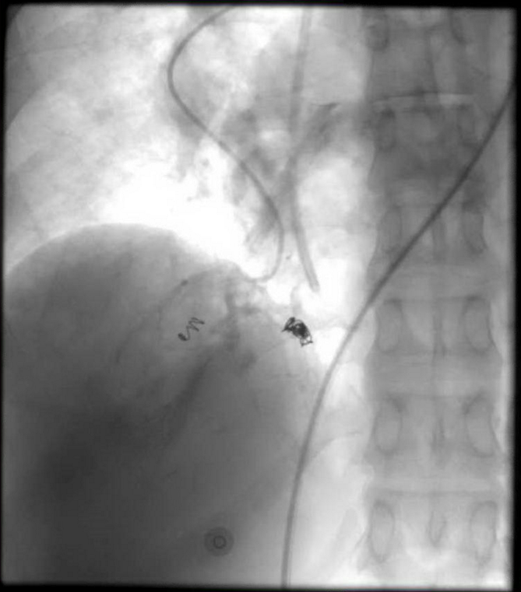

Slide 47
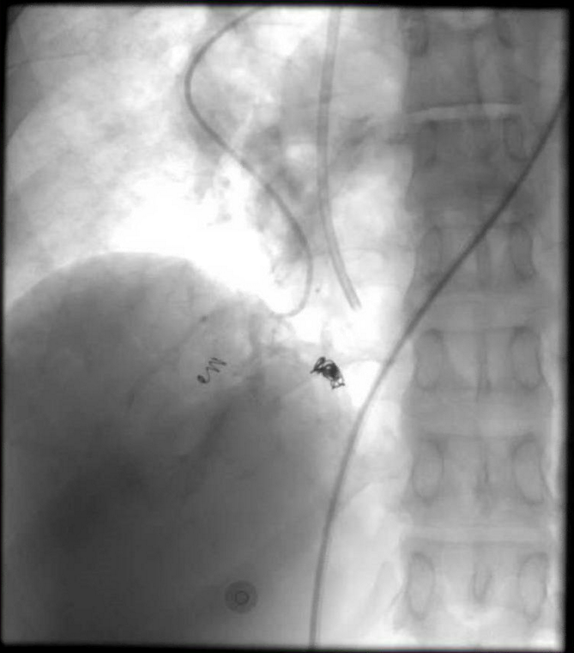

Slide 48
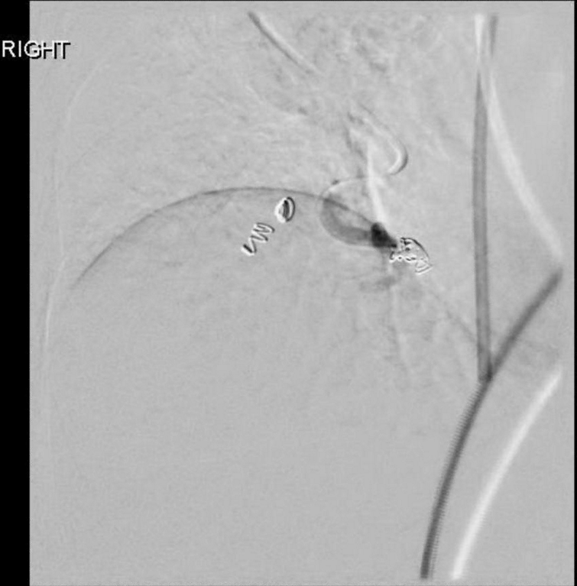
Notes:
2:1 mixture of Trufill liquid embolic glue with Ethiodol

Slide 49
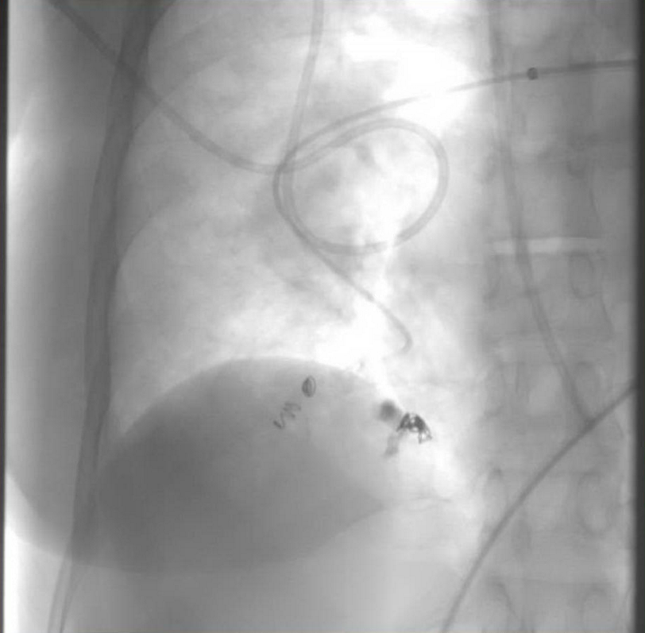

Slide 50
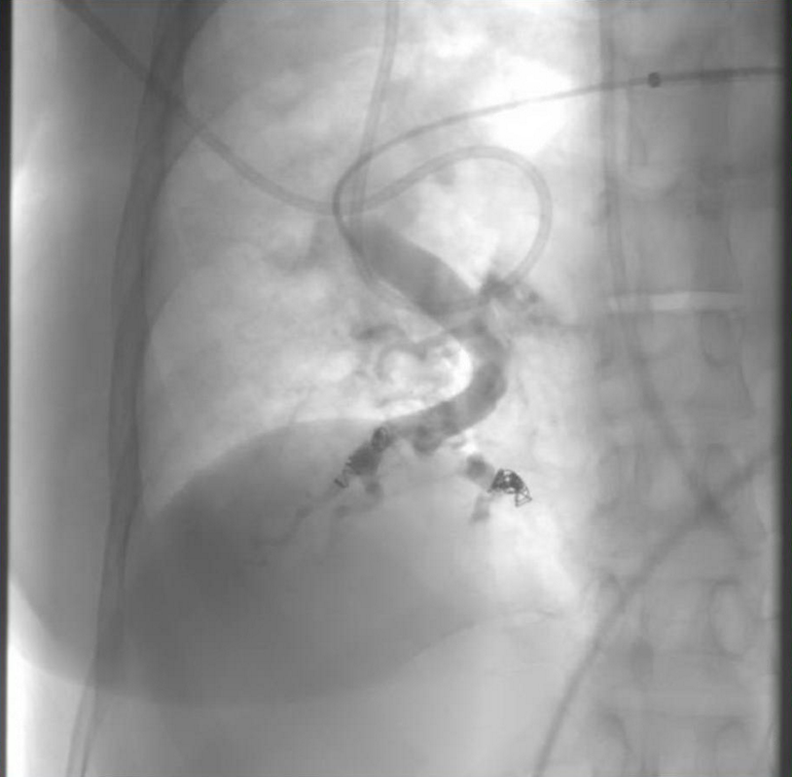

Slide 51
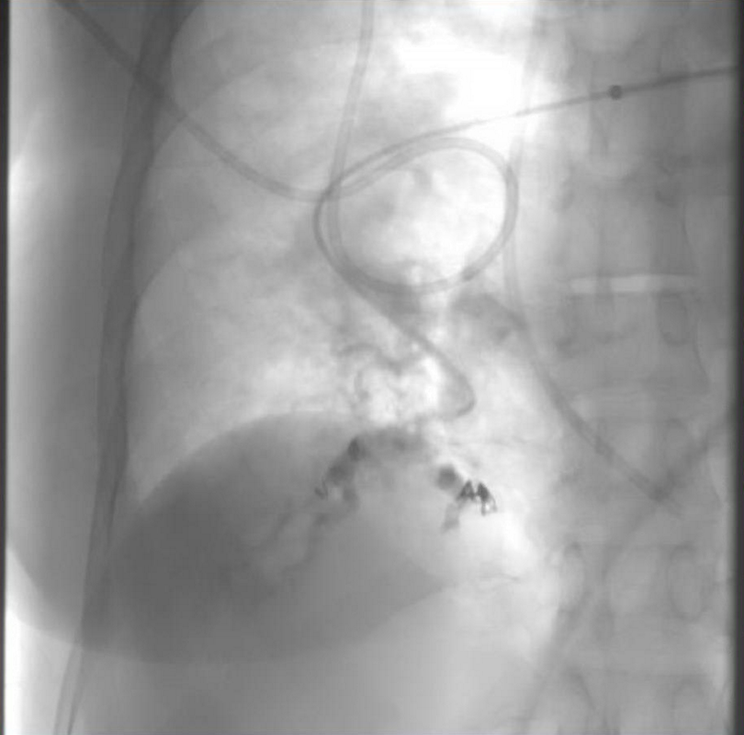

Slide 52
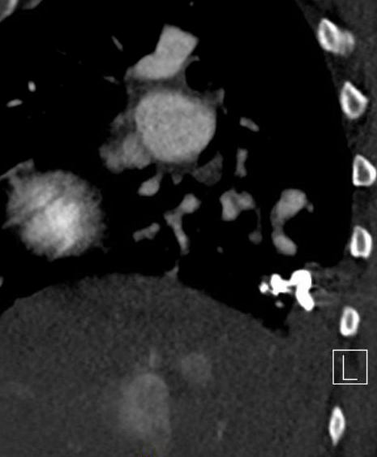
Post embolization
Following the procedure, the patient clinically improved, decreased oxygen requirement.
The patient was discharged 4 days later.
Sagittal
Notes:
7 Fr sheath, 5 Fr Davis, Renegade STC with Fathom microwire
PA pressures low- to mid-100s systolic and 80s diastolic
2 mm x 4 cm Tornado coil – nontarget into more lateral PA subsegmental branch
2:1 mixture of Trufill liquid glue and Ethiodol

Slide 53
Which of the following is the most likely diagnosis?
A) Pulmonary AVM
B) Pulmonary AVF
C) Pulmonary varix
D) Pulmonary aneurysm

Slide 54
Which of the following is the most likely diagnosis?
A) Pulmonary AVM
B) Pulmonary AVF
C) Pulmonary varix
D) Pulmonary aneurysm

Slide 55
Pulmonary Varix
Rare
M=F
May be congenital or acquired
Acquired associated with mitral valve disease, hereditary hemorrhagic telangiectasia, or chronic pulmonary hypertension
Usually asymptomatic
May present with hemoptysis or thromboembolic disease
Diego VP et al. Learning from the pulmonary veins. Radiographics 2013; 33:999-1022.

Slide 56
Angiographic findings
1) Pulmonary artery normal in arterial phase
2) No pulmonary arteriovenous shunt
3) A blood vessel flowed directly from the varix to the left atrium
4) Contrast remained in the varix, compared to retention in normal pulmonary vein
5) Peripheral region of the dilated, tortuous vein was normal
Bartram C, Strickland B. Pulmonary varices. Br J Radiol 1971; 44:927-35.

Slide 57
Thank you

