Slide 1
NESIR Case Presentation 5/8/17

Slide 2
74 y.o. male with a large left lobe HCC involving Segment II,III, and IV also with left portal vein thrombosis. Biopsy confirmed at OSH as moderately differentiated HCC. BCLC stage C tumor. Child-Pugh A with an ECOG PS of 0. Patient presented to MGH for consideration of radioembolization. Patient did not desire chemotherapy due to significant side-effects

Slide 3
Pre-presentation MRI

Slide 4
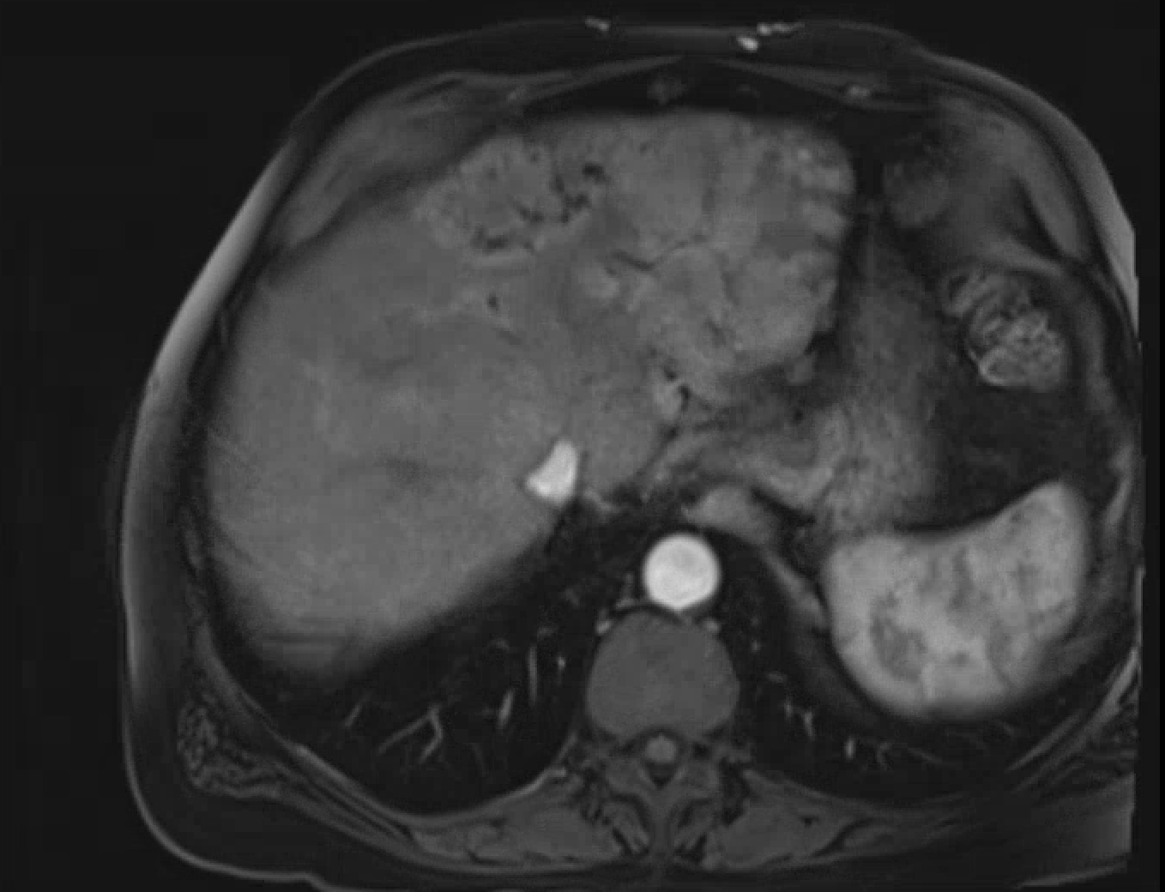

Slide 5
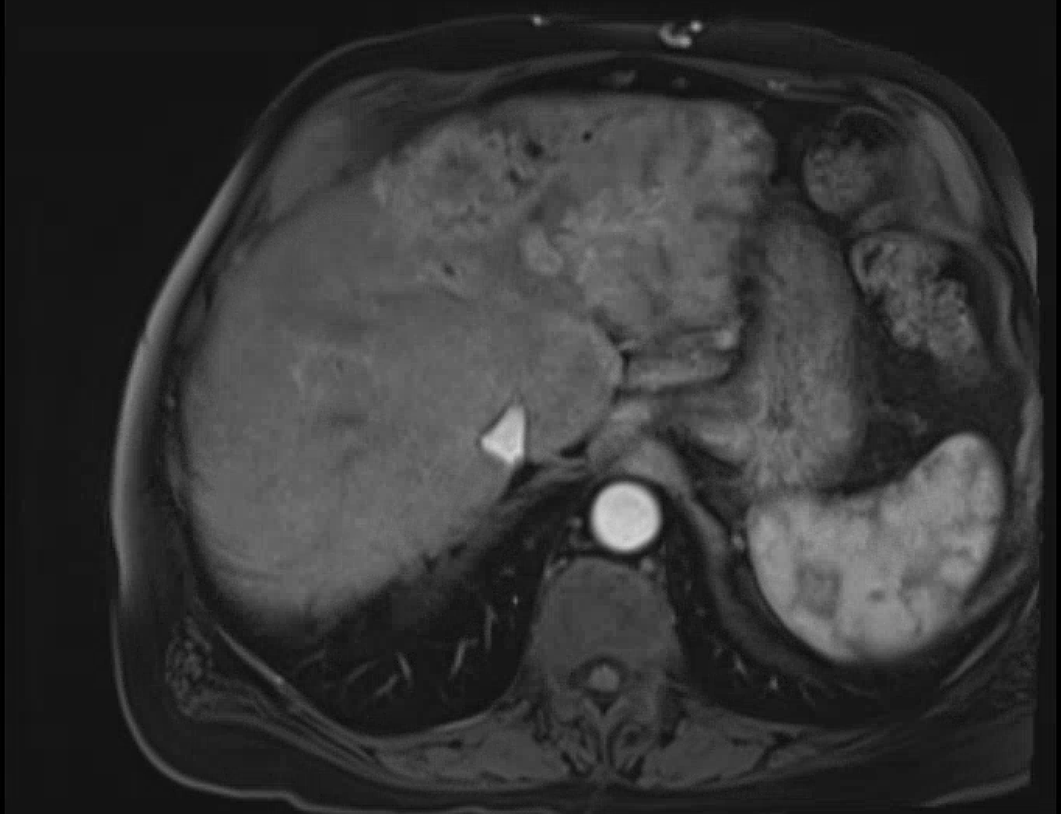

Slide 6
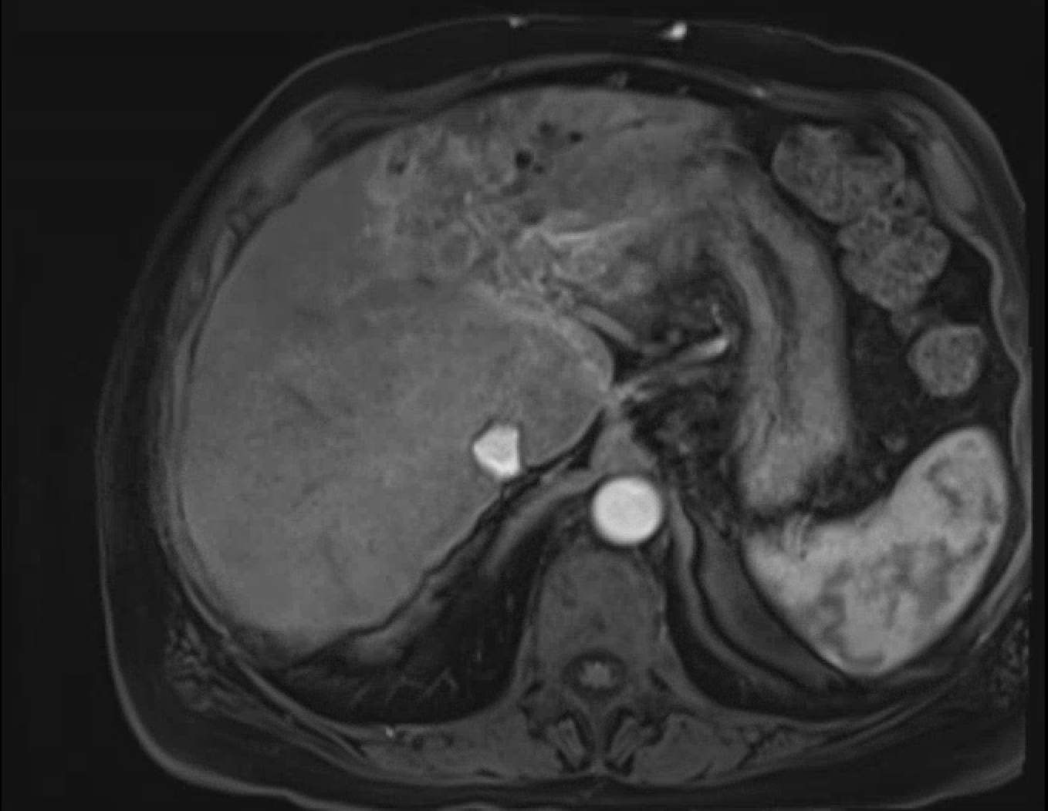

Slide 7
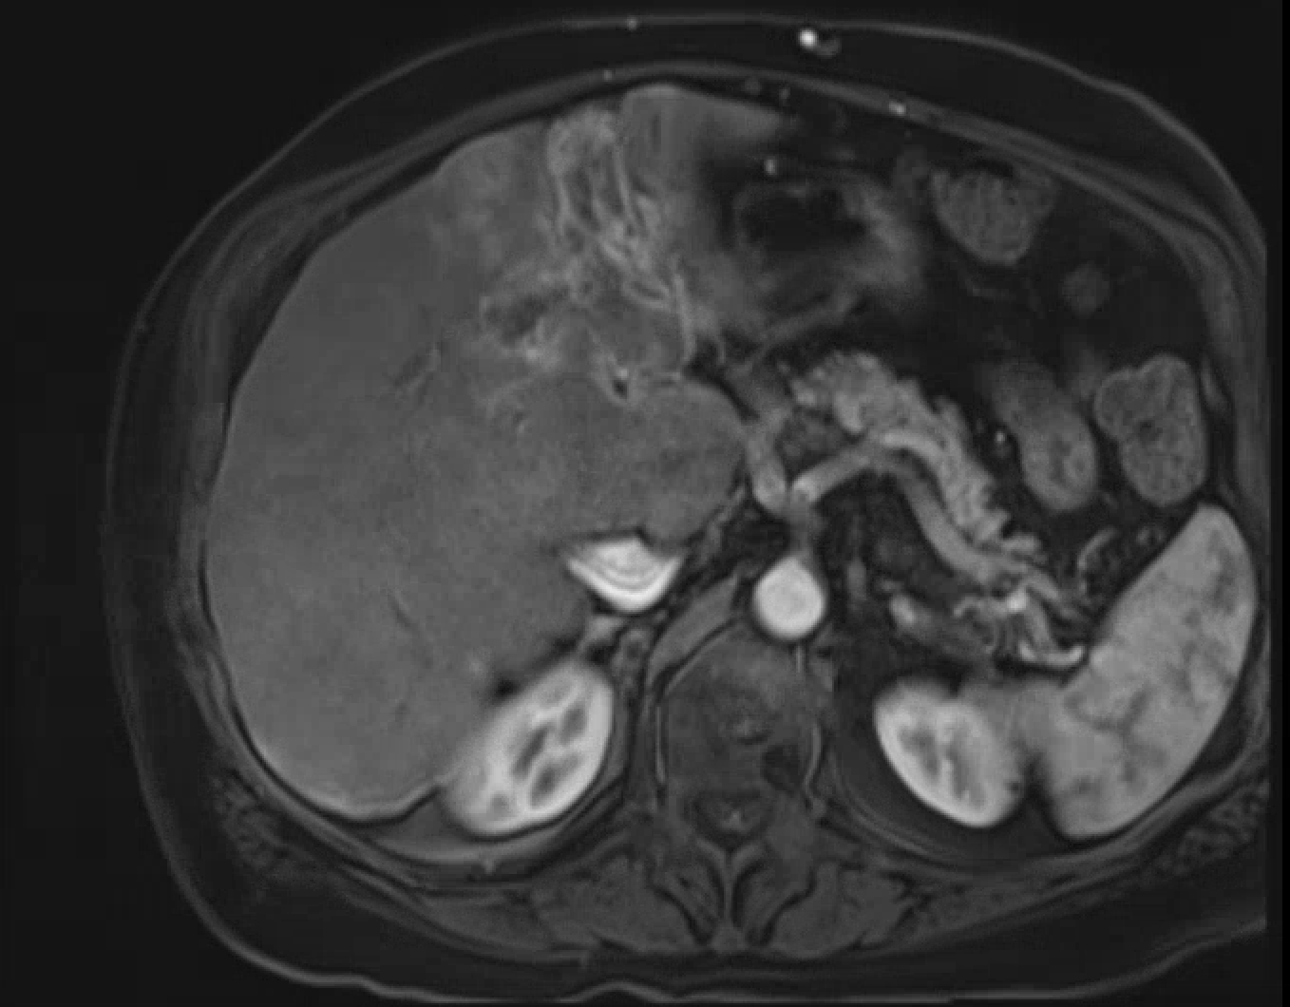

Slide 8
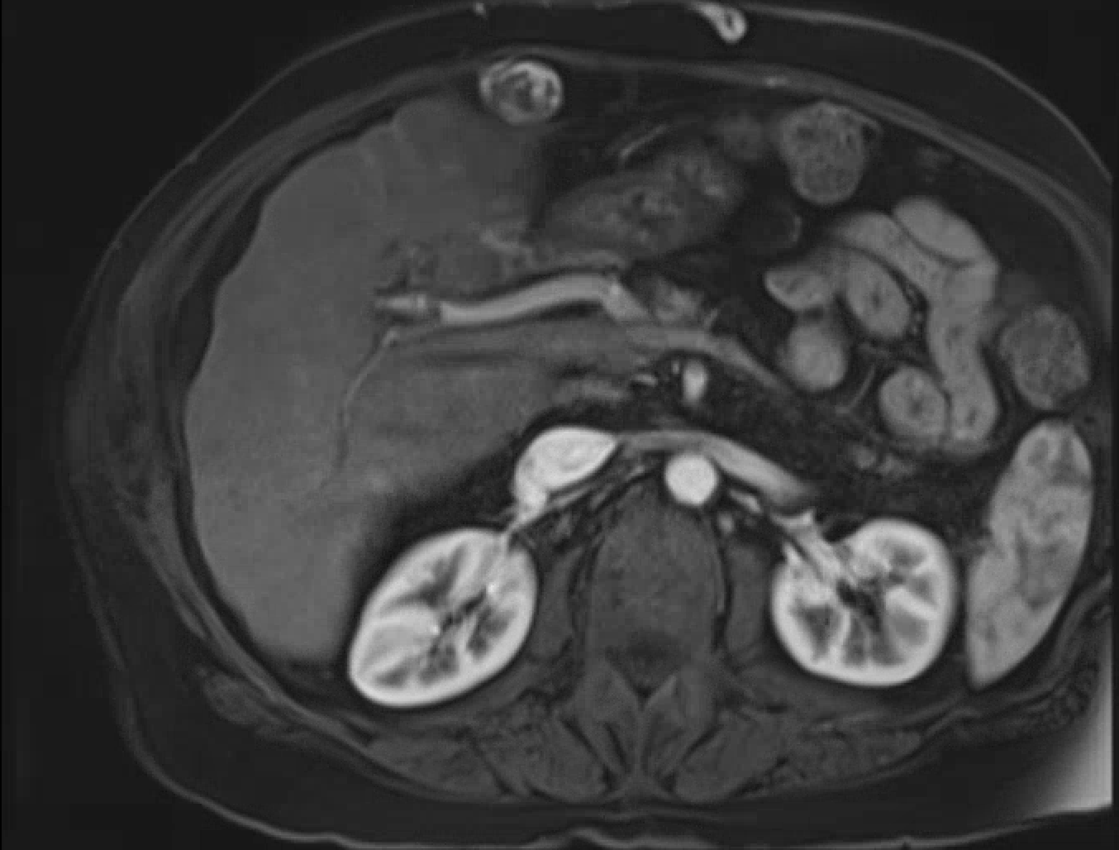

Slide 9
Pre-SIRT

Slide 10
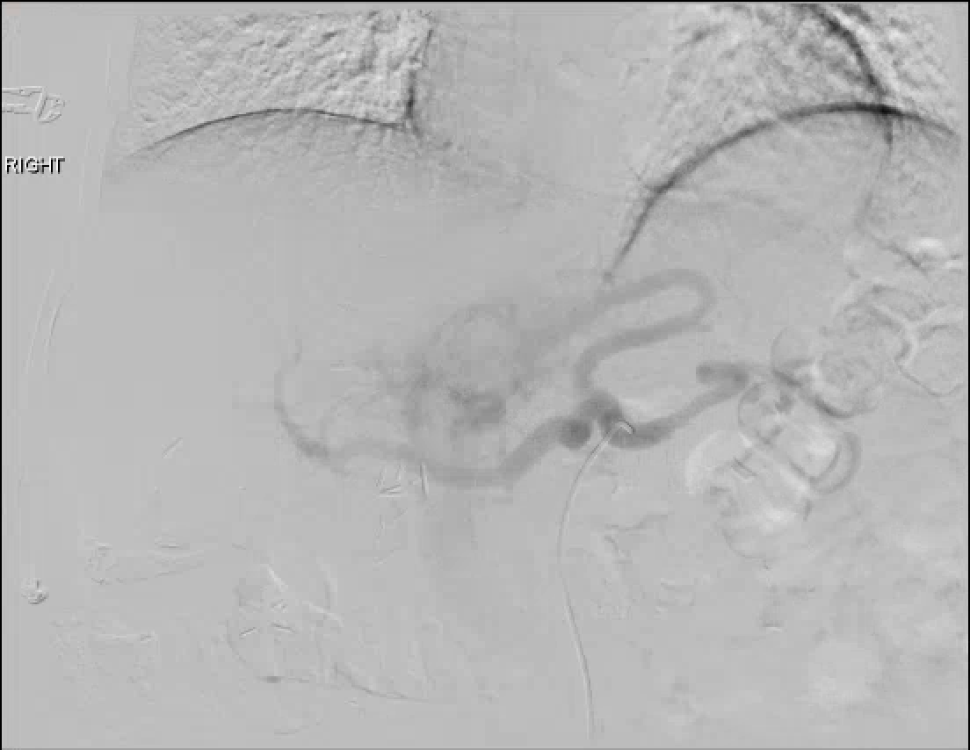

Slide 11
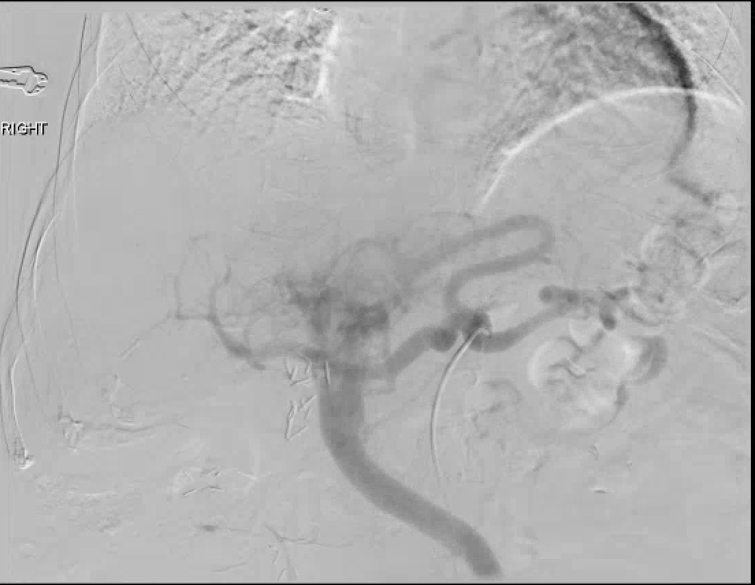

Slide 12
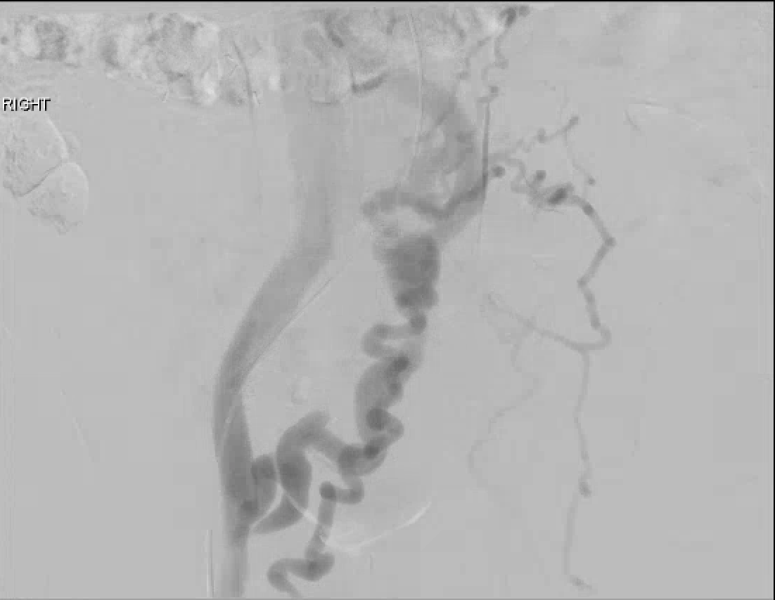

Slide 13
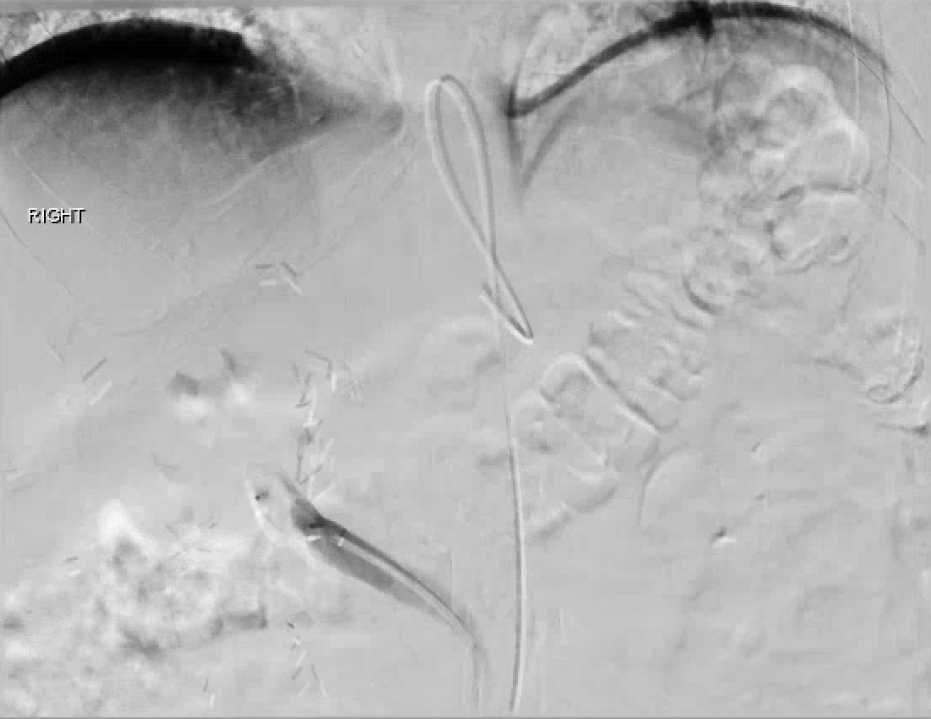

Slide 14
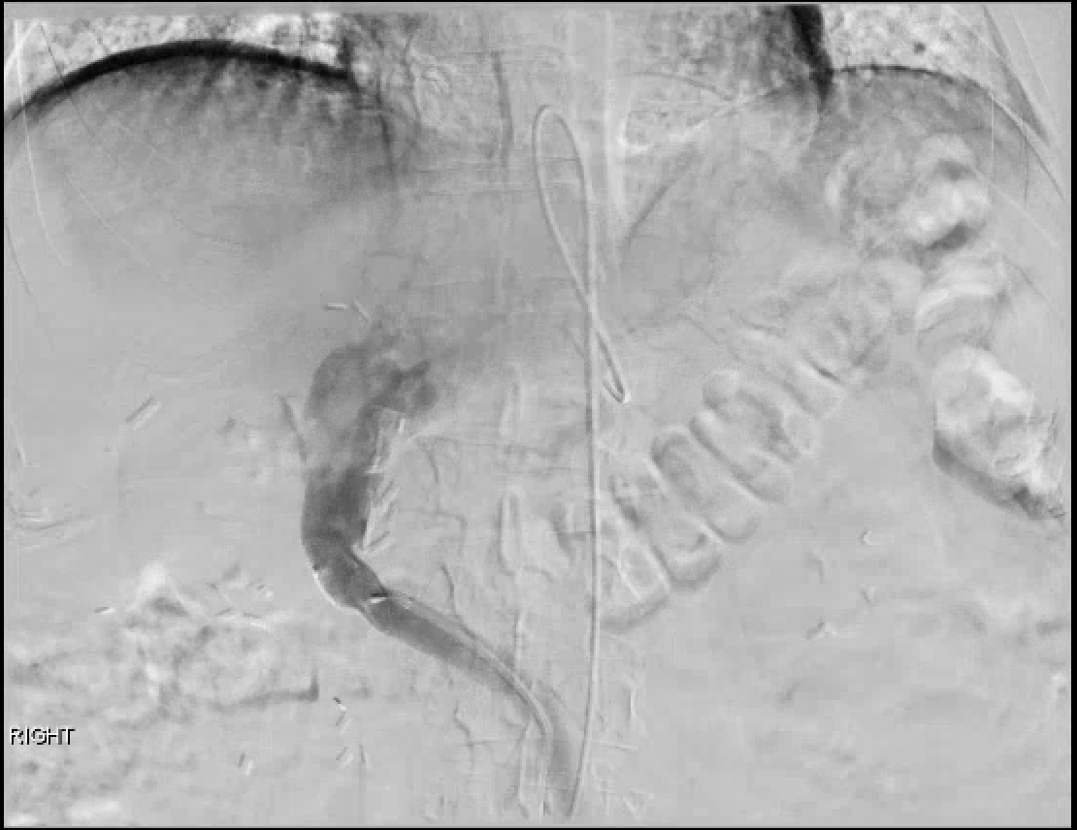

Slide 15
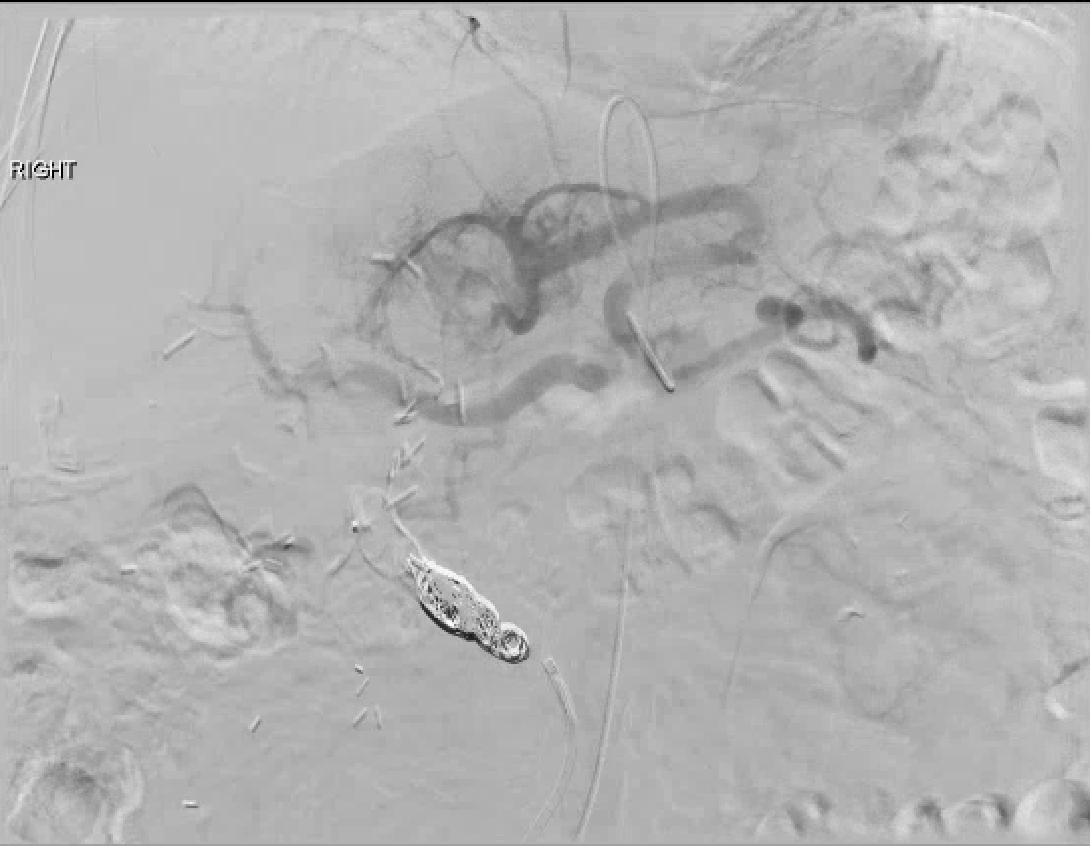

Slide 16
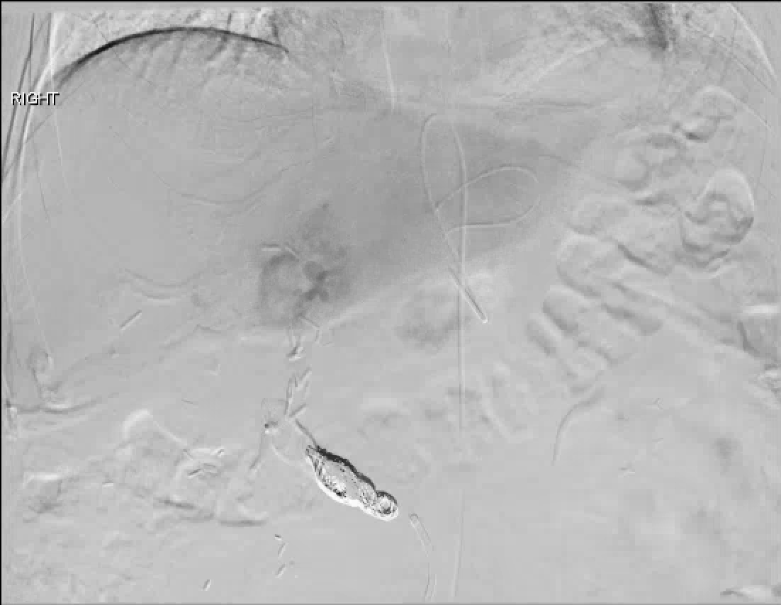

Slide 17
MAA Scan

Slide 18
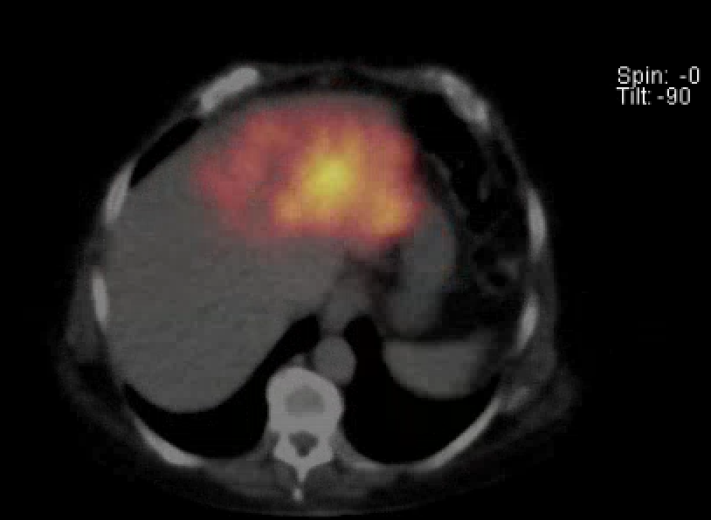

Slide 19
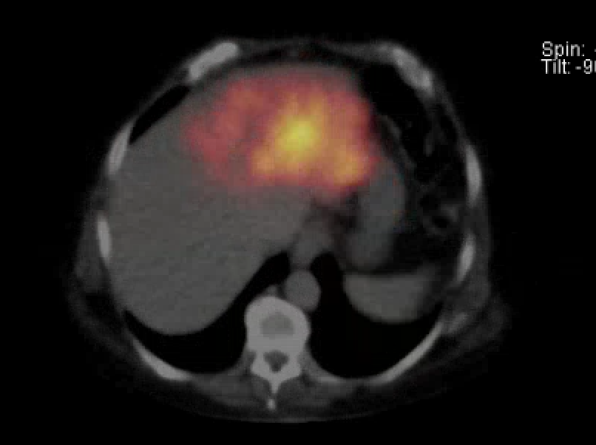

Slide 20
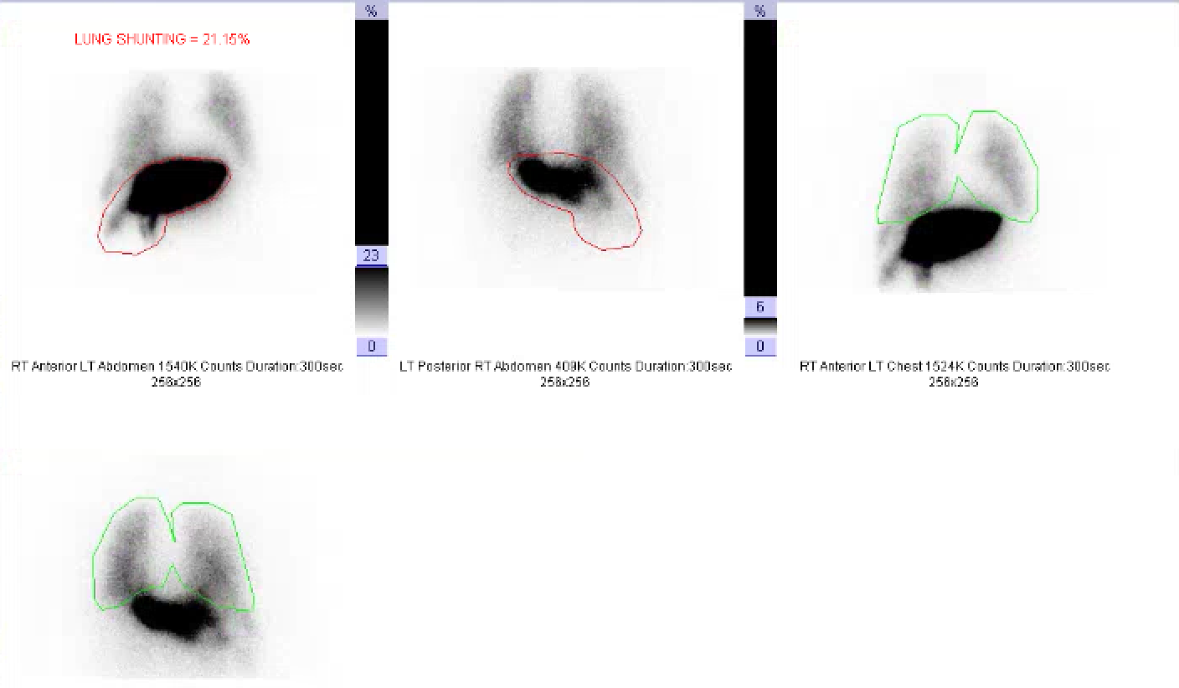

Slide 21
SIRT

Slide 22
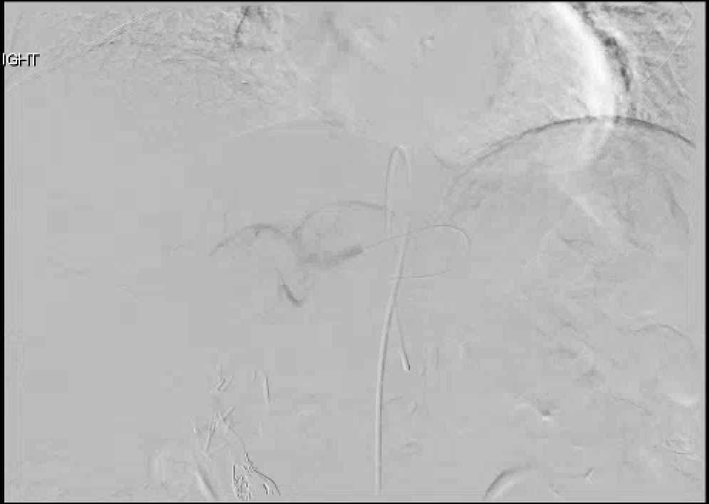

Slide 23
Embolization of massive arteriovenous shunts in HCC
Etiology thought secondary to hepatic vein invasion (micro/macro) by tumor with aberrant angiogenesis causing arterio-venous connections
Case reports describe either temporary occlusion of hepatic vein during TACE or permanent occlusion with either AVP or coils

Slide 24
Radioembolization for BCLC C
Current standard of care is sorafenib (with new multi-kinase inhibitor regorafenib now approved after sorafenib failure)
While not compared in RCT, small studies have evaluated radioembolization for BCLC C pateins
A. Gabr SIR 2017 Abstract –189 pts with BCLC due to ECOG PS, median survival of 19.6 months. 326 pts with BCLC C due to metastases or vascular invasion had median survival of 8 months

Slide 25
Dose reduction for lung shunting
BSA method
Dosage (GBq) = [(BSA – 0.2) + (% tumor involvement/100)] * (%treatment area represents of whole liver/100) (1-(%lung shunt reduction/100))
Recommended lung shunt reduction
<10% = no reduction
10% - 15% = 20% dosage reduction
15% - 20% = 40% dosage reduction
>20% = no treatment
No reduction for lung shunting may be considered if the lung dose is less than 25 Gy per treatment and 50 Gy cumulative dose to the lung.
Lung dose (Gy) = (dosage in GBq * lung shunt fraction) * 50/ lung mass (Kg) Assume lung mass is 1 kg
A 25% dosage reduction may be considered when teating patients with a total bilirubin >2

