Slide 1
Non-Acute TIPS Occlusion; Recanalization vs. Parallel TIPS
Alexis M. Cahalane
Kei Yamada
Department of Interventional Radiology
Massachusetts General Hospital

Slide 2
Background
31YO M
15 months prior to transfer to MGH
Presented to OSH with abdominal distension & UGIB
Grade III esophageal varices – endoscopic banding
Alcohol-related cirrhosis
TIPS 1 month later for persistent variceal bleeding
Course initially complicated by hepatic encephalopathy but improved with lactulose & rifaximin
No GI follow up
PMH
Asthma
ADHD

Slide 3
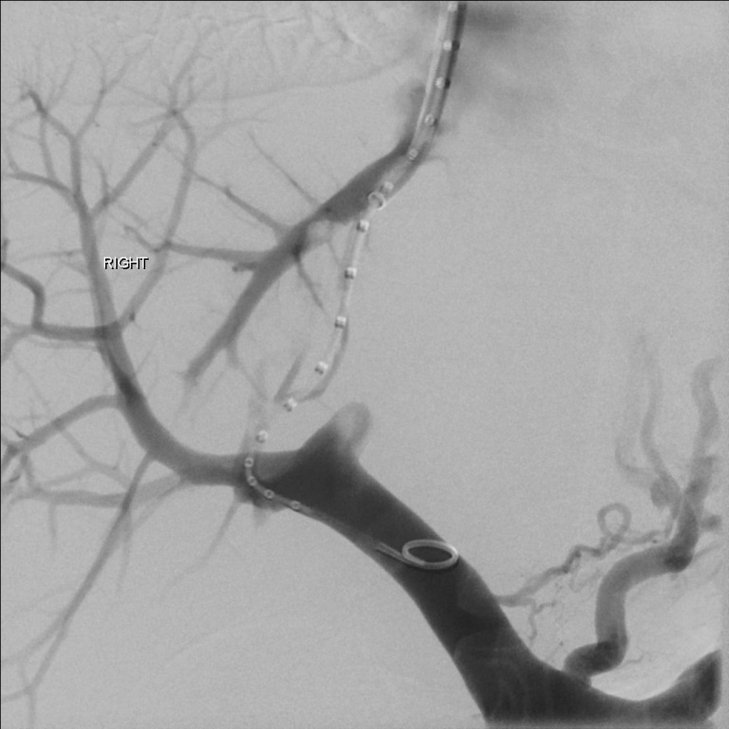
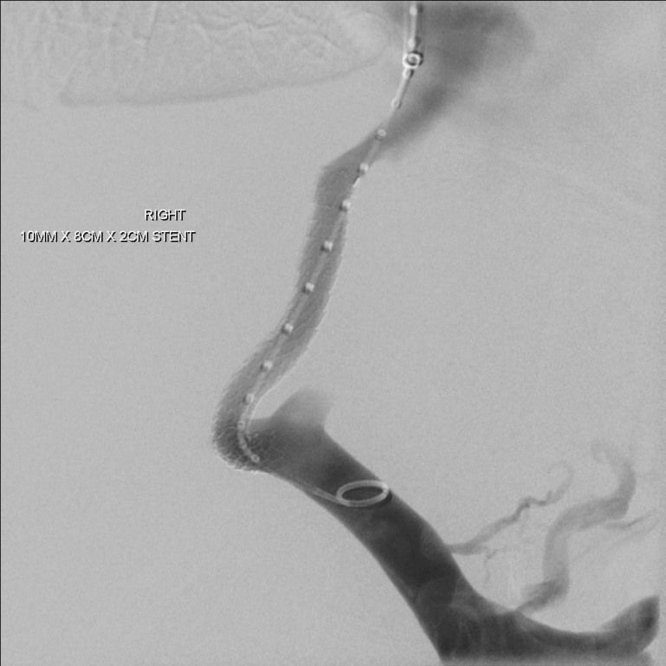
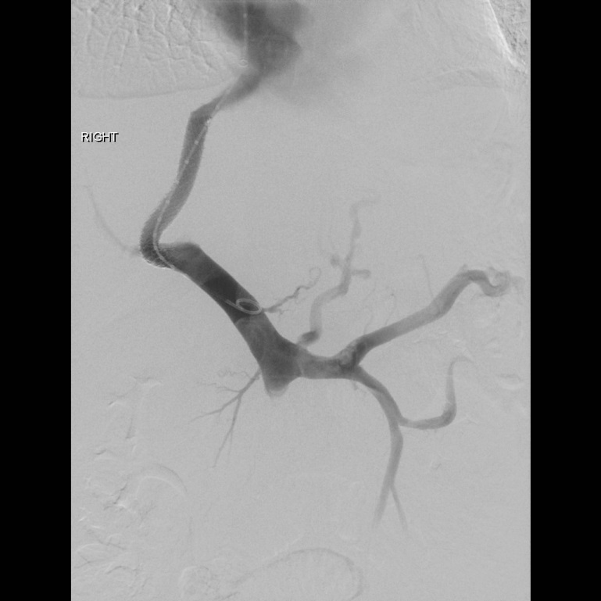
TIPS
Notes:
RHV - Posterior segment branch of RPV

Slide 4
Presentation No. 1
Three weeks prior to transfer to MGH
Presented to OSH with large volume hematemesis
ICU admission requiring intubation
EGD
Grade III EV in mid/lower esophagus without active bleeding
Variceal band ligation x5
5u pRBCs
US
Thrombosed TIPS
Unsuccessful attempt at TIPS recanalization
Discharged after five day hospitalization with plan for GI follow up
Stable Hb 7.8 g/dL

Slide 5
US

Slide 6
Presentation No. 2
Four days after discharge
Represented to OSH with recurrent hematemesis
Hb 7.3 g/dL
Repeat EGD
Multiple banded ulcers in mid/lower esophagus & gastric cardia without active bleeding
Hospitalization course;
RIGHT hepatic hydrothorax – chest drain
Four days after admission
Recurrent hematemesis
EGD
Actively bleeding ulcer in mid-esophagus
Treated with six clips & epinephrine
6u pRBCs
Transferred to MGH for revision of TIPS
Hb 8 g/dL

Slide 7
Presentation No. 2
MELD-Na: 17
MELD: 12
Serum Creatinine 0.58mg/dL
Serum Na 132mmol/L
Total Bilirubin 0.7mg/dL
INR 1.6

Slide 8
Options?
Recanalization
Versus
Parallel TIPS

Slide 10
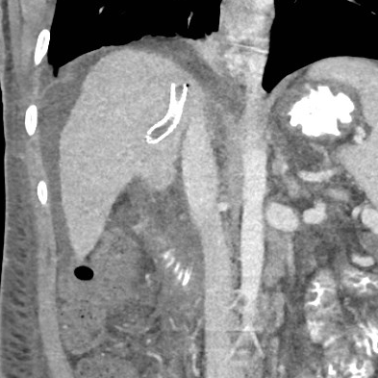
Stent Position
Notes:
Superior aspect of existing TIPS stent lying within parenchymal tract & not extending into RHV
Sharp angulation of inferior aspect of stent

Slide 11
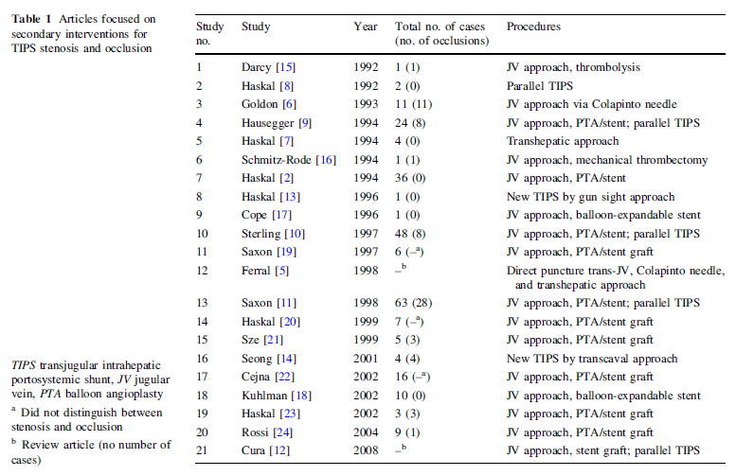
Recanalization
Tanaka et al (2011), CVIR 34:406-412

Slide 12
Recanalization
Components
Mechanical thrombectomy
Catheter-directed thrombolysis
+/- stent placement
Access
Conventional via RIGHT IJV access
Advanced techniques
Percutaneous transhepatic approach
Trans-splenic venous approach

Slide 13
Recanalization Attempt
RIGHT IJV access
Standard micropuncture technique
10Fr x 40cm vascular sheath
RIGHT hepatic vein access
Extra-stiff 0.035 Amplatz guidewire
5Fr C2 catheter
Attempted recanalization of TIPS stent
Angled 0.035 glidewire
5Fr MPA catheter
Unsuccessful

Slide 14
Advanced Recanalization Techniques
Percutaneous transhepatic approach
Percutaneous puncture of caudal end of stent
Snaring a wire cephalad via RIGHT IJV access
Trans-splenic approach
Percutaneous puncturing of spleen
Access small peripheral splenic vein – portal vein
Both techniques describe tract embolization
n-butyl-2-cyanoacrylate and lipiodol
coils

Slide 15
What Next?
Parallel TIPS
Why?
Duration of TIPS stent occlusion
Angulation & position of stent

Slide 16
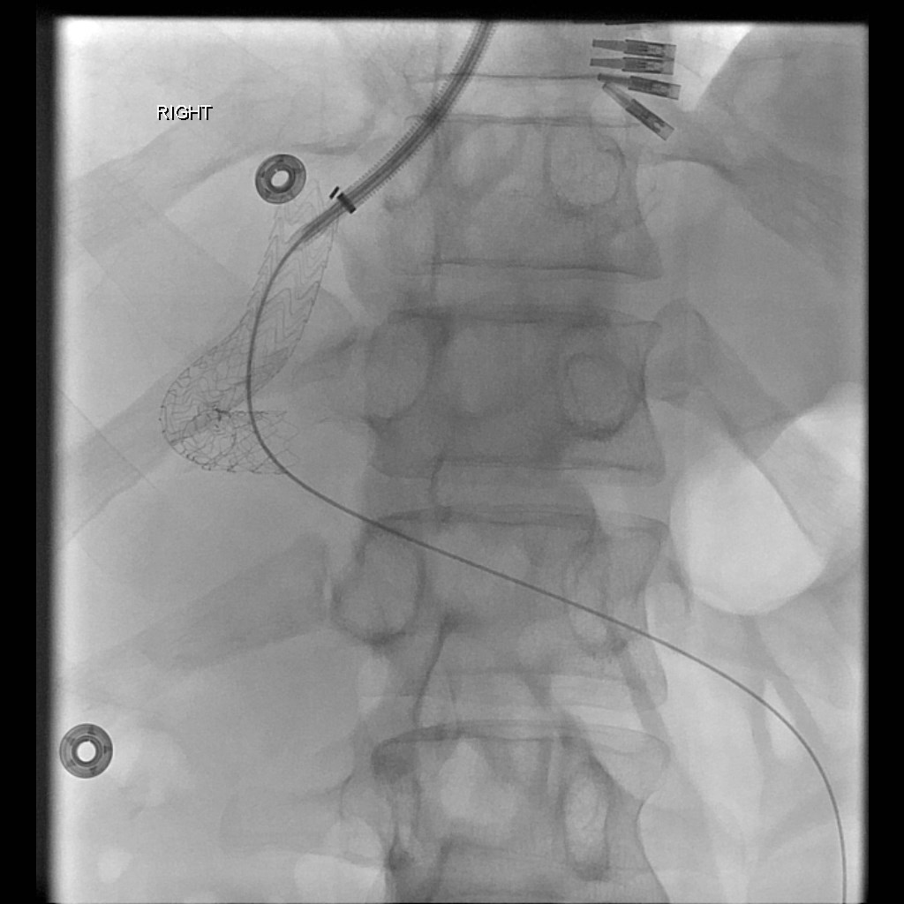
Parallel TIPS – 1st Attempt
PA
RAO 19º
Notes:
Rosch Uchida kit
Colpinto needle

Slide 17
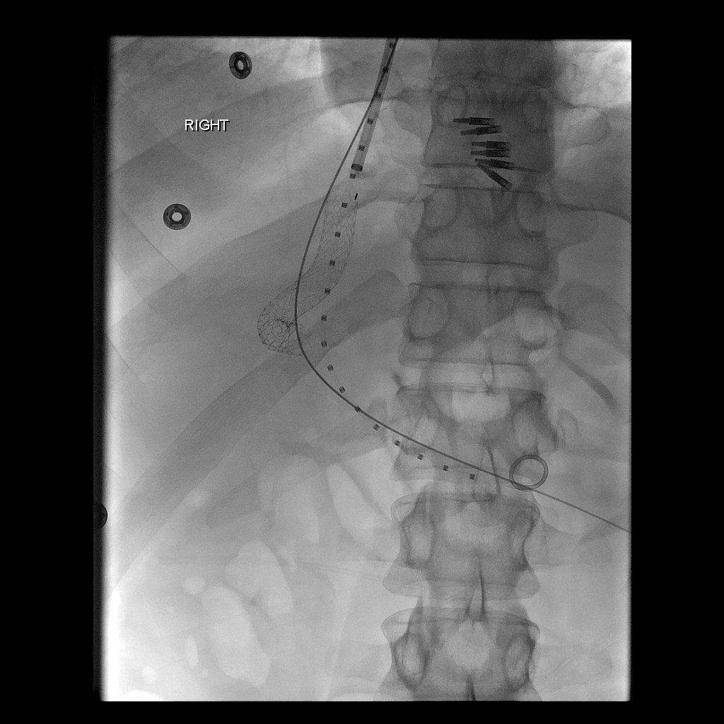
Parallel TIPS – 2nd Attempt

Slide 18
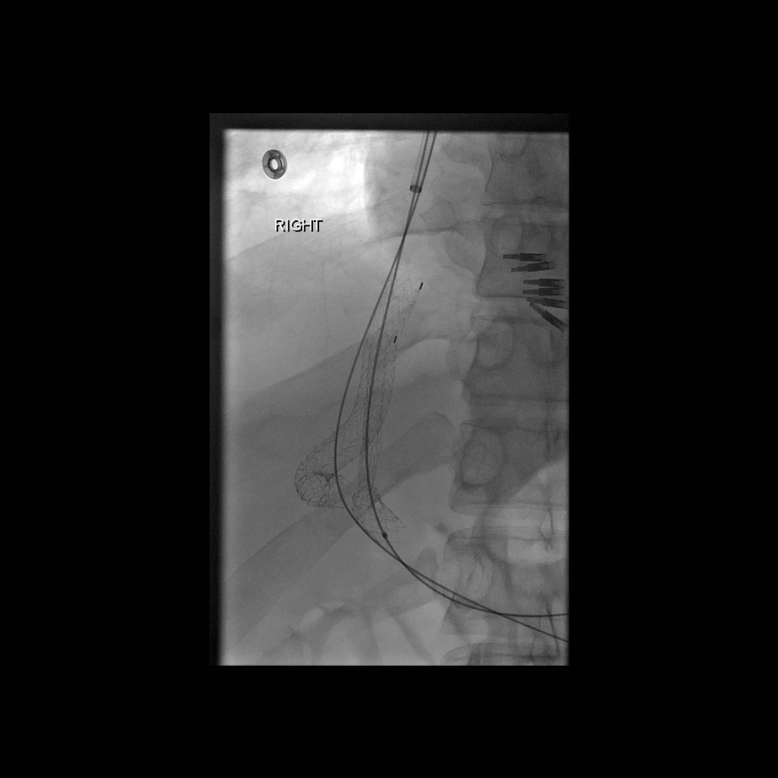
Parallel TIPS

Slide 19
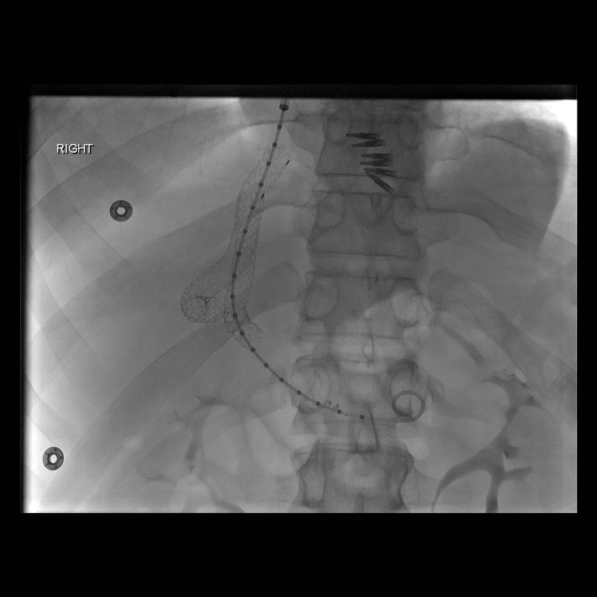
Parallel TIPS
Notes:
10mm x 8cm/2cm Gore Viatorr stent
Ballooned to 10mm

Slide 20
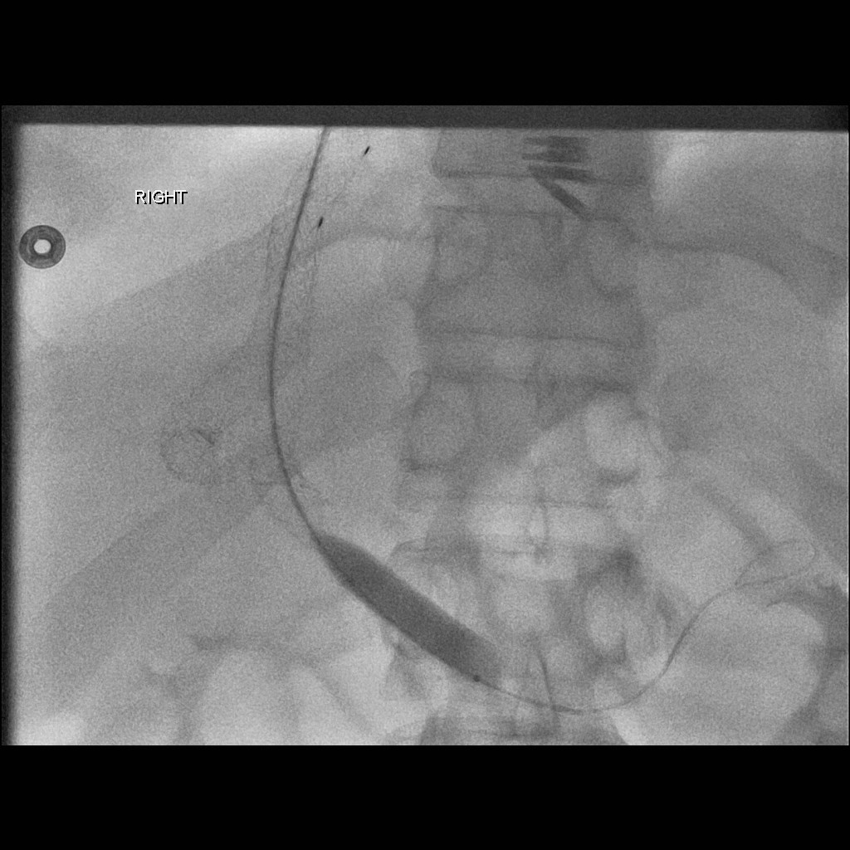
Parallel TIPS

Slide 21
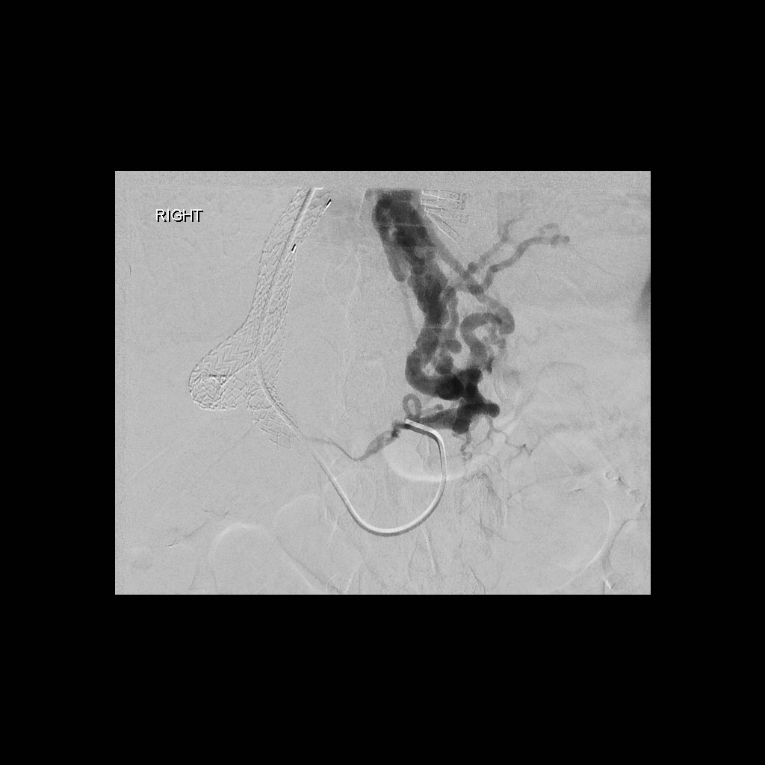
Parallel TIPS

Slide 22
Options?
Embolization?
YES √
Or
NO X

Slide 23
Embolization
Pros
Cons
Limit variceal filling/recanalization
Reduce risk of recurrent hemorrhage due to shunt dysfunction
Relevance in PTFE era?
Increased
Procedure duration
Cost
Radiation exposure
Small incidence of post-embolization syndrome with sclerosing agents

Slide 24
Embolization
Variceal bleeding
90-100% immediate cessation of bleeding s/p TIPS
17-24% recurrent bleeding
Does it make a difference?
Meta-analysis of six studies
TIPS & variceal embolization
Lower incidence of variceal rebleeding
Similar incidence of shunt dysfunction, HE & death
Heterogenous studies

Slide 25
Parallel TIPS
Balloon angioplasty reduced thrombus burden in MPV
Decision made to coil embolize the coronary vein to improve hepatopetal portal flow
Reduced chance of thrombus propagation
?Avoid need for anticoagulation
Reduction in portosystemic gradient
Pre: 18 mmHg
Post: 9 mmHg

Slide 26
Parallel TIPS
Notes:
[6mm x 20cm Interlock coil and 6mm x 14cm Nestor coil]

Slide 27
Post Parallel TIPS
Patent TIPS on US 48 hours post-procedure
No hepatic encephalopathy
Normal diet
Lactulose and rifaximin restarted
During TIPS
Incidental diagnosis of non-occlusive RIGHT IJV thrombus
Likely catheter-related 2/2 CVC at OSH
New diagnosis PFO & variceal bleeding
Patient commenced on heparin gtt 2 days post-procedure
Transitioned to dabigatran 150mg PO 7 days post-procedure
Chosen because of available reversal agent
Notes:
Dabigatran - potent, competitive, reversible direct thrombin inhibitor
Praxbind (idarucizumab)
FDA accelerated approval in October 2015

Slide 28
Follow Up
Discharged 10 days post-procedure
Local GI service
Repeat US neck to determine length of anticoagulation
Dabigatran for 3 months
Diuretics
Furosemide 20mg P Q24H
Spironolactone 100mg PO Q24H
Nadolol 40mg PO Q24H
Lactulose 30mls PO Q6H
Rifaximin 550mg PO Q12H

Slide 29
TIPS Occlusion
1 year patency rates
Bare metal stents: 36-50%
Expanded PTFE-covered stents: 76-84%
MGH institutional follow-up post-TIPS
US and IR Clinic follow up
4 weeks post-procedure, then every six months

Slide 30
References
Chan C-Y & Liang P-C. Recanalization of an Occluded Intrahepatic Portosystemic Covered Stent via the Percutaneous Transhepatic Approach. Korean J Radiol (2010) 11(4)
Gaba RC. Transjugular Intrahepatic Portosystemic Shunt Creation With Embolization or Obliteration for Variceal Bleeding. Tech Vasc Interventional Rad (2016) 19:21-35
Haskal ZJ, Duszak Jr., R & Furth ER. Transjugular Intrahepatic Transcaval Portosystemic
Shunt: The Gun-Sight Approach. JVIR (1996) 7:139-142
Kim SK, Belikoff BG, Guevara CJ & Park SJ. An Algorithm for Management After Transjugular Intrahepatic Portosystemic Shunt Placement According to Clinical Manifestations. Dig Dis Sci (2017) 62:305–318.
Larson M, Kirsch D & Kay D. Parallel Transjugular Intrahepatic Portosystemic Shunt (TIPS) in the Setting of TIPS Occlusion. Ochsner Journal (2016) 16:113–115.
Majdalany BS, Elliott ED, Michaels AJ & Hanje AJ. Radiofrequency Wire Recanalization of Chronically Thrombosed TIPS. Cardiovasc Intervent Radiol (2016) 39:1040–1044.
Miraglia R, Maruzzelli L & Luca A. Recanalization of occlusive transjugular intrahepatic portosystemic shunts inaccessible to the standard transvenous approach. Diagn Interv Radiol (2013) 19:61–65
Qi X, Liu L, Bai M, Chen H, Wang J, Yang Z, Han G & Fan D. Transjugular intrahepatic portosystemic shunt in combination with or without variceal embolization for the prevention of variceal rebleeding: A meta-analysis. Journal of Gastroenterology and Hepatology (2014) 29:688–696
Tanaka T, Gunther RW, Isfort P, Kichikawa K & Mahnken AH. Pull-Through Technique for Recanalization of Occluded Portosystemic Shunts (TIPS): Technical Note and Review of the Literature. Cardiovasc Intervent Radiol (2011) 34:406-412.

Slide 31
Questions?
Thank You

