Slide 1
New England Society of Interventional Radiology Case Presentation 1/9/17
Patrick Redmond MD
Interventional Radiology Fellow
BIDMC

Slide 2
Clinical history
45M w/ gun shot wound to abdomen
OSH: Ex-lap, small bowel resection, sigmoid repair, L external iliac vein stenting – Viabahn 9 x 50mm.
Transferred to BIDMC: Hemodynamically unstable, mass transfusion protocol, ex-lap, sigmoid colectomy, evacuation of large retroperitoneal hematoma, L external iliac artery transection repaired.
Notes:
45 male with unknown PMH s/p GSW to abdomen who initially presented to OSH where he underwent exploratory laparotomy, ex-lap, SBR, sigmoid repair and left external iliac vein stenting. Patient was then transferred to BIDMC. He was hemodynamically unstable, prompting initiation of mass transfusion protocol. Patient went to OR with vascular surgery, lost pulses on table, then received CPR. A left EIA transection was identified which was repaired. He then underwent ex-lap, sigmoid colectomy, left in discontinuity, and with open abdomen, transferred to TSICU for further resuscitation. CXR and CTA on 10/4 showed a migrated vascular stent from the L EIV to the RLL pulmonary artery. IR in addition to thoracic surgery were consulted for the migrated stent.

Slide 3
Notes:
CXR demonstrated what appeared to be a stent within the right lower hemithorax.

Slide 4
Notes:
-CT with IV contrast performed the same day demonstrated a stent within the right lower lobe pulmonary artery.
-The stent was patent and in-line with the RLL pulmonary artery.
-No thrombus within the stent or the right pulmonary arteries.

Slide 5
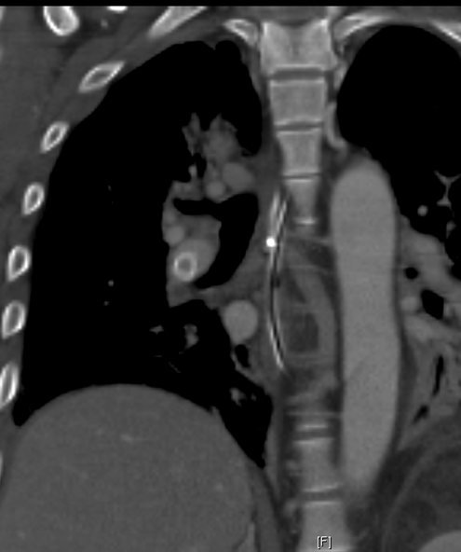

Slide 6
Consult
IR and thoracic surgery consulted for evaluation of possible migrated stent removal.
At time of consult, pt was still hemodynamically unstable on pressors.
CT chest showed that stent was patent, well-seated and in-line with right lower lobe pulmonary artery, no distal thrombus and no thrombus within other right pulmonary arteries.
Notes:
After review of the imaging, given it's location and patency, we
feel at this time observation is indicated given low chance for
further complication such as distal migration. The stent is well
seated with in-line flow, no distal thrombus, or occlusion of
other right pulmonary arteries. Although future risk of
complications is unclear in this patient, given our experience
with placing pulmonary artery stents in similar locations for
other patients, we generally have observed good outcomes.
Additionally, given the multiple acute issues the patient is
currently dealing with, we feel this would be a non-urgent
removal if indicated. Regarding anticoagulation for the stent, it
is not entirely clear if anticoagulation is necessary but our
general sense is that it is not required given its high flow and
larger caliber. If the patient at some point develops a
complication, we feel an endovascular approach +/- surgical
backup would be a viable option for stent removal. Dr. Wilson and
Dr. Ahmed discussed the details of this case. Further
multidisciplinary approach/discussion is recommended.

Slide 7
Consult
Multidisciplinary discussion between IR, thoracic surgery, vascular surgery, acute care surgery, and ICU.
If pt were to have surgery for stent removal –> thoracotomy and extraction of stent with possible bilobectomy
Given the patient’s young age, the inability to anticoagulate at the time, and unclear risk of thrombosis of the RLL pulmonary artery branch.
Plan: when pt clinically stabilizes, to first attempt endovascular removal of the stent, with open surgery as a back up option.

Slide 8
3 days later
Notes:
Right common femoral vein access
After initially gaining access to the right pulmonary artery, an 11 F 70cm sheath was placed into main pulmonary artery.
Right pulmonary angiogram was performed – patent stent in-line w/ RLL pulmonary artery.
A glide catheter was then placed through the stent and a Rosen wire was advanced through the glide catheter and stent.
Right common femoral vein access.
- 7 French sheath placed
- Glide catheter and Bentson wire were used to cross the right heart into the main and then left pulmonary artery.
-The Bentson wire was replaced with an Amplatz wire.
-The 7 French sheath was removed and after dilation with a 9 French dilator, a 11 French 70 cm sheath was placed over the Amplatz wire into the main pulmonary artery.
-The glide catheter was then placed through the sheath and the glide catheter and Amplatz wire were used to access the right pulmonary artery.
-The glide catheter was replaced with a pigtail catheter and a right pulmonary arteriogram was performed.
-The glidewire and Glide catheter were used to access the right lower lobe pulmonary artery.
-A Rosen wire was placed and the sheath was advanced into the right pulmonary artery.
-The glide catheter was then placed through the stent and the Rosen wire was advanced through the glide catheter and stent.
-The glide catheter was removed.

Slide 9
Notes:
-Next, a 10 mm x 40 mm Admiral balloon pre-loaded with an adjacent 20 mm Goose Neck snare through a 5Fr modified C1 catheter was placed over the wire and into the stent.
-The balloon was inflated and the snare was advanced over the balloon and proximal portion of the stent, and the snare was pulled tight over the
proximal portion of the stent.

Slide 10
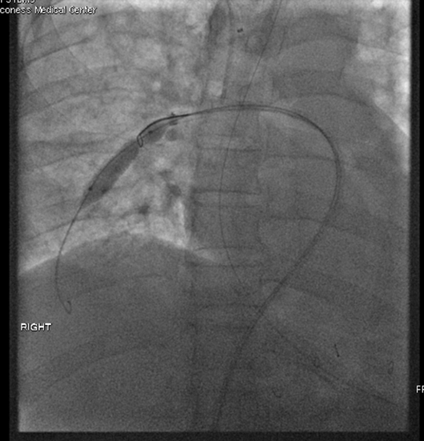
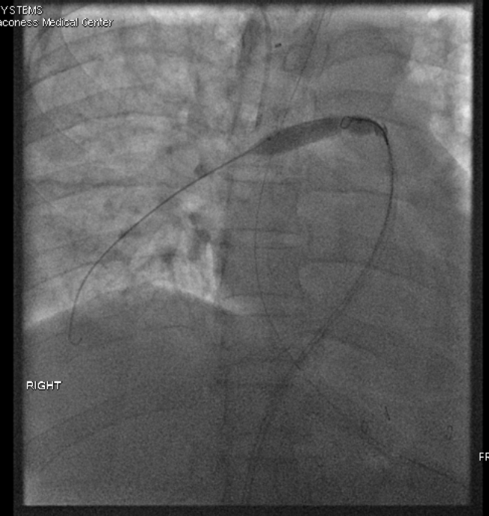
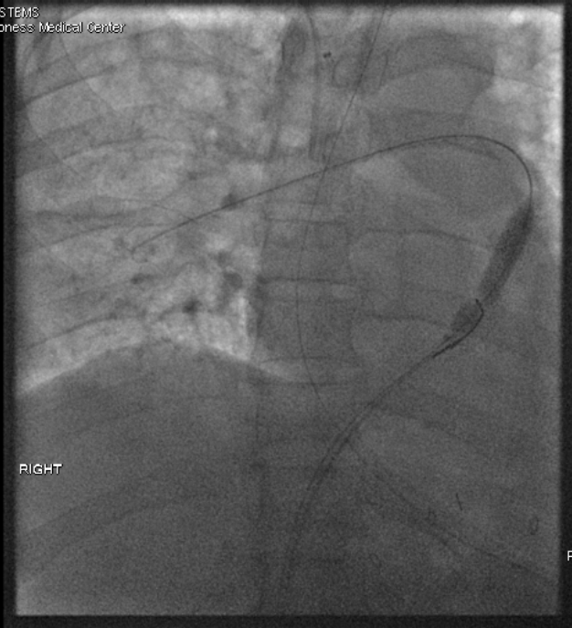
Notes:
-As a unit, the balloon, snare, stent, and sheath were gently pulled out of the right pulmonary artery over the wire and into the IVC.

Slide 11
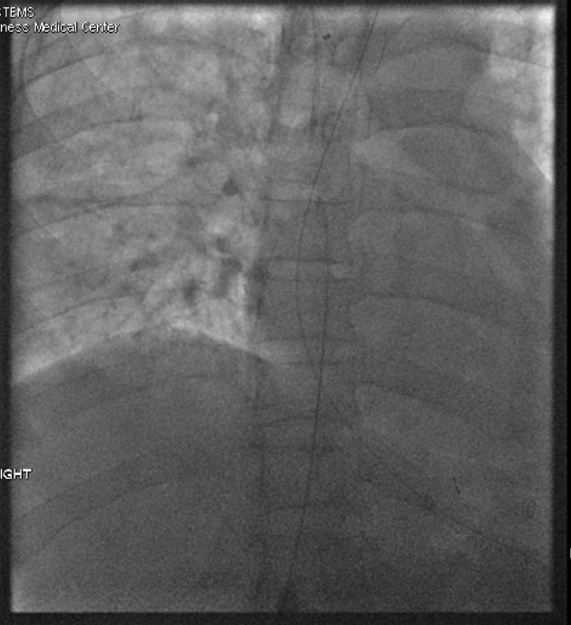
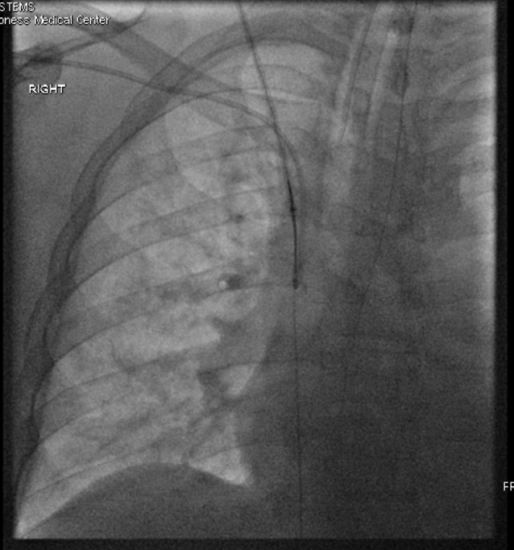
Notes:
-Next, using the right IJ access, a 6 French 15 mm Goose neck snare was placed through the sheath and into the IVC
-The distal portion of the Rosen wire was snared and pulled out of the right IJ access sheath to obtain through and through access via the right common femoral vein and right IJ vein.

Slide 12
Notes:
-16 French 40 cm sheath was placed via the right internal jugular vein.
-7 French 15-20 mm Ensnare was placed through the sheath and used to snare the distal aspect of the stent after the balloon was mildly inflated.
-The sheath was then slowly advanced over the stent to re-capture / re-sheath the stent.
-However, after the majority of the stent was within the sheath, the snare became detached from the stent and a small portion of the stent remained
outside of the 16 French sheath but still captured by the distal original snare.
-The 6 French sheath was removed and after serial dilation with 10, 14 and 16 French dilators, a 16 French 40 cm sheath was placed via the right internal jugular vein.
-The inner dilator was removed and the sheath was advanced over the Rosen wire and to the distal aspect of the stent.
-A 7 French 15-20 mm Ensnare was placed through the sheath and used to snare the distal aspect of the stent after the balloon was mildly inflated.
-The sheath was then slowly advanced over the stent to re-capture / re-sheath the stent.
-However, after the majority of the stent was within the sheath, the snare became detached from the stent and a small portion of the stent remained
outside of the 16 French sheath but still captured by the distal original snare.

Slide 13
Notes:
-Pursestring sutures were placed at the right IJ vein access site.
-The entire through and through access system including both sheaths, wire, balloon, stent, and snares were pulled through the right IJ access site.
-The right IJ sheath and stent and snare were removed.
-The right common femoral vein sheath, Rosen wire, balloon, and snare were pulled back into the body and removed via the right common femoral vein access

Slide 14
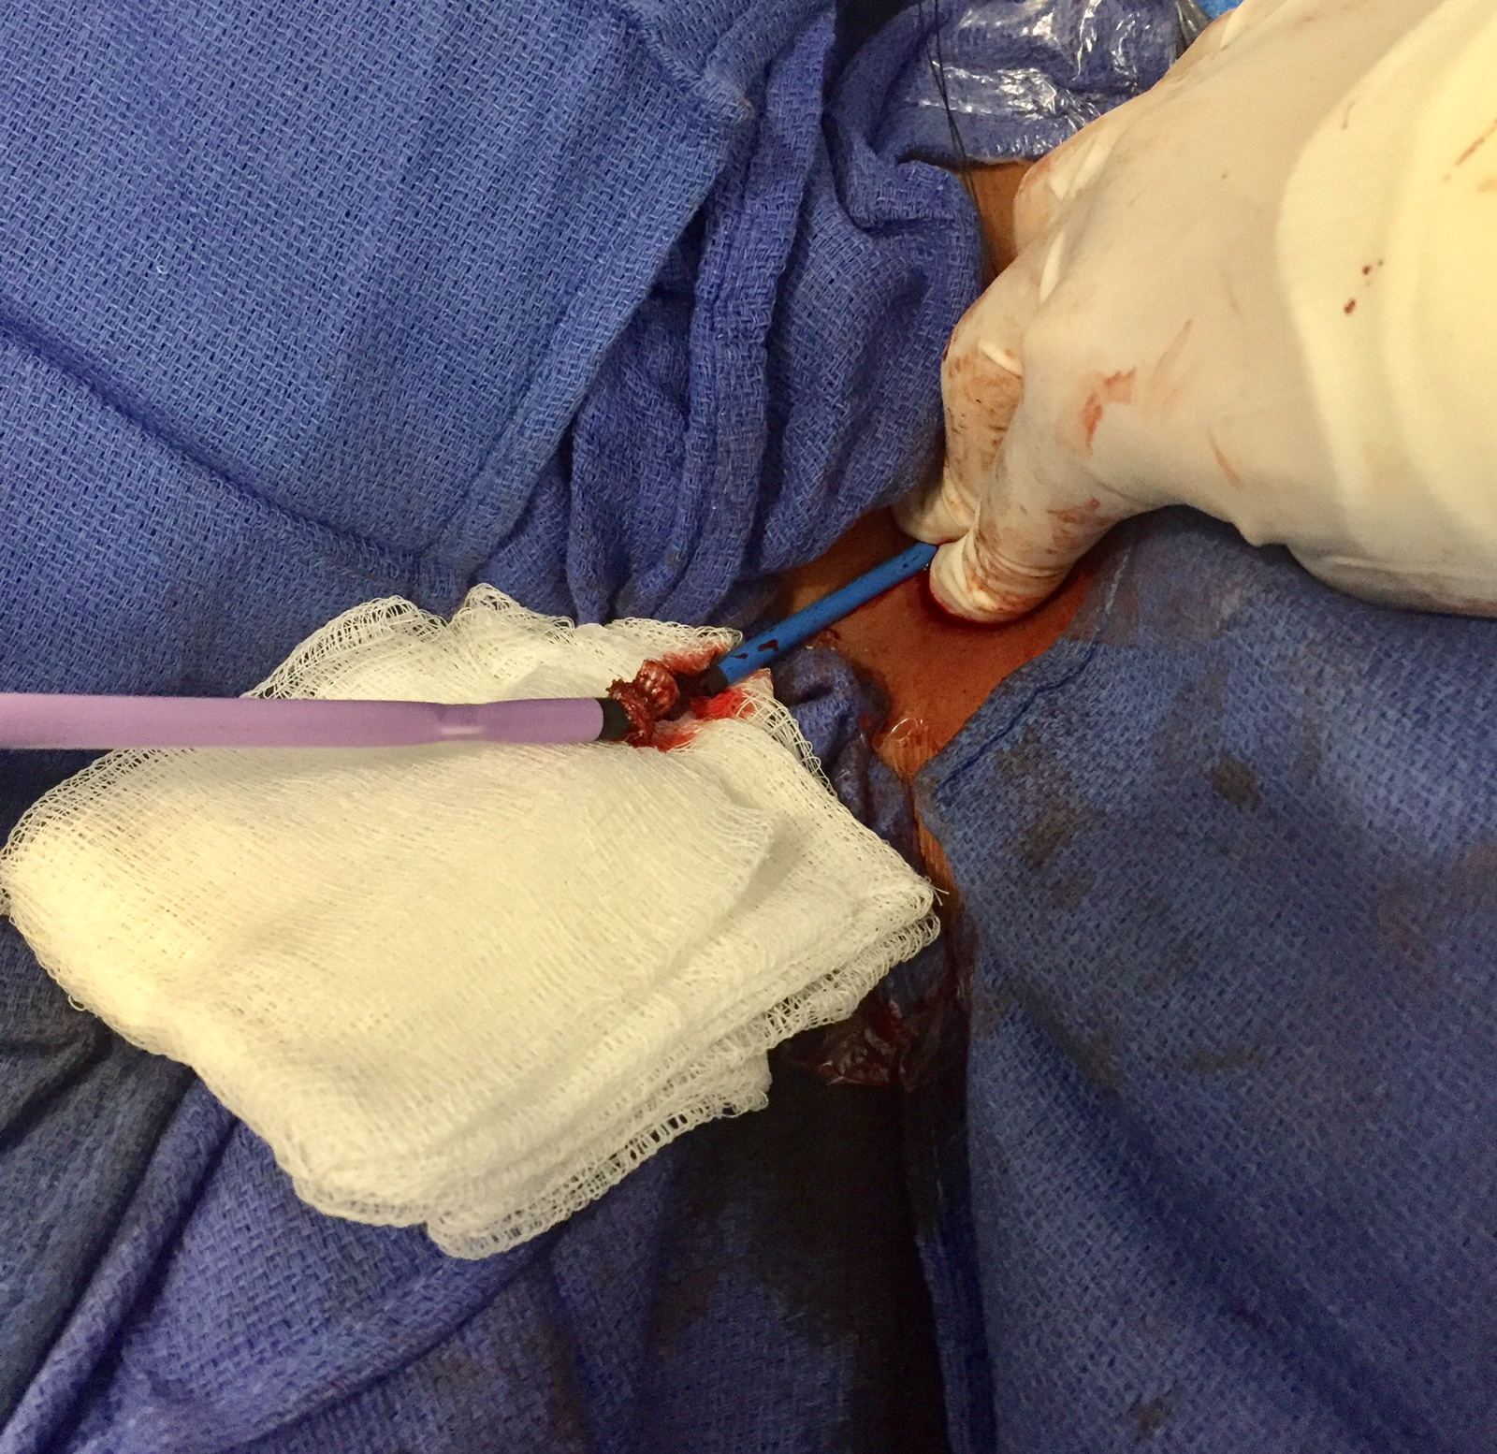
Notes:
-Both 16F RIJ and 11F RCFV sheaths outside the patient at RIJ access site.

Slide 15
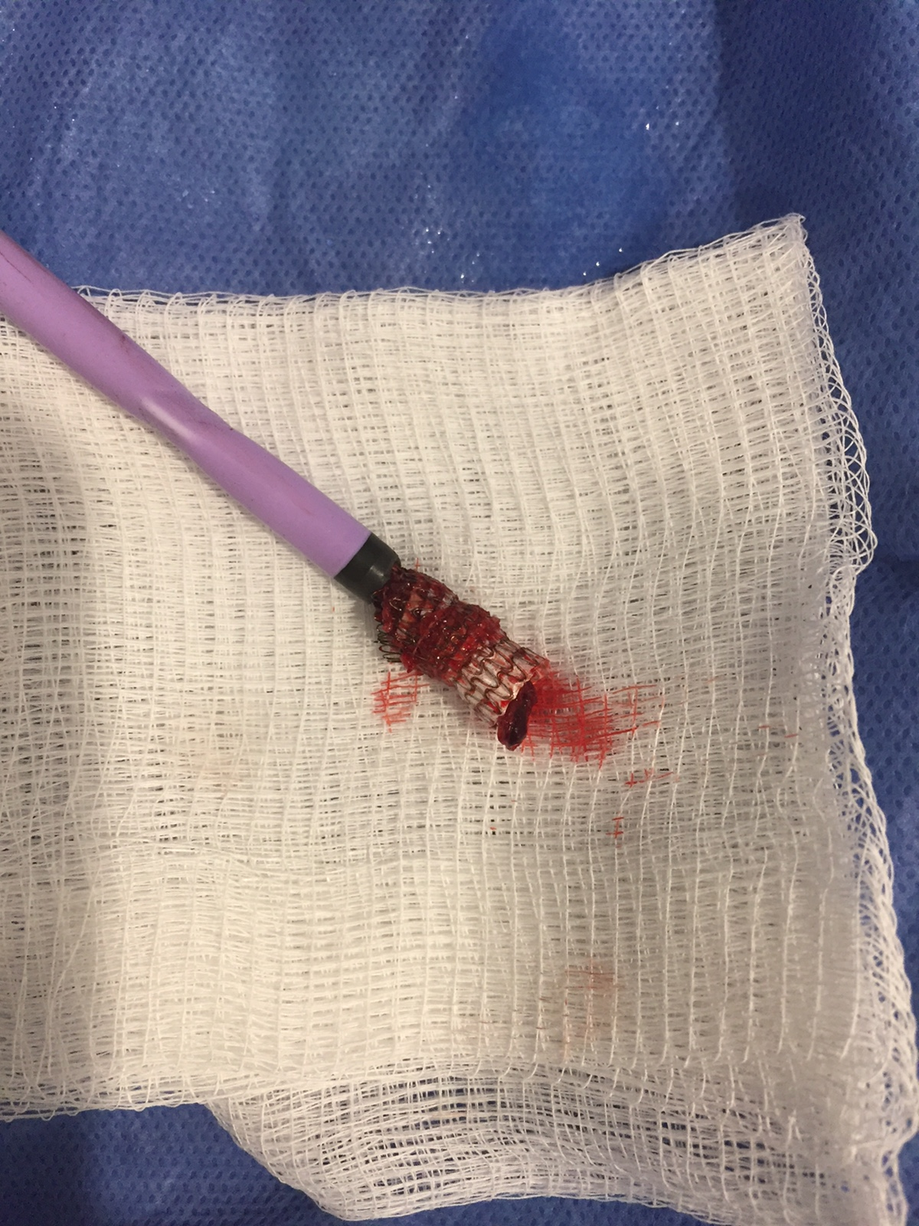
Notes:
-After removal of 16F sheath and stent from the patient with stent still partially within the sheath.

Slide 16
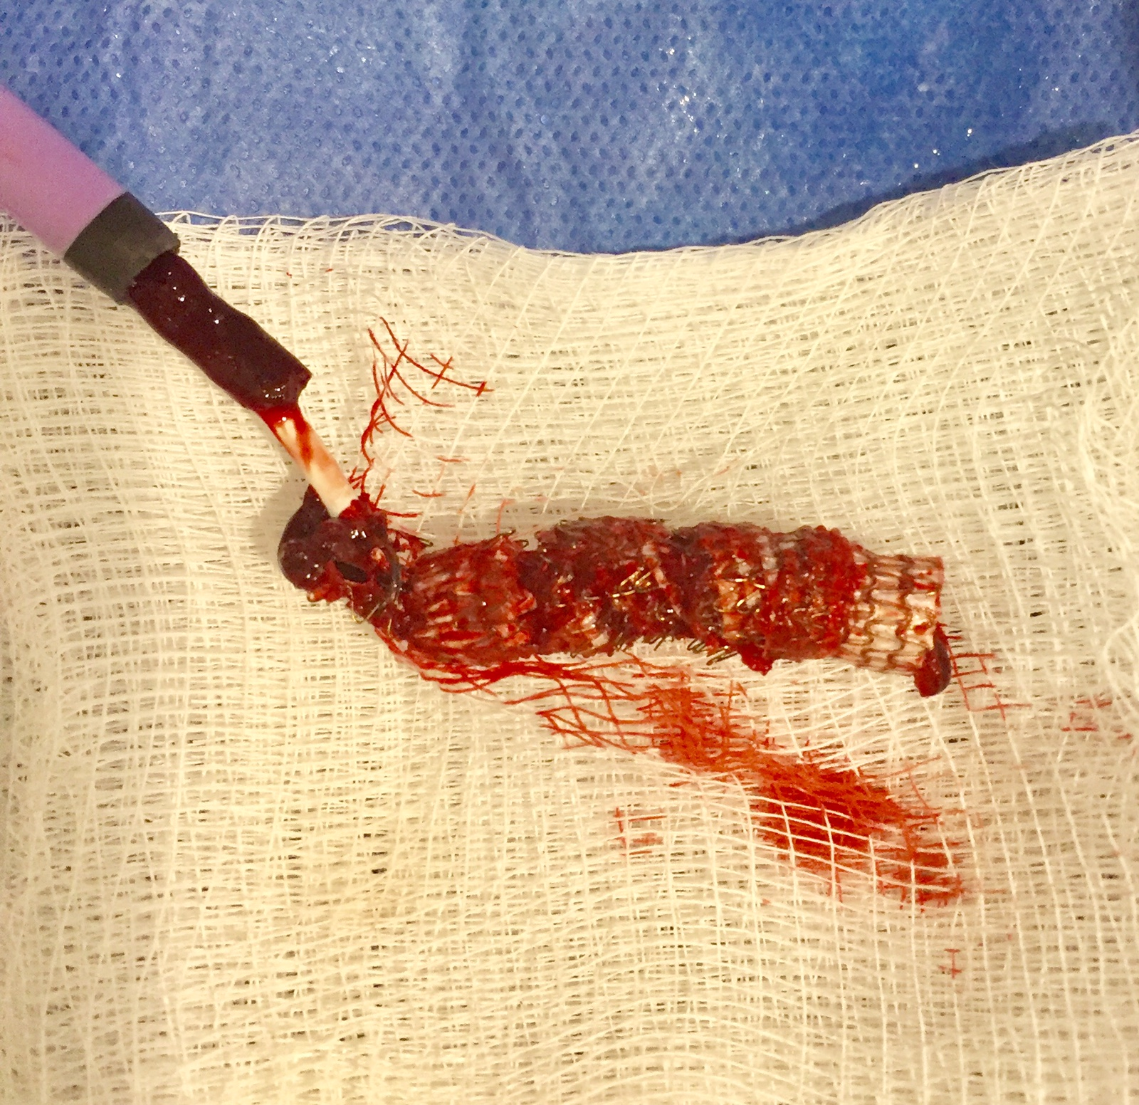
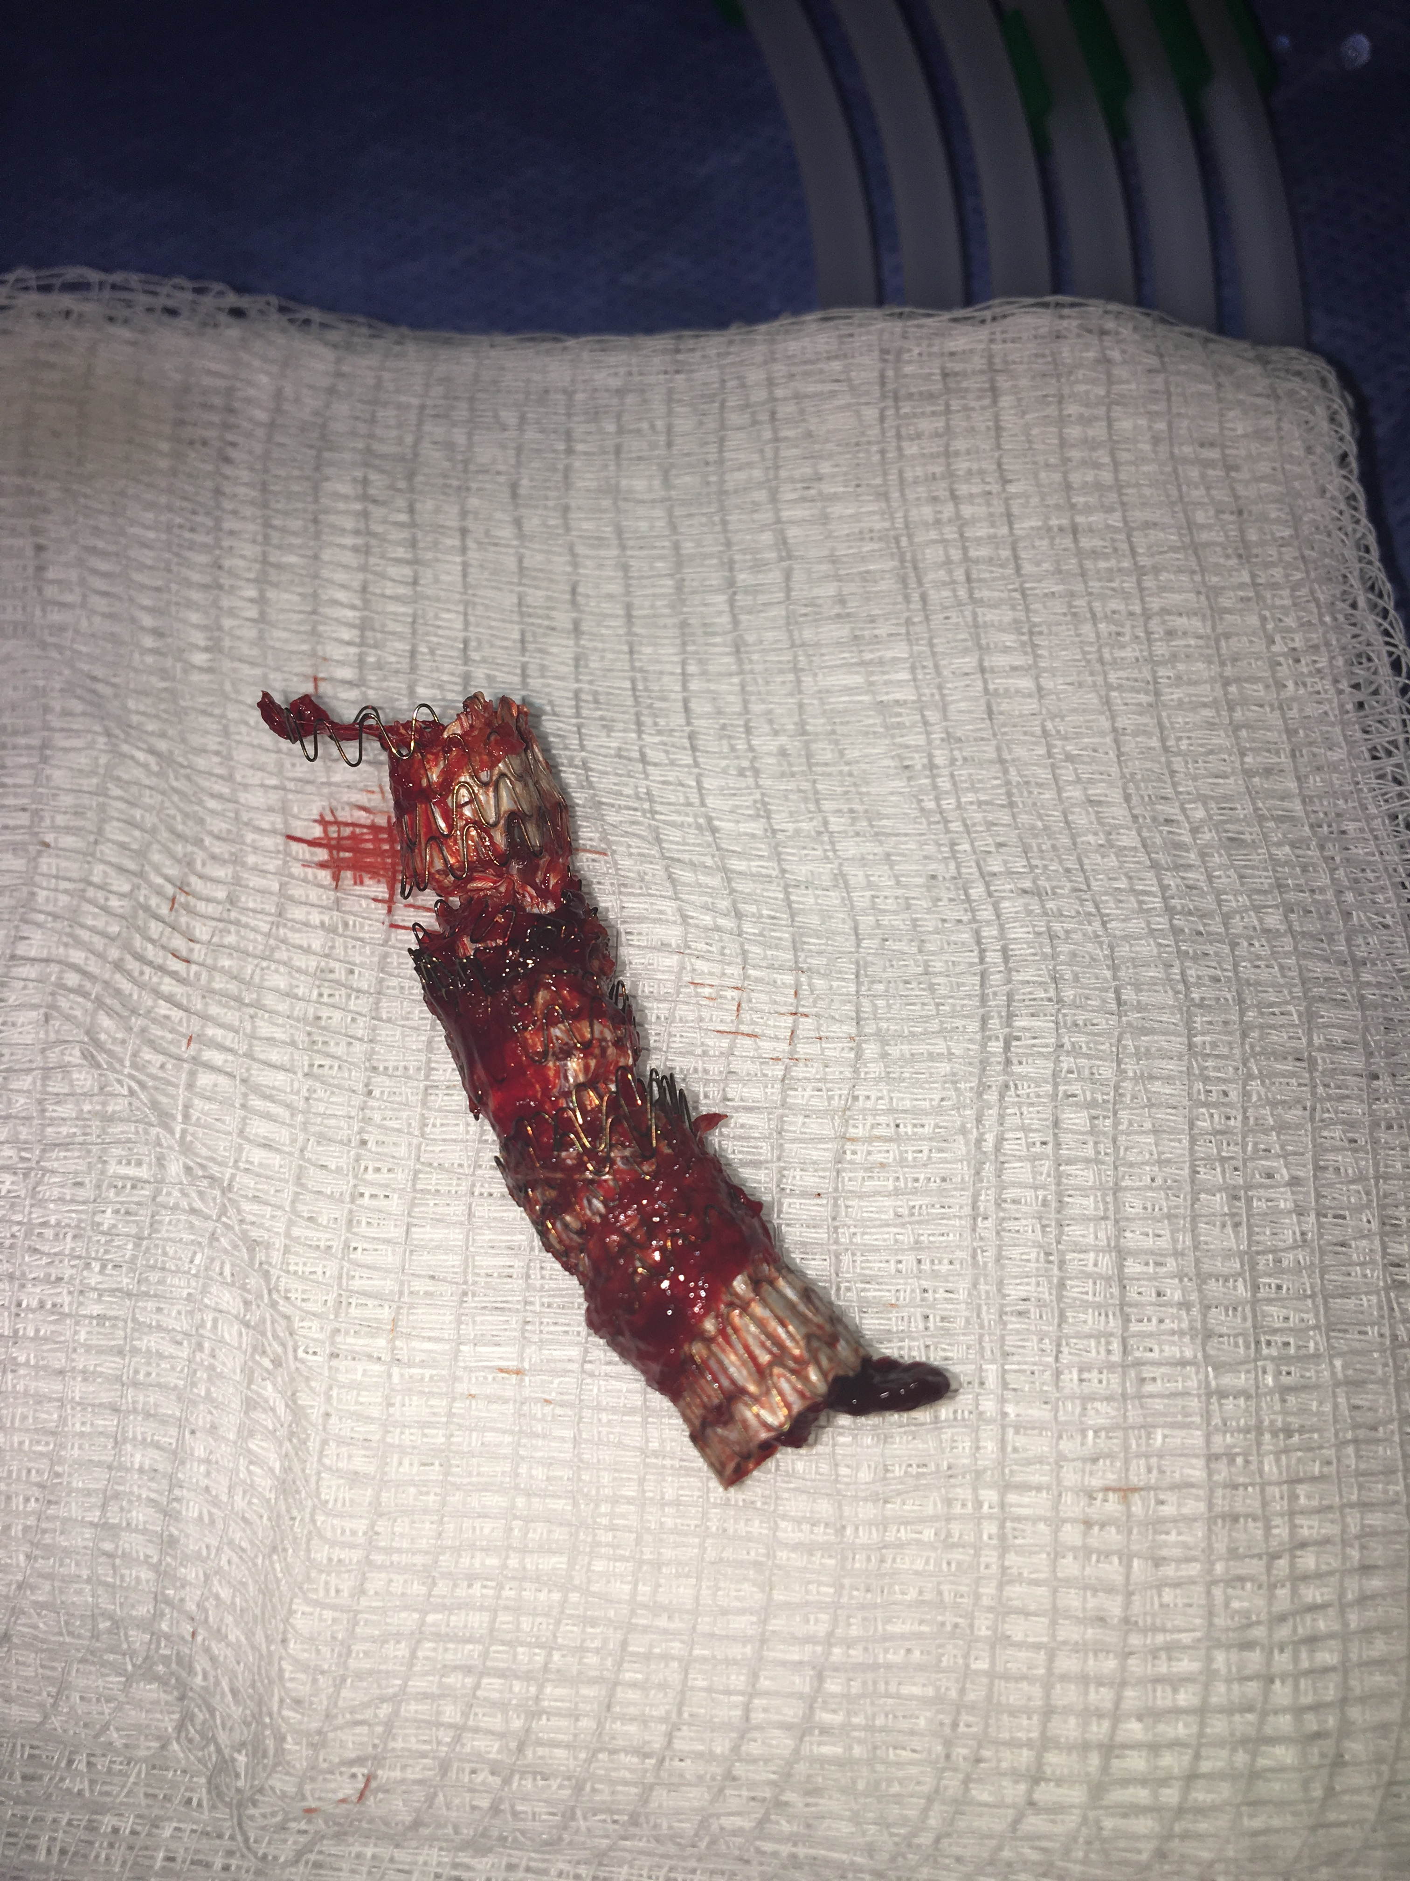
Notes:
-Stent removed from the sheath.
-Viabahn stent.

Slide 17
Follow up
Patient had long hospital stay requiring several more abdominal operations to repair bowel injuries.
No new concerning findings on follow up chest radiographs. Did not have any further chest CT scans.
Discharged to Rehab after 2 month hospital stay.
Had outpatient surgical clinic visit after 1 month at rehab.
Significantly improving and being discharged from rehab to home.

Slide 18
Thank you
Dr. Muneeb Ahmed
Dr. Jeffrey Weinstein
Notes:
FINDINGS:
1. Right pulmonary arteriogram demonstrates the right external iliac vein
stent which had migrated to the right lower lobe pulmonary artery. Contrast
is seen flowing through the stent indicating its patency.
2. The stent was successfully retrieved and after inspection of the stent
outside of the body, the entire stent was intact.
IMPRESSION:
Successful retrieval of the covered stent which had migrated from the right
iliac vein to the right lower lobe pulmonary artery.

