Slide 1
Case Presentation
New England Society of Interventional Radiology
November 14, 2016
Robert Schiff, MD
Dartmouth hitchcock medical center

Slide 2
History of Present Illness (HPI)
57 year old male with PMH of colon cancer (adenocarcinoma) s/p hemicolectomy and colostomy in 2012.
Stage IV disease with metastasis to the right hepatic lobe.
Initial management at OSH included:
Resection
Chemotherapy
Biliary stenting

Slide 3
PET/CT 9/2015
Increasing activity:
Right hepatic lobe
CBD
Porta hepatis
Notes:
Increased activity involving the site of the biliary stent extending from the anterior abdominal wall into the left lobe of the liver may be due to infection. (Tumor is possible but considered less likely.)

Slide 4
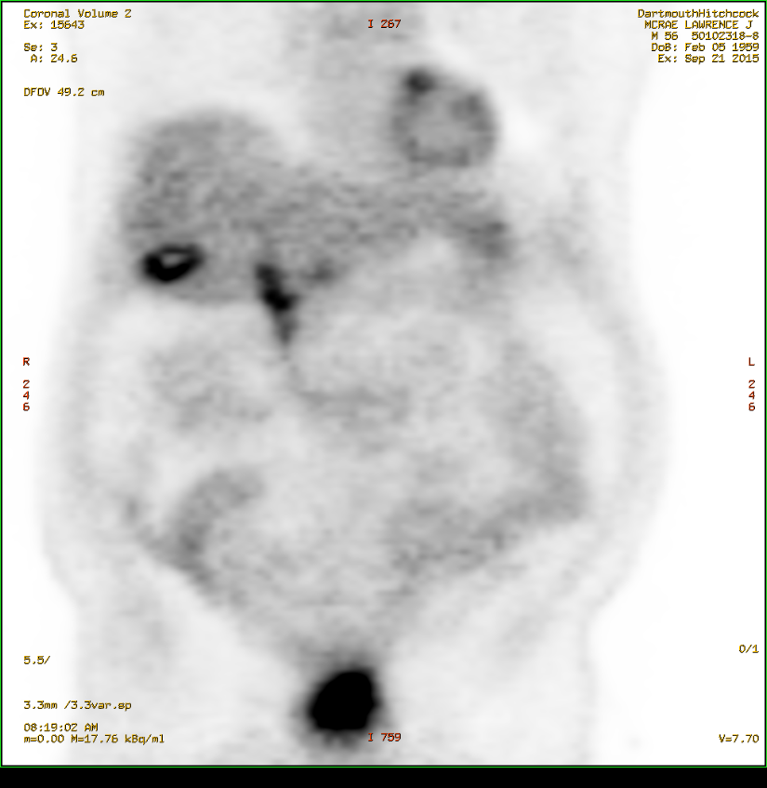
PET/CT 9/2015

Slide 5
PET/CT 9/2015

Slide 6
PET/CT 9/2015

Slide 7
Treatment Plan - 9/2015
Case was presented at our local institutional GI tumor board.
Patient was referred to IR for consideration of ablation of known areas of disease.
Decision reached to proceed with:
MWA of right hepatic lobe lesion
IRE of CBD + porta hepatis lesions

Slide 8
IRE – November 2015
Six electrodes placed around CBD, as defined by IE-PBD.
Five electrodes placed around porta hepatis node (deep) and CBD (peripheral).

Slide 9
IRE – November 2015

Slide 10
IRE – November 2015

Slide 11
IRE – November 2015

Slide 12
IRE – November 2015

Slide 13
IRE – November 2015

Slide 14
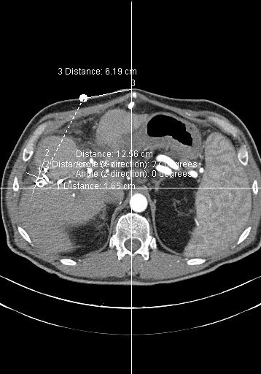
MWA – January 2016
14 cm probe
Total 4 ablations
140W @ 4 minutes each
Notes:
14cm probe, total 4 ablations at 140W x 4 minutes

Slide 15
MWA – January 2016

Slide 16
March 2016 PET/CT
Nodular activity along periphery of ablation cavity.
Decreased but persistent uptake in porta hepatis.

Slide 17
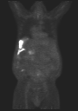
June 2016 PET/CT
Tumor recurrence in right lateral perihepatic space (extending from ablation cavity)
Worsening porta hepatic activity

Slide 18
Ongoing Management
Given the pattern of disease recurrence, further local management deemed not feasible.
Plan to re-start systemic chemotherapy.

Slide 19
August 2016
CLINICAL HISTORY: Patient developed bleeding from vessel at ostomy site, concern for peri-stomal varix.
Patient admitted, CTA of abdomen/pelvis ordered as inpatient.

Slide 20
CTA August 2016
Which of the following are present findings from the CT? (choose all that may apply)
A) Active intra-abdominal hemorrhage
B) Portal vein stenosis/occlusion
C) Stomal varices
D) Abdominopelvic ascites

Slide 21
CTA August 2016

Slide 22
CTA August 2016

Slide 23
CTA August 2016

Slide 24
CTA August 2016

Slide 25
CTA August 2016
Which of the following are pertinent findings from the CT?
A) Active intra-abdominal hemorrhage
B) Portal vein stenosis/occlusion
C) Stomal varices
D) Abdominopelvic ascites

Slide 26
IR is consulted for stomal varix bleeding - how would you proceed?

Slide 27
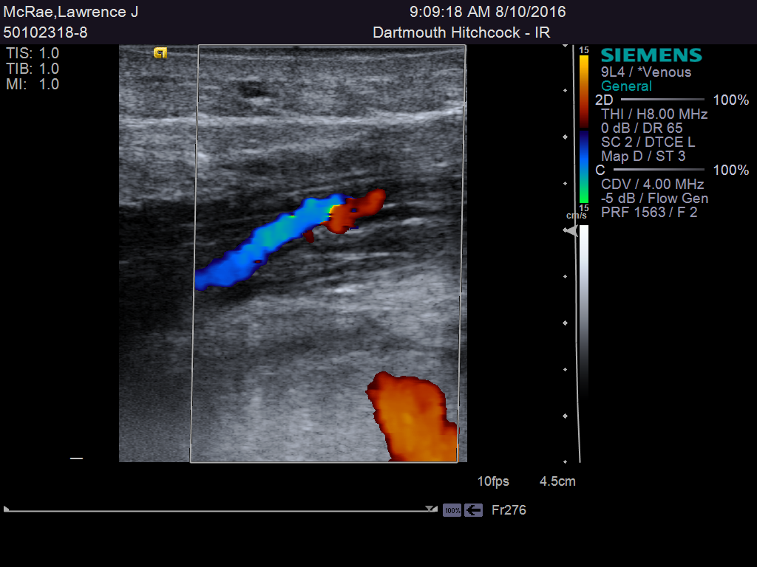
Direct Variceal Puncture
US used to identify a peristomal vein
21G access
Contrast injected
Embolized with gelfoam/sodium sotradecol slurry
Additional superficial vein identified, but supply to peristomal region not identified

Slide 28
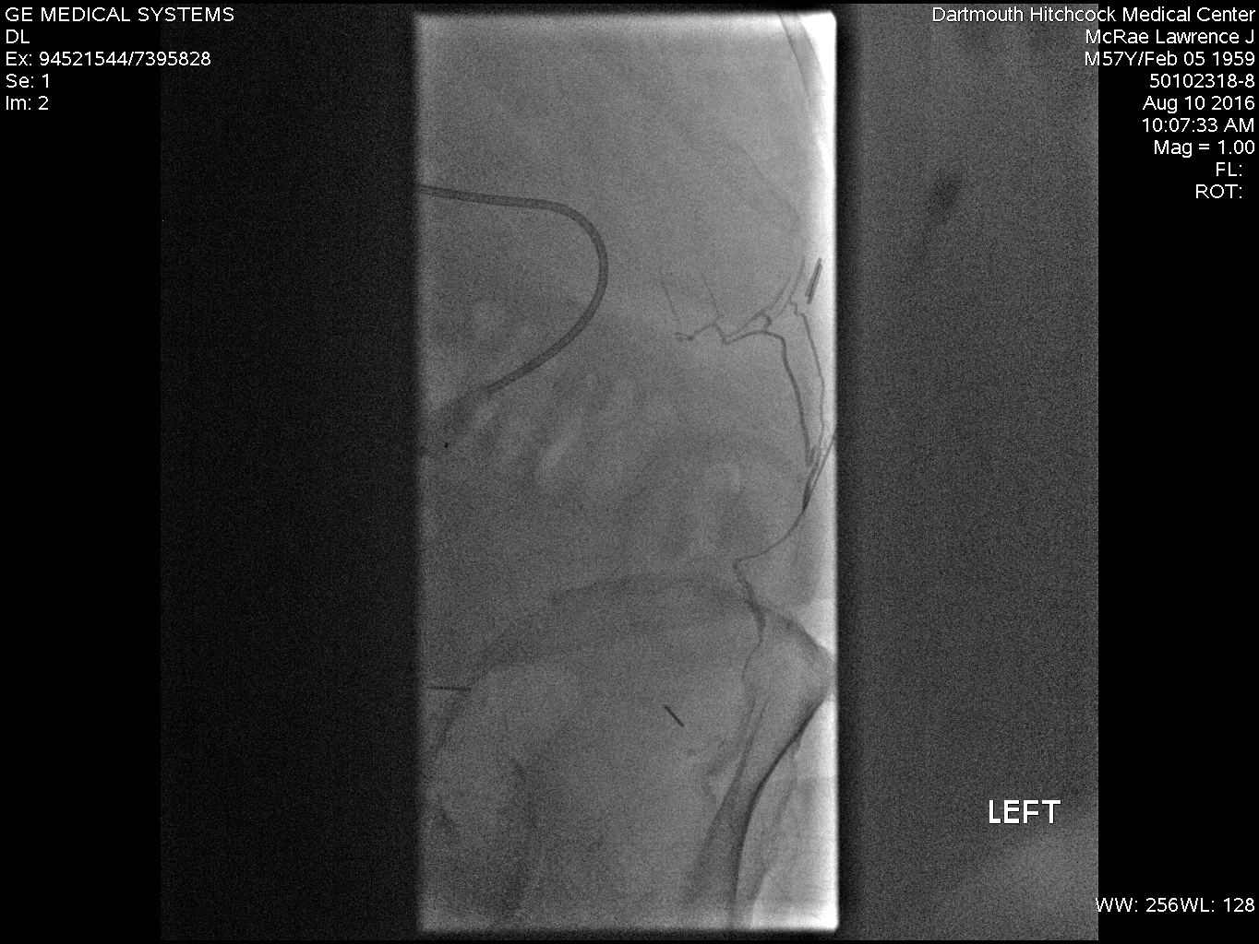
Direct Variceal Puncture

Slide 29
What would you do next?

Slide 30
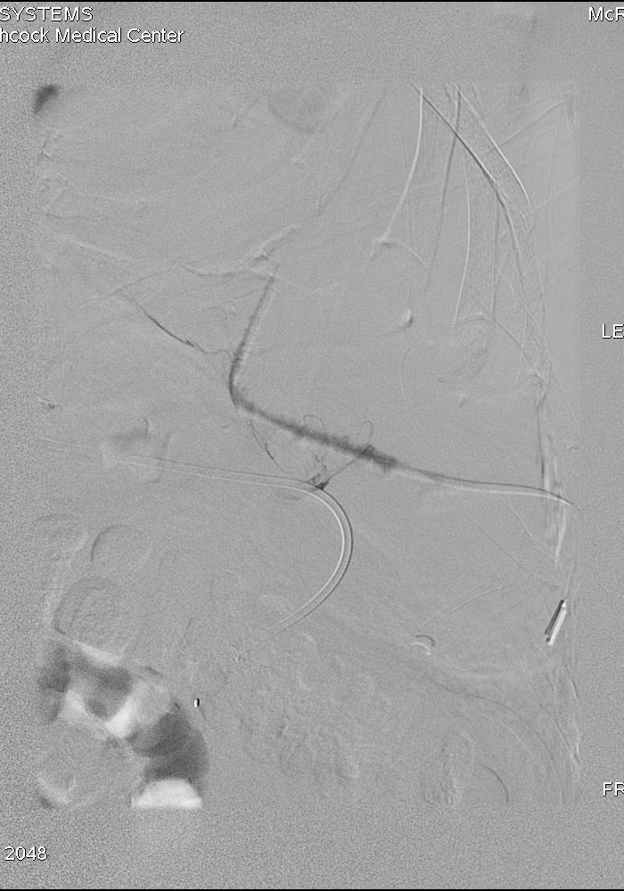
Trans-splenic puncture
21G AccuStick
Inferior splenic vein branch selected under US guidance
0.018 wire advanced to the portomesenteric confluence

Slide 31
Trans-splenic puncture
6Fr triaxial introducer placed
Wire exchanged for 0.035 wire
Tract dilated, 6Fr, 25cm sheath placed
Contrast study performed...

Slide 32
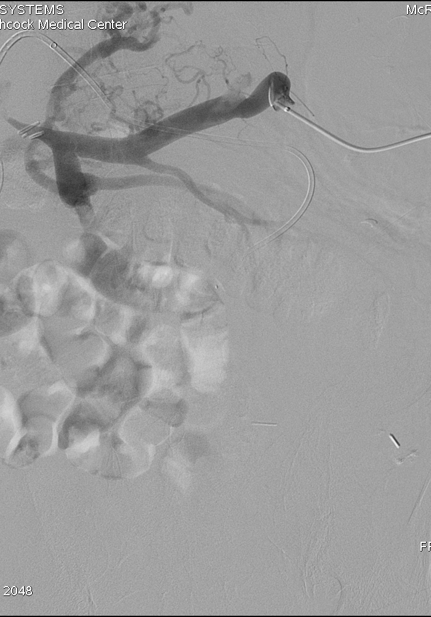
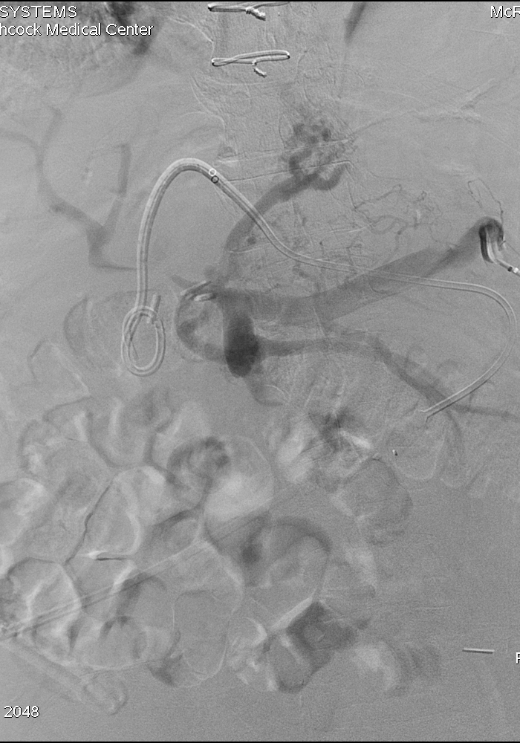
Trans-splenic portogram

Slide 33
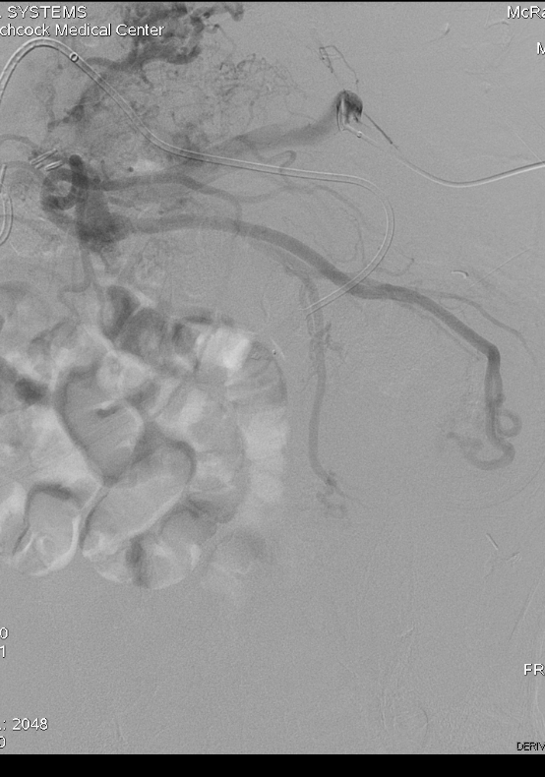
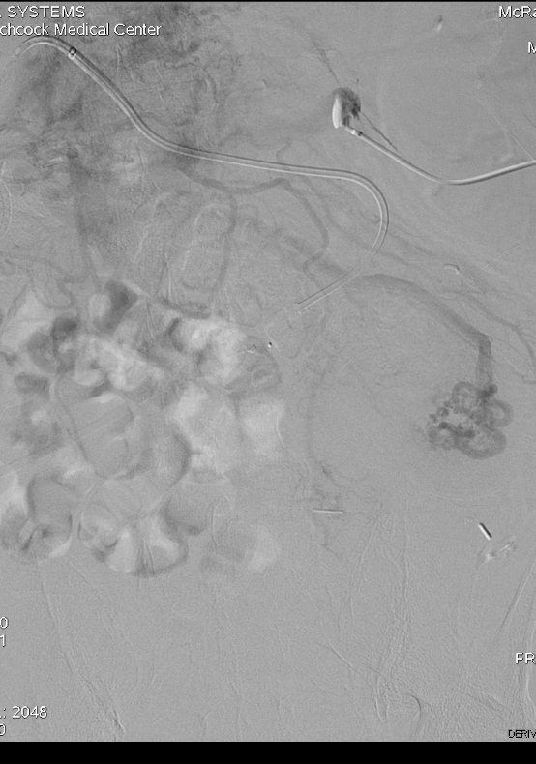
Trans-splenic portogram

Slide 34
What are the salient findings?

Slide 35
Mesenteric portogram
Key findings
SMV tributary flows retrograde to peristomal varices
90%+ stricture in MPV, with hepatofugal flow into coronary vein and SMV

Slide 36
Subselection - SMV
5Fr C2 catheter advanced over the wire and SMV branch supplying the peristomal varices selected

Slide 37
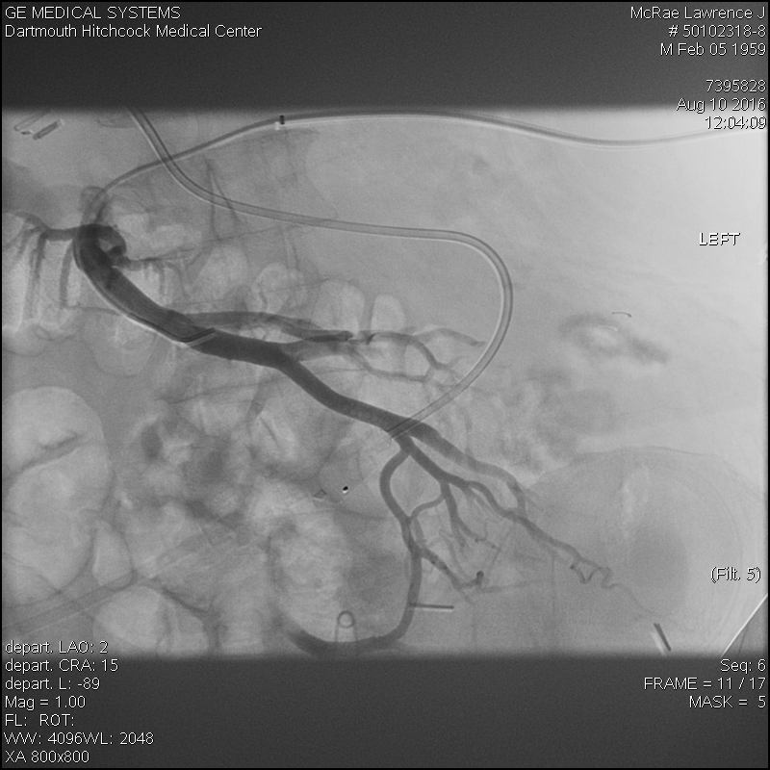
Subselection – Stomal Varix

Slide 38
Embolization – Stomal Varix
Coil embolization
8mm Nester (x3)
7mm Vortex

Slide 39
MPV Recanalization
Initial attempts to cross the stenosis were unsuccessful...
C2/0.035" Glide
HiFlo Renegade/0.018"
What would you do next?

Slide 40
MPV Recanalization
QuickCross catheter (5Fr) + glidewire passed through stricture into LPV
Pressure recordings obtained
Splenic vein 30mmHg
Intrahepatic 11mmHg
Gradient 19mmHg

Slide 41
MPV Recanalization
QuickCross exchanged for 8mm x 4cm balloon catheter
Stenosis dilated
12mm x 4cm self-expanding stent was then advanced + deployed
Dilated to 10.5 mm

Slide 42
MPV Recanalization
Pull back pressures + contrast study performed
Splenic vein 21mmHg
Intrahepatic PV 16mmHg
Gradient 5mmHg

Slide 43
Splenic Sheath Removed
Sheath retracted to splenic vein
GelFoam pledgets and coils injected along access tract and sheath removed

Slide 44
End of Case Presentation
Thank you!

