Slide 1
NESIR Case Presentation
February 13, 2017
Charles N. Weber, MD
Kei Yamada, MD
Interventional Radiology
Massachusetts General Hospital
cnweber@partners.org

Slide 2
TG - History
54M with h/o excessive alcohol use and prior necrotizing pancreatitis c/b chronic splenic vein thrombosis, enterocutaneous fistula requiring jejuno-ileal bypass, loop ileostomy, gastric varices c/b multiple prior presentations for UGIB, G-tube placement, and benign esophageal stricture.
Additional medical history includes C.Diff, depression, anxiety, full liquid diet with TPN for past decade
Presents to OSH with UGIB (at least 4th time in past year)
Very little specific clinical information and imaging on file regarding past bleeding episodes, family also unsure

Slide 3
OSH notes
Pt lost 4+L bright red blood from ostomy site + hematemesis
Given 5 units PRBCs and 2 L IVF
Started on octreotide, PPI
Intubated for airway protection
Endoscopy unsuccessful 2/2 esophageal stricture, however blood seen refluxing through the GE junction.
Hgb 8.0, SBP low 70’s, briefly on light pressors (unclear)
Transferred to MGH for further care

Slide 4
DDx
Gastric variceal hemorrhage
PUD
G-tube site bleed
Stomal variceal hemorrhage
Post-surgical complication/hemorrhage
Hemorrhagic pancreatitis
Splanchnic artery pseudoaneurysm bleed

Slide 5
Next step?
Conservative management
Repeat endoscopy
Tagged RBC scan
CT/CTA
Surgery Consult
GI consult

Slide 6
Initial work up at MGH
Physical exam demonstrated clots in ileostomy and ECF ostomy bags and bright red blood draining from G-tube.
GI consulted
TTE performed – no shunt
EGD performed
benign appearing severe stricture (5mm)
Could not navigate without pedi scope
Blood clot in cardia with GOV2 gastric varices seen underneath clot
Clips in lesser curvature at prior bleeding site
CTA ordered

Slide 7
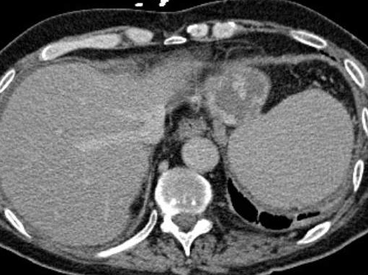
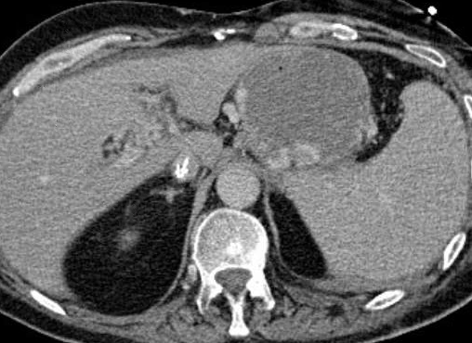
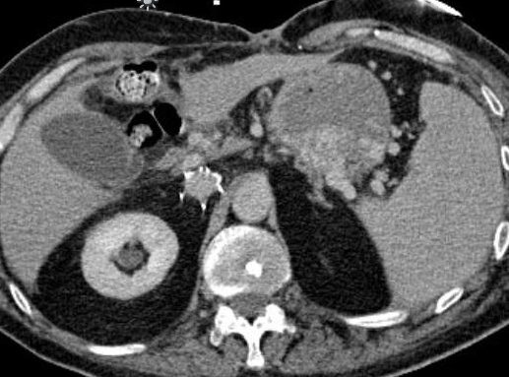
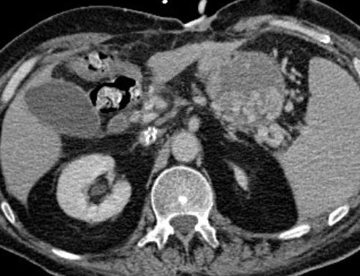
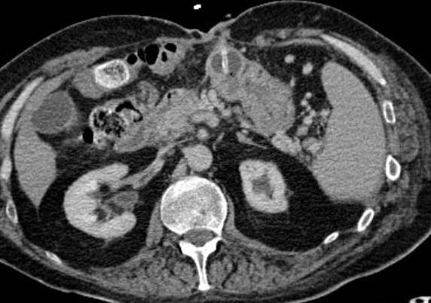
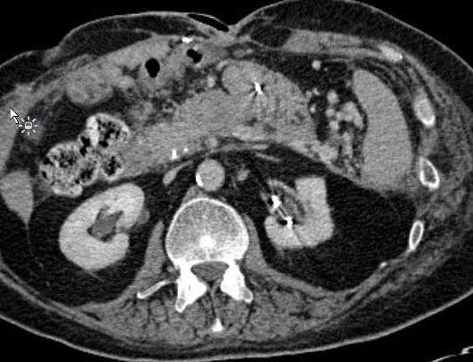
CTA - delayed

Slide 8
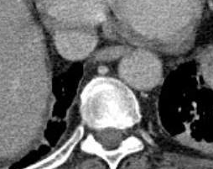
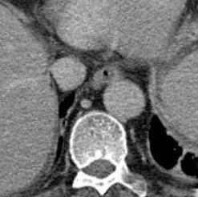
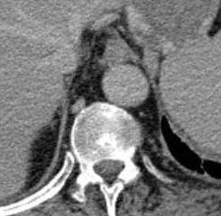
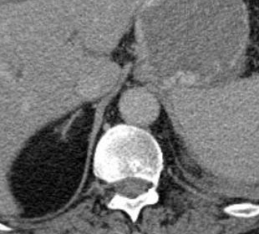
CTA - delayed
No esophageal varices

Slide 9
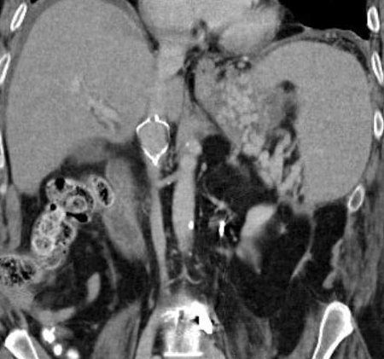
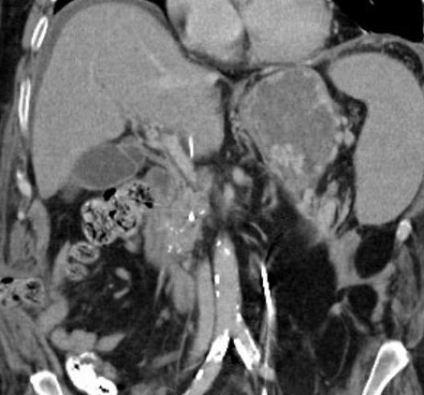
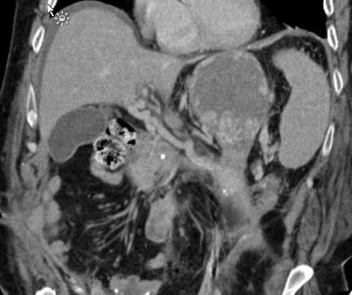
CT - delayed

Slide 10
CTA Findings
Extensive isolated gastric varices, no active bleeding
Chronic splenic vein thrombosis
Patent portal vein although cavernous transformation evident
Chronic pancreatitis – no fluid collections
No splanchnic pseudoaneurysm
Post-surgical bowel, ECF, no active bleed
No stomal varices
No clear gastro/spleno-renal/systemic shunt identified

Slide 11
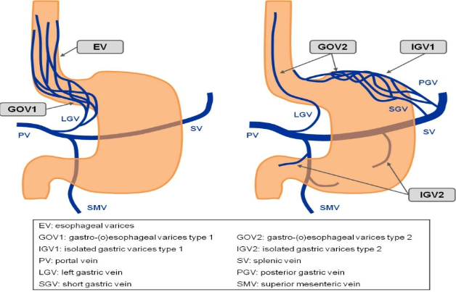
Sarin Classification of Gastric Varices
GOV1 – Gastroesophageal varices type 1 – Left gastric vein/portal vein
GOV2 – Gastroesophageal varices type 2 – short gastric vein, posterior gastric vein, splenic vein
IGV1 – Isolated gastric varices type 1 - short gastric vein, posterior gastric vein, splenic vein
IGV2 – Isolated gastric varices type 2 – Splenic vein
EV - Esophageal varices – Left gastric vein/portal vein

Slide 12
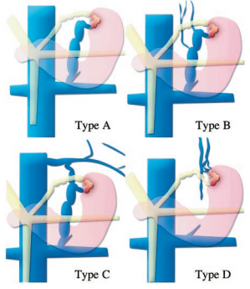
Classification based on draining veins
Type A – single shunt
Type B – single shunt and collateral veins
Type C – both gastrorenal and gastrocaval shunts
Type D – no catheterizeable shunt
X
BRTO NOT POSSIBLE
Kiyosue et al. Radiographics. 2003

Slide 13
What next?
TIPS
BRTO
Esophageal dilation with endoscopic therapy
Surgery
G-tube access for endoscopic therapy
Other percutaneous access to varices
Splenic artery embolization

Slide 14
Plan
Transplenic gastric variceal embolization
Partial splenic artery embolization

Slide 15
Procedure
Left common femoral artery accessed with micropuncture set under US guidance, exchanged for 5F vascular sheath.
Celiac artery selected with 5F C2 catheter (unstable)
C2 exchanged for 5F Sim 1 glide catheter, advanced into proximal splenic artery
Angiography performed

Slide 16
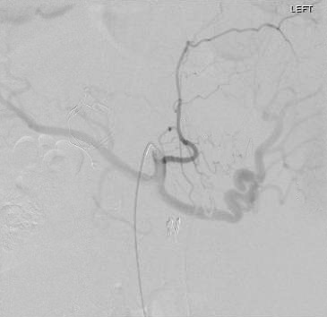
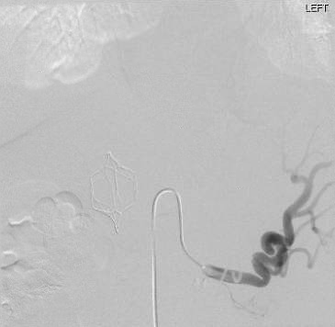
Procedure
C2 catheter in celiac artery
Sim1 glide catheter in splenic artery

Slide 17
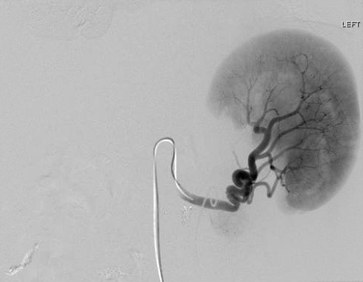
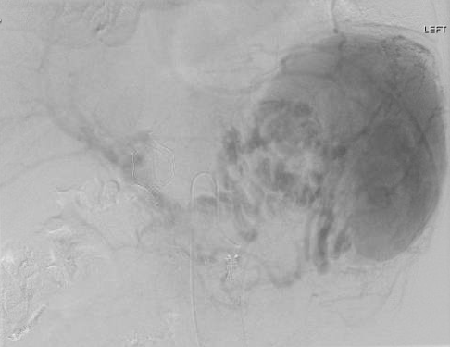
Variceal mapping
Arterial phase
Delayed venous phase

Slide 18
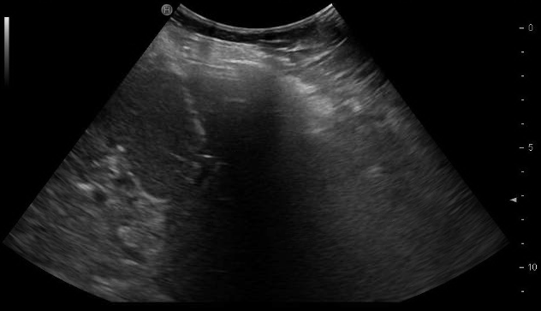
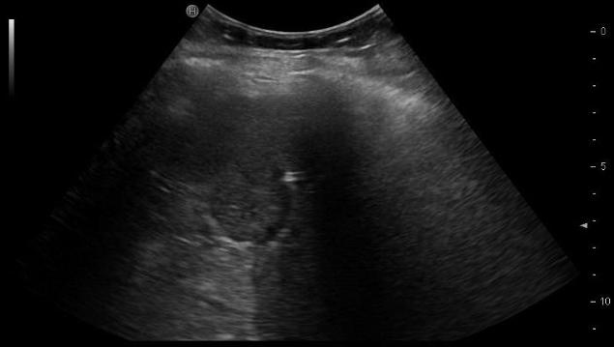
Transplenic access
US-guided percutaneous access to
intraparenchymal splenic vein branch
21G needle from 6F MAK set (Merit)
0.018” guidewire
3F inner dilator sheath

Slide 19
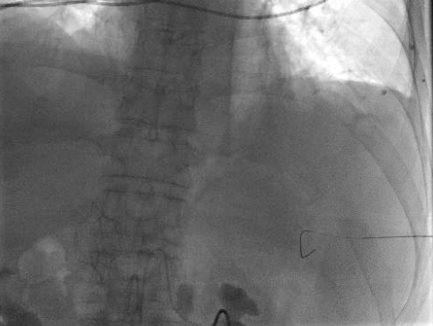
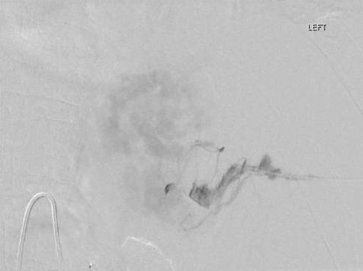
Transplenic access x1

Slide 20
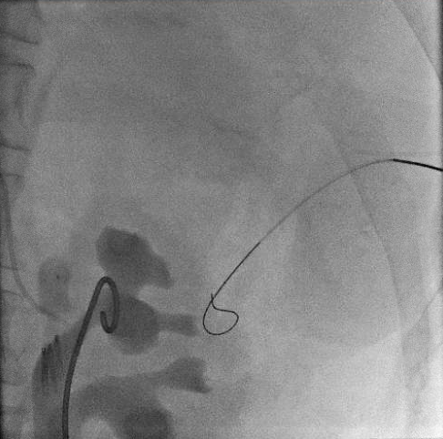
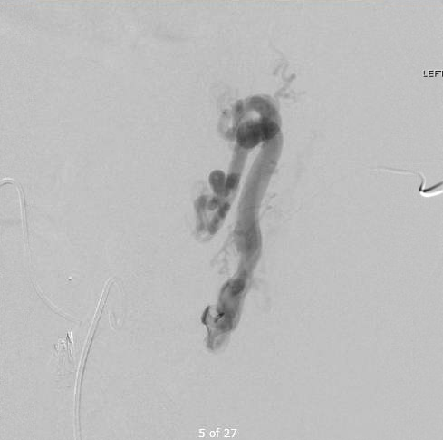
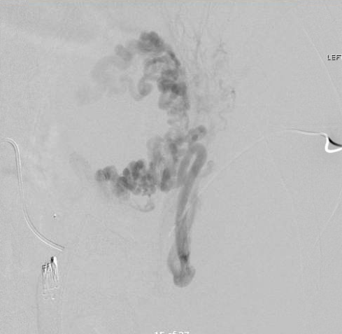
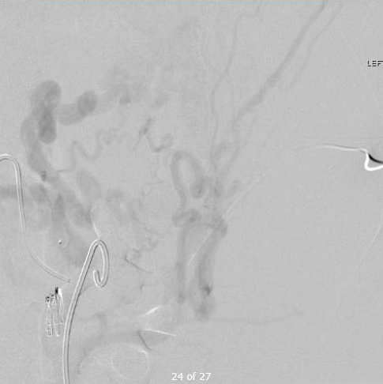
Transplenic access x2

Slide 21
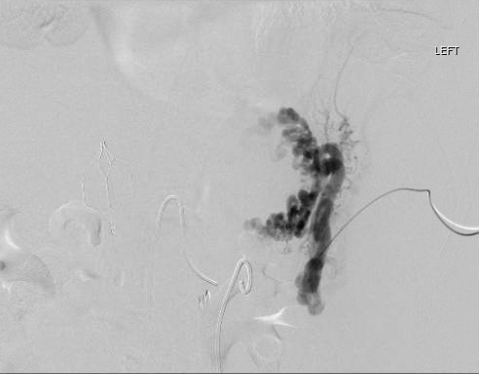
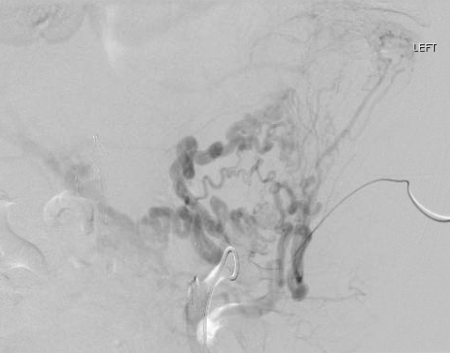
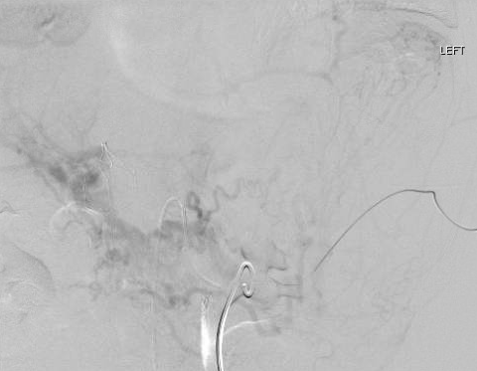
Transplenic access
Early
Mid
Late

Slide 22
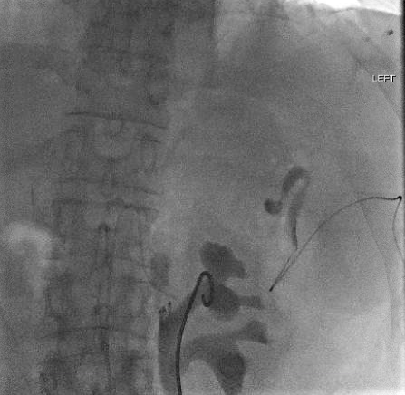
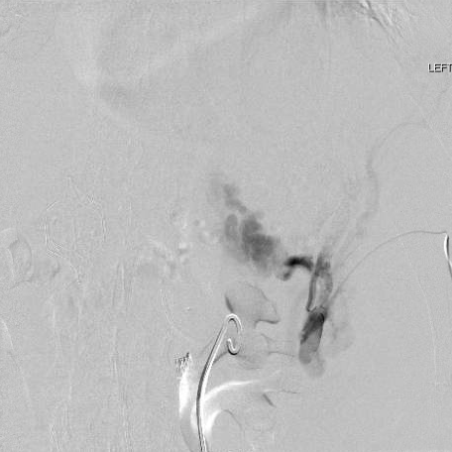
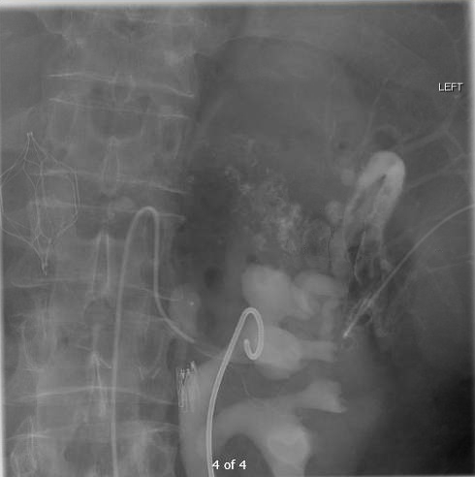
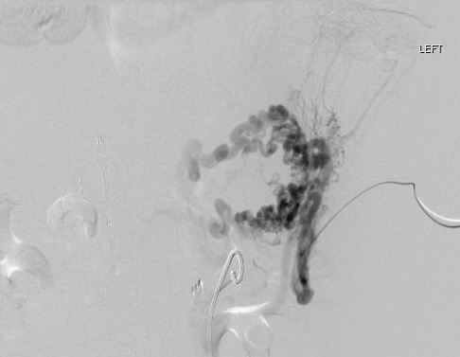
Variceal Embolization
Check flow with contrast
Small boluses of 3% STS/air foam (1:1) (negative contrast)
Intermittent check with contrast injections
Followed by 3%STS/gelfoam (1:1)
Near stasis
Finished with lipiodol/3% STS/air (1:2:3)
Pre - embo

Slide 23
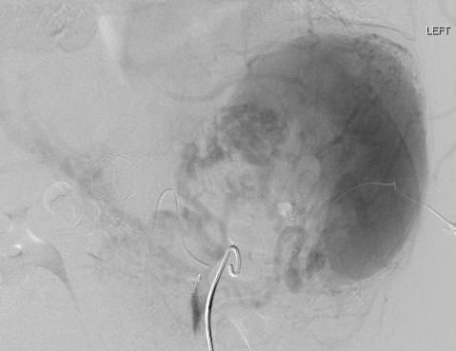
Post variceal embolization
Pre-embo
Selected Varices
Post-variceal embo

Slide 24
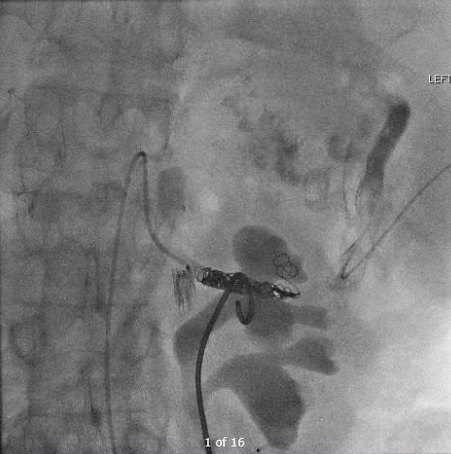
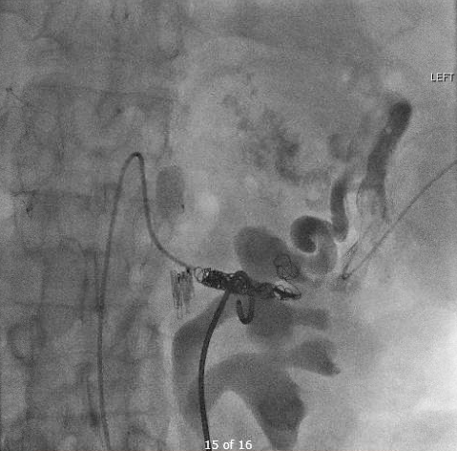
Splenic artery embolization
One 10 mm x 20 cm Interlock
Two 8 mm x 20 cm Interlock
Three 6 mm x 20 cm Interlock
Delayed flow through splenic artery

Slide 25
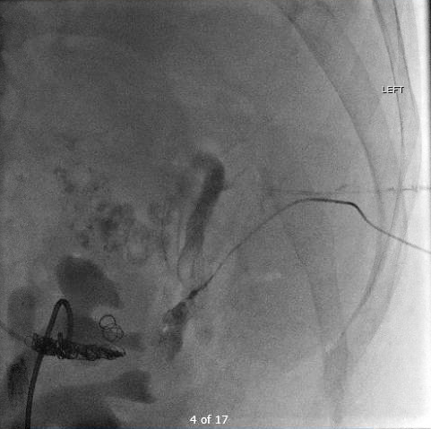
Embolization of splenic access tract
Trufill n-BCA glue/lipiodol (1:1)

Slide 26
Post-procedure hospital course
POD#1
Required brief pressor increase (Levo 10) next AM, which subsided within a few hours.
WBC count increased from 7 to 23 by next AM (~12 hrs), however normalized to 8 by 24 hrs. Blood cultures negative.
H/H remained stable. No PRBC transfusion.
No further evidence of bleeding
Extubated

Slide 27
Post-procedure hospital course
POD#2
Transferred out of MICU to floor
POD#6
Discharged home
Plan to see patient in IR clinic in one month with updated imaging
If future embolization indicated, could consider:
More superior transplenic approach
Trans-hepatic approach
Further splenic artery embolization

Slide 28
Sinistral portal hypertension is clinical syndrome of local (“left sided”) portal hypertension induced by splenic vein thrombosis often due to primary pancreatic diseases included pancreatitis, pseudocysts and carcinomas.
Wang et al. CVIR. 2016
14 patients with bleeding gastric varices 2/2 sinistral portal hypertension (left-sided) secondary to pancreatic disease (pancreatitis or malignancy).
Splenic embo (1 step or 2 step) performed with particles and coils
No recurrent gastric bleeding during follow up in ALL patients
Li et al. Case Rep Gastroenterol. 2012
1 pt bleeding gastric varices one week following acute pancreatitis and splenic vein thrombosis.
Failed endoscopic therapy
Splenic artery embolized with gelfoam
transhepatic catheterization of portal system demonstrated extravasation from a short gastric vein – coil embolized

Slide 29
Percutaneous transplenic approach for portal vein interventions is not uncommon
Zhu et al. JVIR. 2013
46 pts with portal vein interventions via transplenic approach using a 5F sheath
Used glue/lipiodol to embolize transplenic tract
3 (6.5%) had major bleeding requiring transfusion

Slide 30
Thank you

