Slide 1
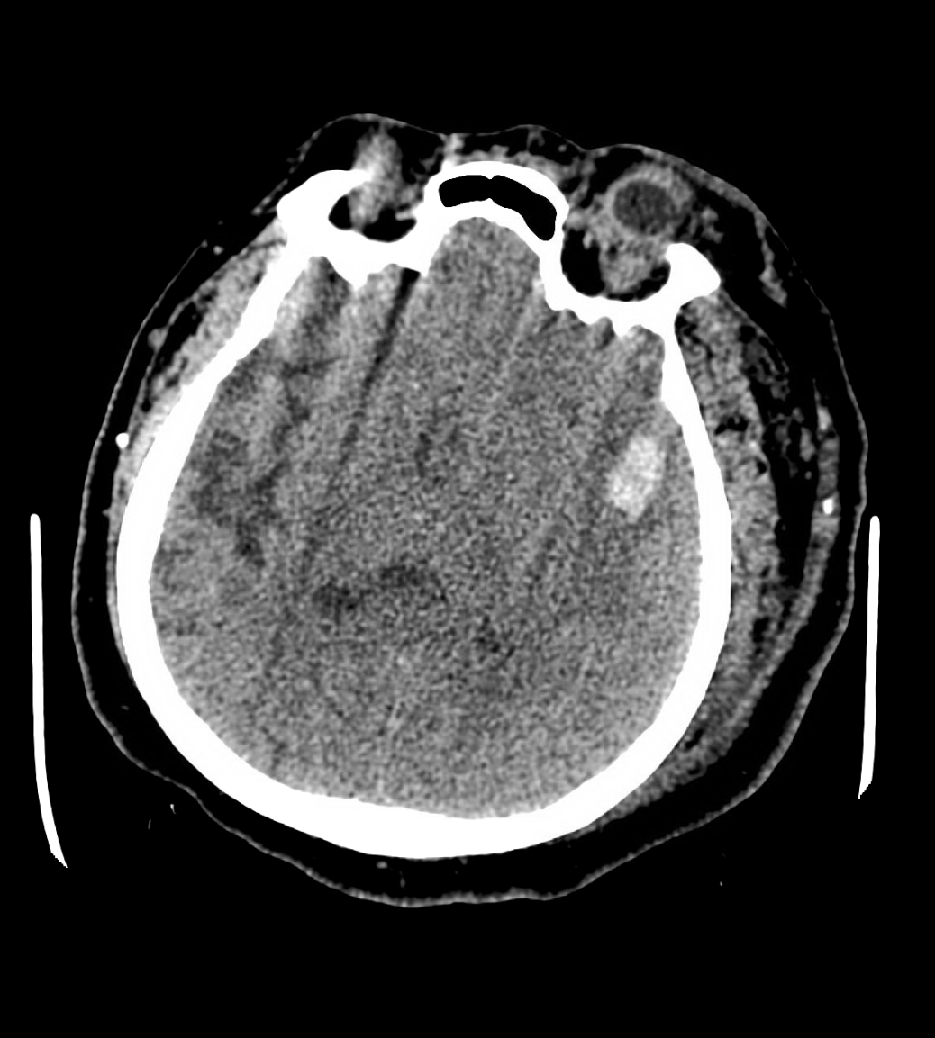
57 year old woman presented with slurred speech

Slide 2
CTA: Venous contamination

Slide 6
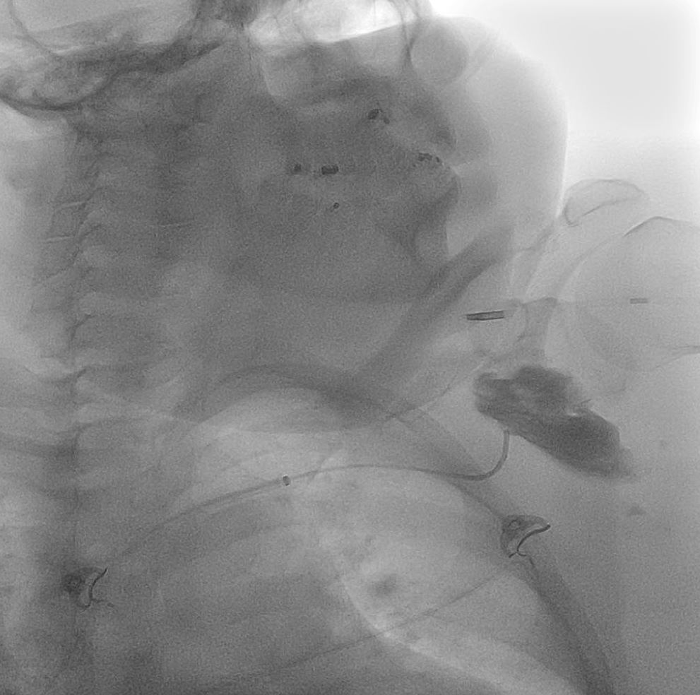

Slide 7
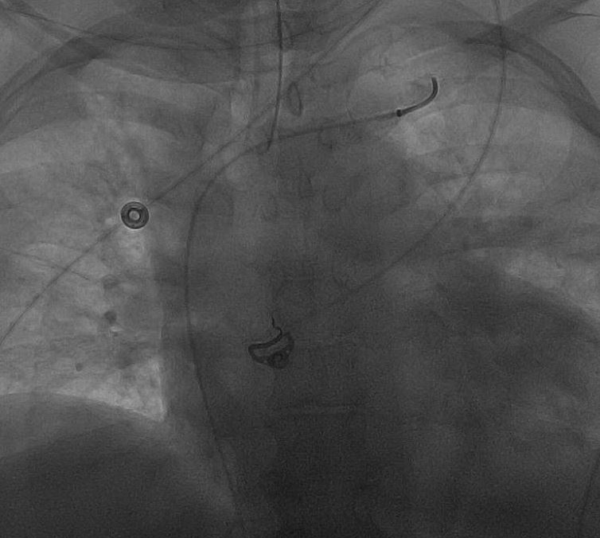

Slide 11
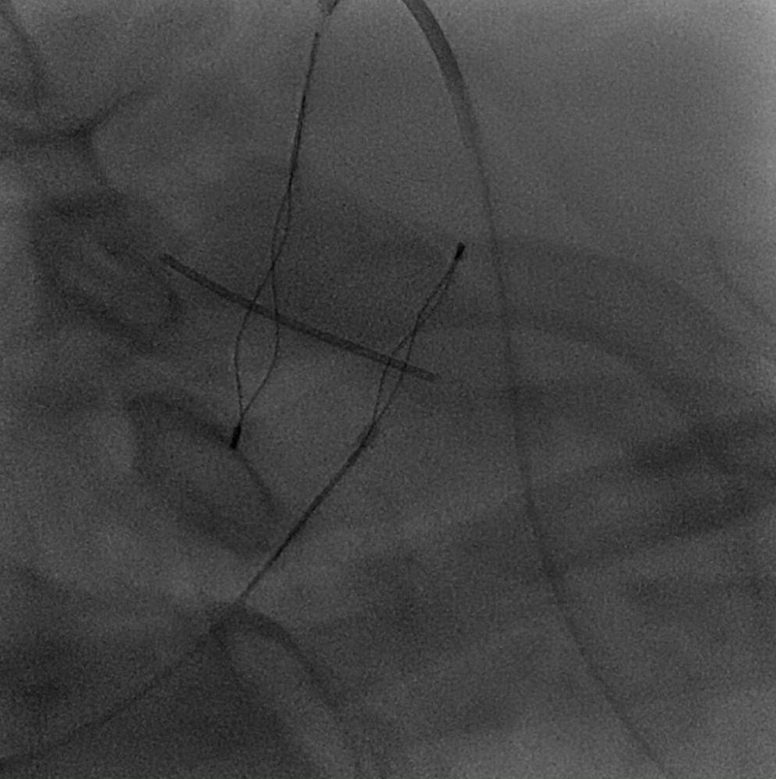

Slide 12
